Slide 1
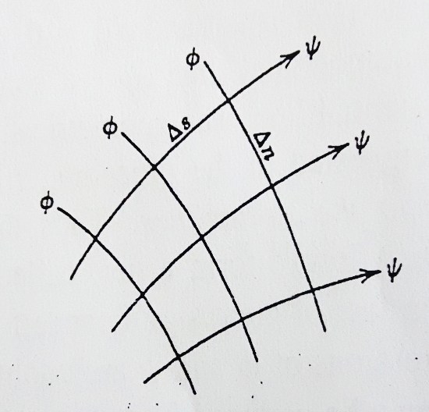
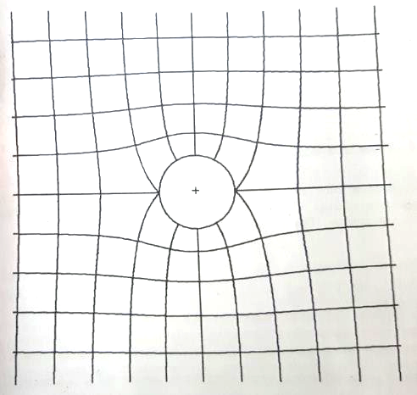
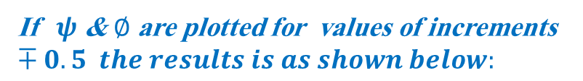
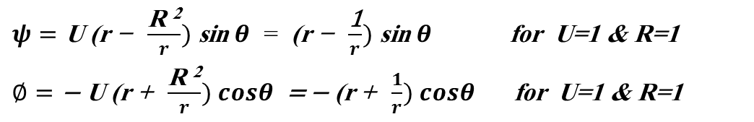
The Flownet
Example: Draw the flownet for the rectilinear flow of unit velocity past a circular cylinder of a unit radius
$ψ=\text{U}\text{ (}\text{r} \text{− }\frac{\text{R} \text{2}}{r}) \text{sin} θ$ = $\text{ (}\text{r} \text{− }\frac{\text{1}}{r}) \text{sin} θ$ for U=1 & R=1
$∅=\text{− }\text{U}\text{ (}\text{r}\text{ + }\frac{\text{R} \text{2}}{r}) cosθ$ = $\text{− }\text{(}\text{r}\text{ + }\frac{1}{r}) cosθ$ for U=1 & R=1
If $ψ$ & $∅$ are plotted for values of increments $∓0.5 the results is as shown below:$
Notes:
The potential is related to the velocity components. Equations describing the velocity potential are given above.

Slide 2
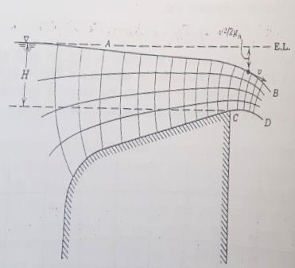
The Flownet
Example: predict the flowrate q from a large reservoir over the outflow structure for a given head H.
Notes:
The potential is related to the velocity components. Equations describing the velocity potential are given above.

Slide 3
Velocity Potential vs Stream Function
In 2D inviscid flow (incompressible flow OR steady state compressible flow), both functions exist
What is the relationship between them?
Notes:
Comparison of stream functions and velocity potential. Don’t memorize this, looking for a 4 mark question. It will not be asked in the exam. This summary is just to give you an overall perspective.

