Slide 1

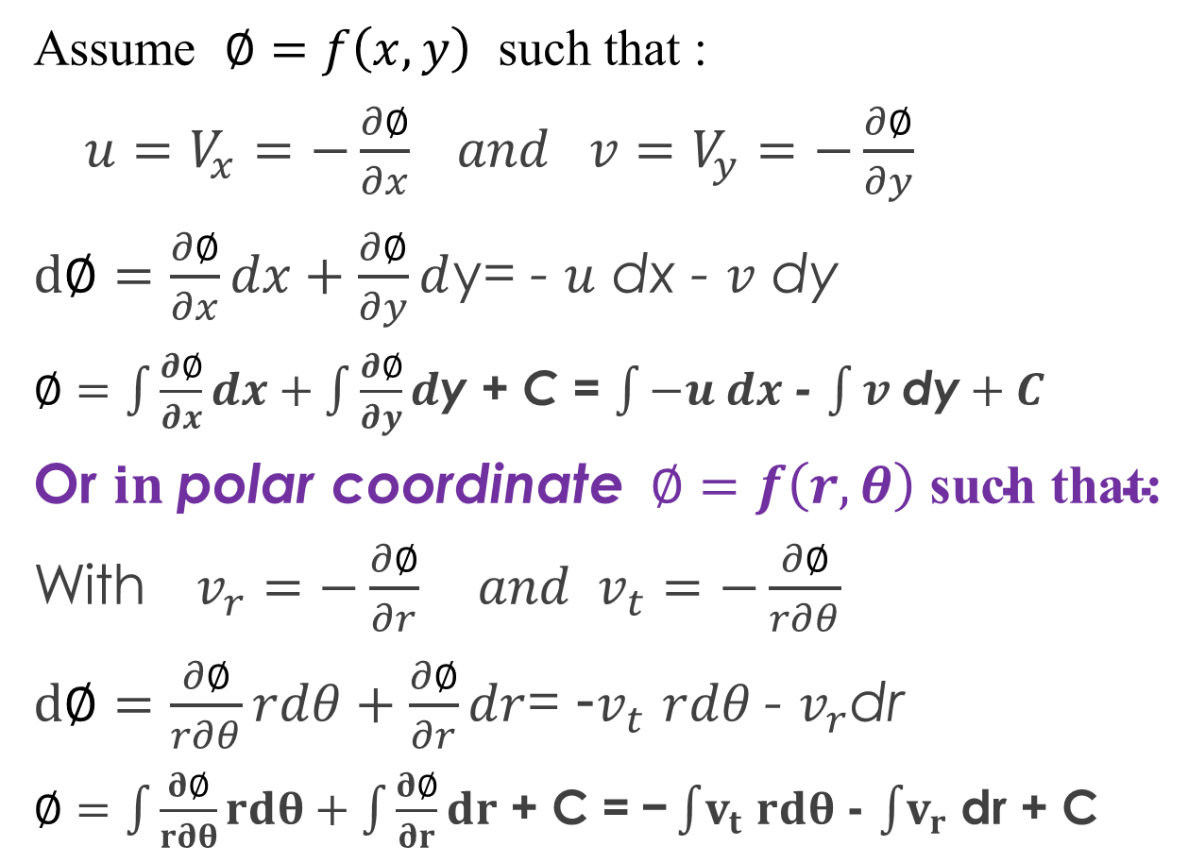
The Velocity Potential - $∅$-
Assume $∅=f\left(x,y\right)$ such that :
${u=V}_{x}=−\frac{∂∅}{∂x} and {v=V}_{y}=−\frac{∂∅}{∂y}$
$d∅=\frac{∂∅}{∂x}dx+\frac{∂∅}{∂y}d$y= - $u$ dx - $v$ dy
$∅=\int{\frac{∂∅}{∂x}dx}+\int{\frac{∂∅}{∂y}d\text{y}}$ + C = $\int{−u dx }$- $\int{v \text{dy}}+C$
Or $in \text{polar} \text{coordinate} ∅=f\left(r,θ\right) \text{such} \text{that}\text{:}$
With $v_{r}=−\frac{∂∅}{∂r} and v_{t}=−\frac{∂∅}{r∂θ}$
$d∅=\frac{∂∅}{r∂θ}rdθ+\frac{∂∅}{∂r}dr$= -$v_{t}$ $rdθ$- $v_{r}$dr
$∅=\int{\frac{∂∅}{r∂θ}rdθ}+\int{\frac{∂∅}{∂r}dr}$ + C =$\text{−}\int{v_{t}}$ $rdθ$- $\int{v_{r}}$ dr + C
Notes:
The potential is related to the velocity components. Equations describing the velocity potential are given above.

Slide 2
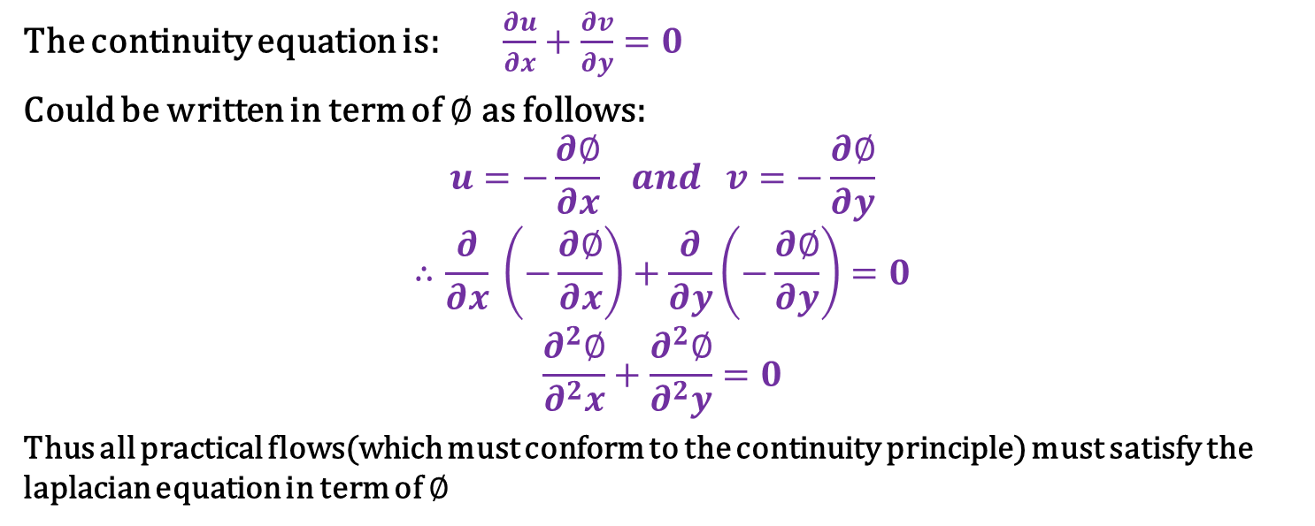
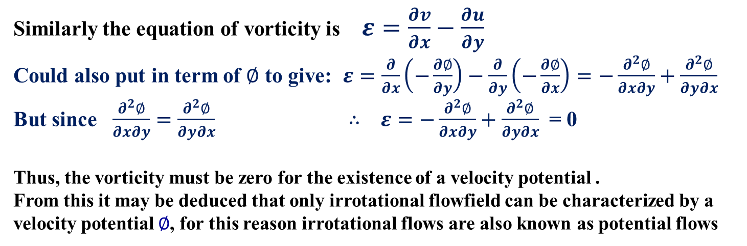
The continuity equation is: $\frac{∂u}{∂x}+\frac{∂v}{∂y}=0$
Could be written in term of $∅$ as follows:
$$u=−\frac{∂∅}{∂x} and v=−\frac{∂∅}{∂y}$$
$$∴\frac{∂}{∂x} \left(−\frac{∂∅}{∂x}\right)+\frac{∂}{∂y}\left(−\frac{∂∅}{∂y}\right)=0$$
$$\frac{∂^{2}∅}{∂^{2}x}+\frac{∂^{2}∅}{∂^{2}y}=0$$
Thus all practical flows(which must conform to the continuity principle) must satisfy the laplacian equation in term of $∅$
Similarly the equation of vorticity is $ε=\frac{∂v}{∂x}−\frac{∂u}{∂y}$
Could also put in term of $∅$ to give: $ε=\frac{∂}{∂x}\left(−\frac{∂∅}{∂y}\right)−\frac{∂}{∂y}\left(−\frac{∂∅}{∂x}\right)=−\frac{∂^{2}∅}{∂x∂y}+\frac{∂^{2}∅}{∂y∂x}$
But since $\frac{∂^{2}∅}{∂x∂y}=\frac{∂^{2}∅}{∂y∂x}$ $∴ ε=−\frac{∂^{2}∅}{∂x∂y}+\frac{∂^{2}∅}{∂y∂x}$ = 0
Thus, the vorticity must be zero for the existence of a velocity potential .
From this it may be deduced that only irrotational flowfield can be characterized by a velocity potential $∅$, for this reason irrotational flows are also known as potential flows
Notes:
The potential is related to the velocity components. Equations describing the velocity potential are given above.

Slide 3
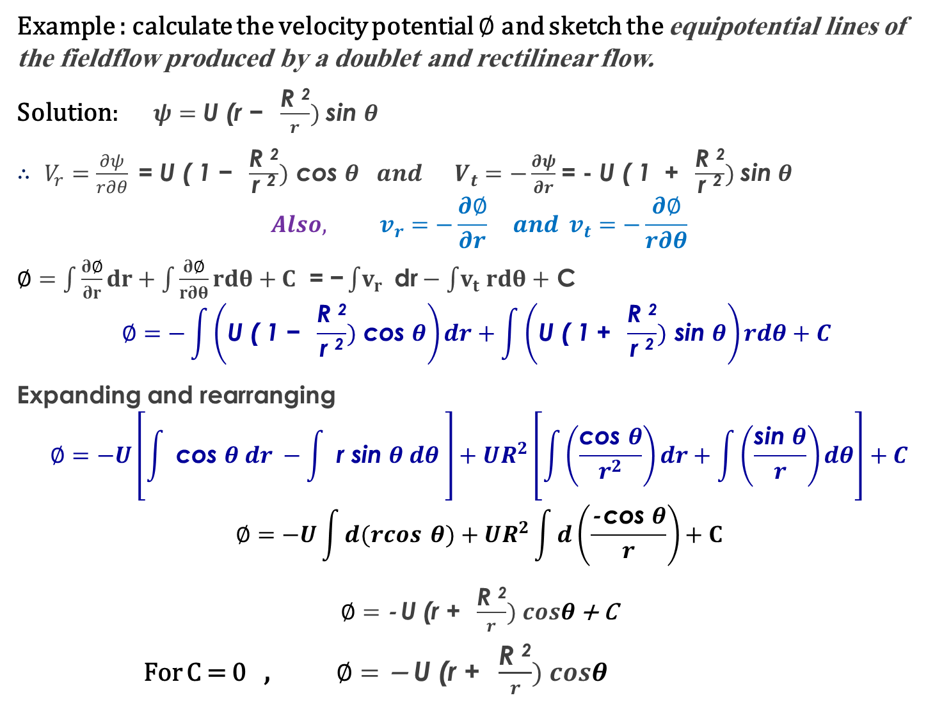
Example : calculate the velocity potential $∅$ and sketch the equipotential lines of the fieldflow produced by a doublet and rectilinear flow.
Solution: $ψ=\text{U}\text{ (}\text{r} \text{− }\frac{\text{R} \text{2}}{r}) \text{sin} θ$
$∴$ $V_{r}=\frac{∂ψ}{r∂θ}$= $\text{U}\text{ ( }\text{1 }\text{− }\frac{\text{R} \text{2}}{\text{r} \text{2}}) \text{cos} θ$ $and V_{t}=−\frac{∂ψ}{∂r}$ = - $\text{U}\text{ ( }\text{1 }\text{+ }\frac{\text{R} \text{2}}{\text{r} \text{2}}) \text{sin} θ$
$$Also, v_{r}=−\frac{∂∅}{∂r} and v_{t}=−\frac{∂∅}{r∂θ}$$
$∅=\int{\frac{∂∅}{∂r}dr}+\int{\frac{∂∅}{r∂θ}rdθ}+C$ =$\text{−}\int{v_{r}} \text{dr}−\int{v_{t}}$ $rdθ+$ C
$$∅=−\int{\left(\text{U}\text{ ( }\text{1 }\text{− }\frac{\text{R} \text{2}}{\text{r} \text{2}}) \text{cos} θ\right)dr+\int{\left(\text{U}\text{ ( }\text{1 }\text{+} \frac{\text{R} \text{2}}{\text{r} \text{2}}) \text{sin} θ\right)rdθ+C }}$$
Expanding and rearranging
$$∅=−U\left[\int{ \text{cos} θ dr −\int{ \text{r} \text{sin} θ dθ }}\right]+UR^{2}\left[\int{\left(\frac{\text{cos} θ}{r^{2}}\right)}dr+\int{\left(\frac{\text{sin} θ}{r}\right)}dθ\right]+C$$
$$∅=−U\int{d(rcos }θ)+UR^{2}\int{d\left(\frac{\text{− }\text{cos} θ}{r}\right)}+C$$
$∅=\text{− }\text{U}\text{ (}\text{r}\text{ + }\frac{\text{R} \text{2}}{r}) cosθ$ + C
For C = 0 , $∅=\text{− }\text{U}\text{ (}\text{r}\text{ + }\frac{\text{R} \text{2}}{r}) cosθ$
Notes:
The potential is related to the velocity components. Equations describing the velocity potential are given above.

Slide 4
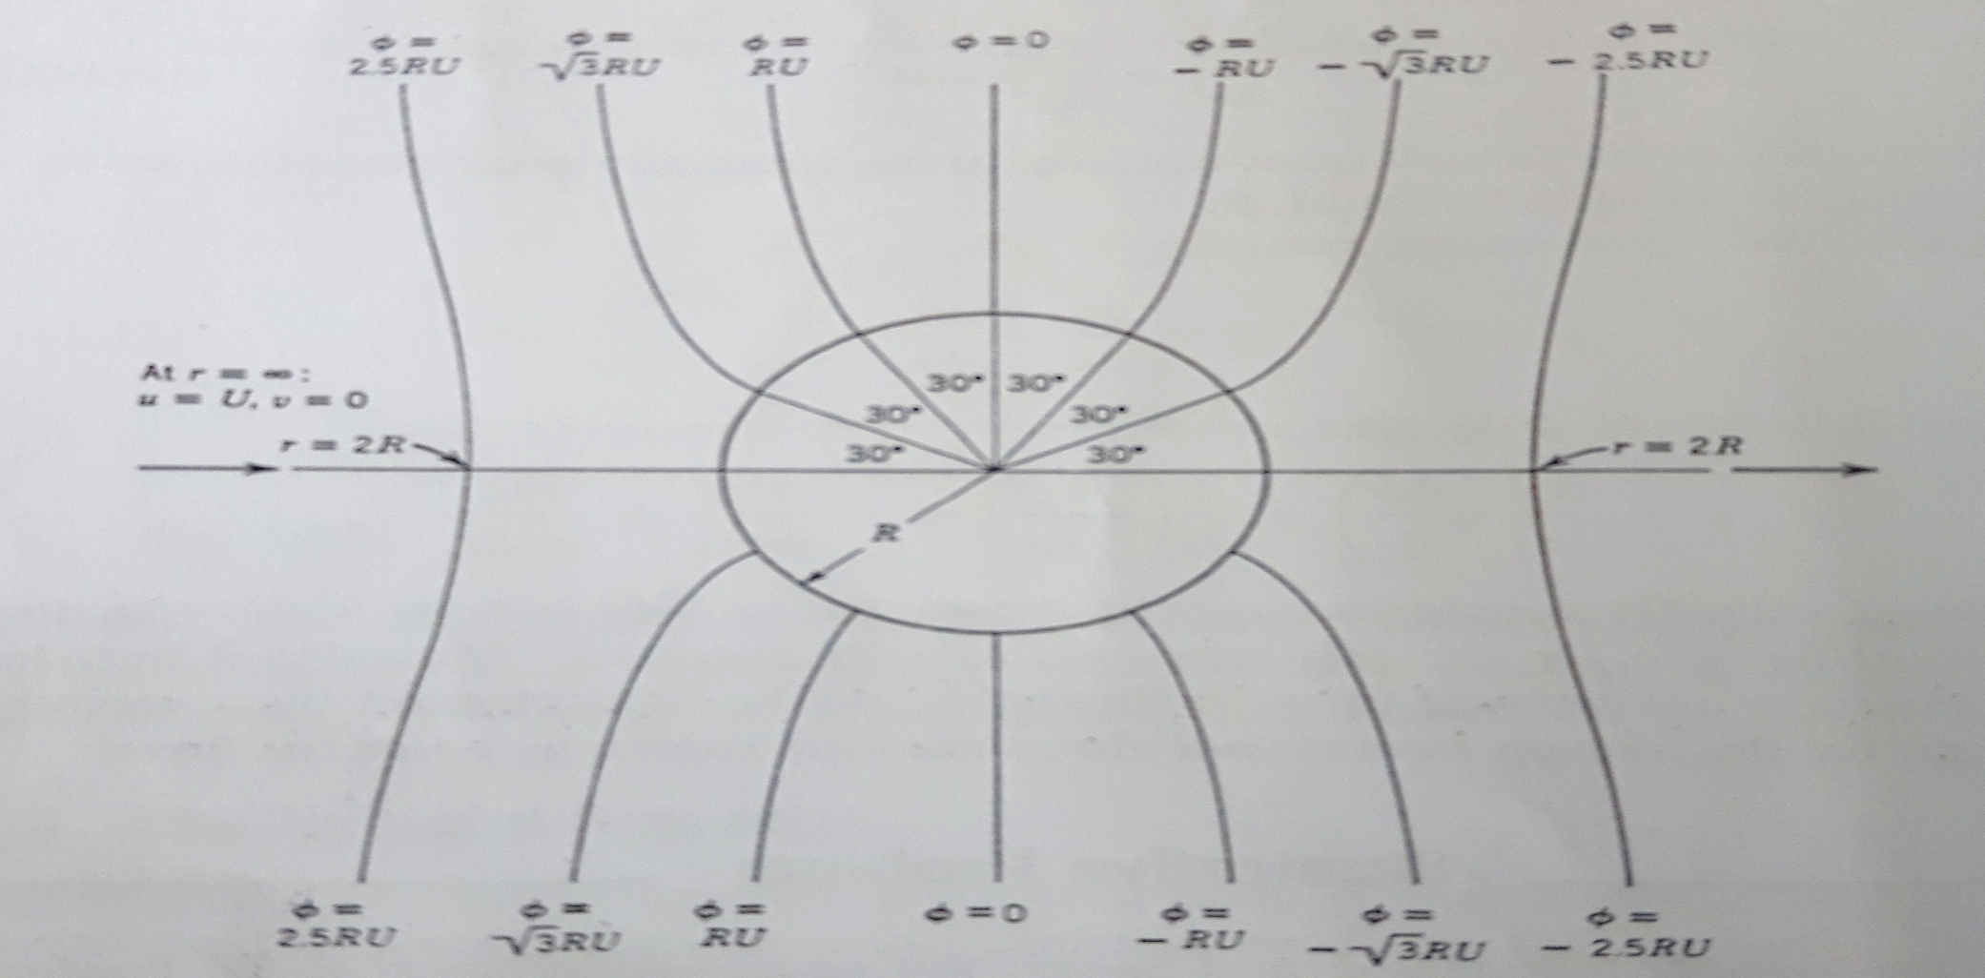
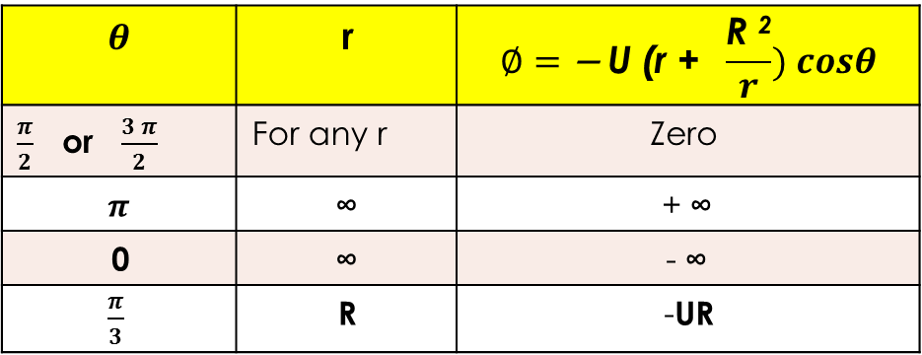
$$∅=\text{− }\text{U}\text{ (}\text{r}\text{ + }\frac{\text{R} \text{2}}{r}) cosθ$$ | r | $$θ$$
Zero | For any r | $\frac{π}{2}$ or $\frac{3 π}{2}$
+ ∞ | ∞ | $$π$$
- ∞ | ∞ | 0
-UR | R | $\frac{π}{3}$
Notes:
The potential is related to the velocity components. Equations describing the velocity potential are given above.

