Slide 1
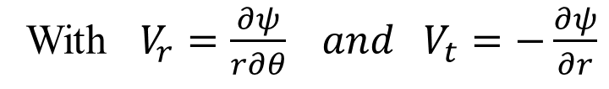
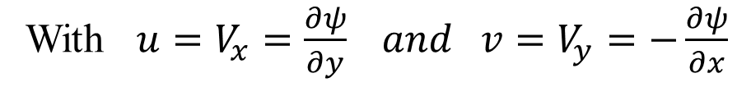

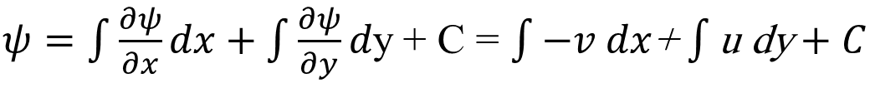
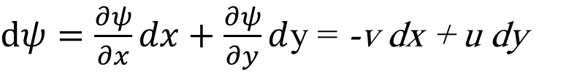
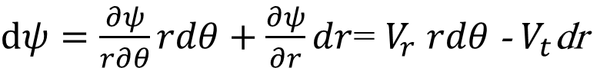
Stream function in polar coordinate
$$For cardizian coordinate ψ=f(x,y)$$
With ${u=V}_{x}=\frac{∂ψ}{∂y} and {v=V}_{y}=−\frac{∂ψ}{∂x}$
$dψ=\frac{∂ψ}{∂x}dx+\frac{∂ψ}{∂y}d$y = -v dx + u dy
$ψ=\int{\frac{∂ψ}{∂x}dx}+\int{\frac{∂ψ}{∂y}d\text{y}}$ + C = $\int{−v dx}$+ $\int{\text{u} \text{dy}}+C$
$$For \text{polar} \text{coordinate} ψ=f(r,θ)$$
With $V_{r}=\frac{∂ψ}{r∂θ} and V_{t}=−\frac{∂ψ}{∂r}$
$dψ=\frac{∂ψ}{r∂θ}rdθ+\frac{∂ψ}{∂r}dr$= $V_{r}$ $rdθ$- $V_{t}$dr
$ψ=\int{\frac{∂ψ}{r∂θ}rdθ}+\int{\frac{∂ψ}{∂r}dr}$ + C= $\int{V_{r}}$ $rdθ$- $\int{V_{t}}$ dr + C

Slide 2


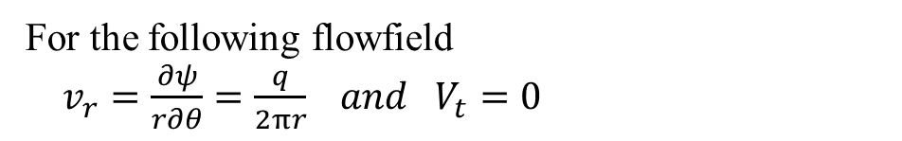




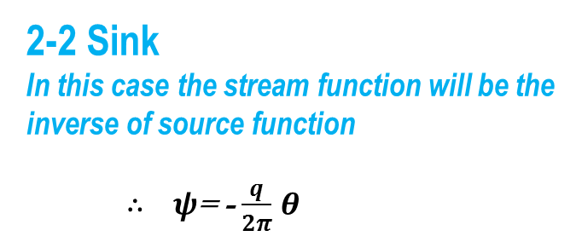

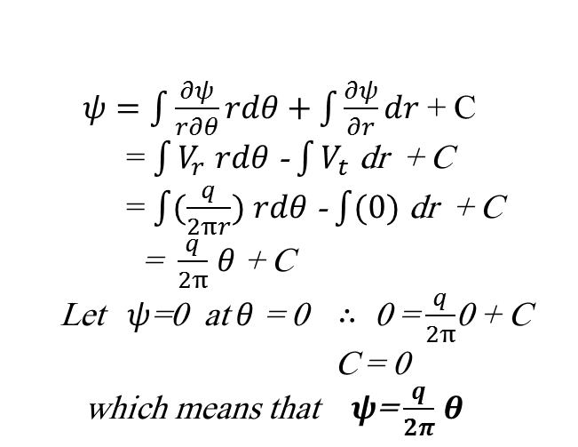

Basic Flowfields
2- Source and Sink
2-1 Source
$ψ$= $\frac{q}{4π}$
Source
For the following flowfield
$v_{r}=\frac{∂ψ}{r∂θ}=\frac{q}{2πr} and V_{t}=0$
$ψ$= $\frac{q}{2}$
$ψ$= $0$
$ψ=\int{\frac{∂ψ}{r∂θ}rdθ}+\int{\frac{∂ψ}{∂r}dr }$+ C
= $\int{V_{r}}$ $rdθ$- $\int{V_{t}}$ dr + C
= $\int{(\frac{q}{2πr})}$ $rdθ$- $\int{(0)}$ dr + C
= $\frac{q}{2π}$ $θ$ + C
Let $ψ$=0 at $θ$ = 0 $∴$ 0 = $\frac{q}{2π}$0 + C
C = 0
which means that $ψ$= $\frac{q}{2π}$ $θ$
$ψ$= $\frac{3q}{4}$
$ψ$= -$\frac{q}{4π}$
Sink
2-2 Sink
In this case the stream function will be the inverse of source function
$∴$ $ψ$= - $\frac{q}{2π}$ $θ$
$ψ$=- $\frac{q}{2}$
$ψ$= $0$
$ψ$= $\frac{−3q}{4}$

Slide 3
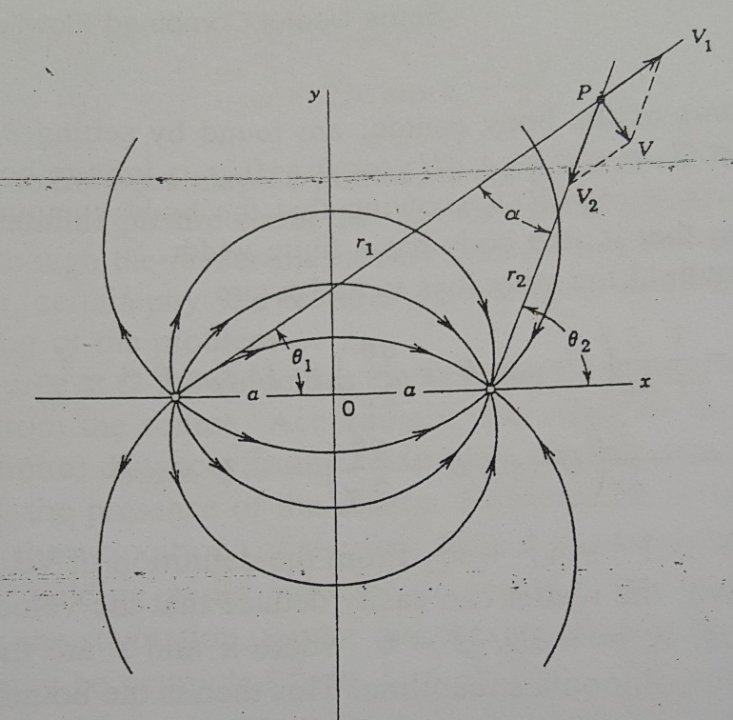
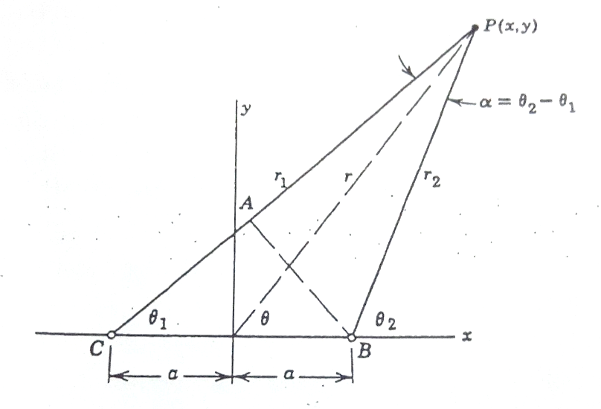
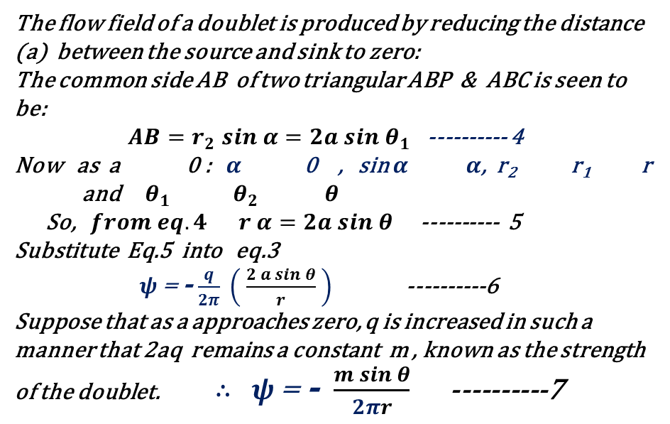


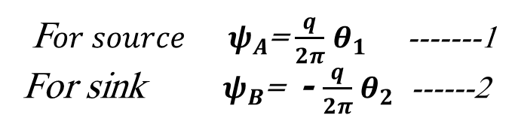
The Doublet
Some Useful Combined Flowfields
F$or source ψ_{A}$= $\frac{q}{2π}$ $θ_{1}$ -------1
For sink $ψ_{B}$= - $\frac{q}{2π}$ $θ_{2}$ ------2
For source and sink, ${ψ=ψ}_{A}+ψ_{B}$
$or ψ$=- $\frac{q}{2π}$ $α$ -------- 3
The flow field of a doublet is produced by reducing the distance (a) between the source and sink to zero:
The common side AB of two triangular ABP & ABC is seen to be:
${ AB=r}_{2} sin α=2a sin θ_{1}$ ---------- 4
Now as a 0 : $α$ 0 , sin $α$ $α$, r₂ r₁ r
and $θ_{1}$ $θ_{2 }$ $θ$
So, $from eq.4 r α=2a sin θ$ ---------- 5
Substitute Eq.5 into eq.3
$ψ$=- $\frac{q}{2π} \left( \frac{2 a sin θ}{r} \right)$ ----------6
Suppose that as a approaches zero, q is increased in such a manner that 2aq remains a constant m , known as the strength of the doublet. $∴$ $ψ$= - $\frac{m sin θ}{2πr}$ ----------7

Slide 4
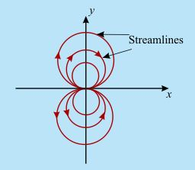
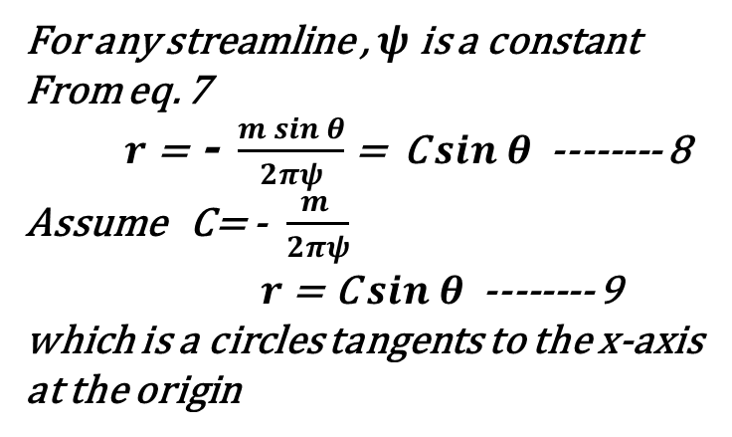
For any streamline , $ψ$ is a constant
From eq. 7
$r$= - $\frac{m sin θ}{2πψ}$ = C $sin θ$ -------- 8
Assume C= - $\frac{m }{2πψ}$
$r$= C $sin θ$ -------- 9 which is a circles tangents to the x-axis at the origin

Slide 5
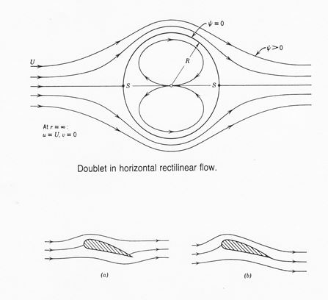
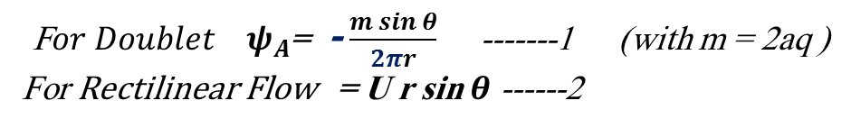
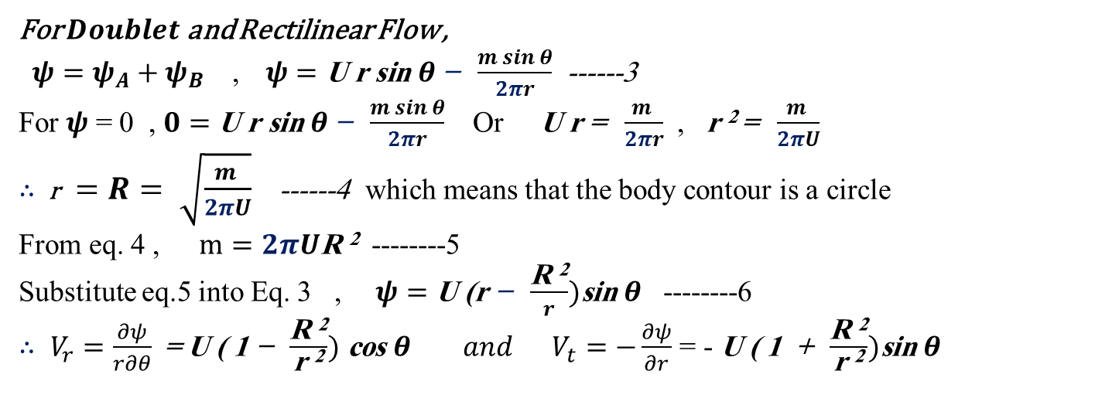
Doublet in Rectilinear Flow
F$or Doublet ψ_{A}$= - $\frac{m sin θ}{2πr}$ -------1 (with m = 2aq )
For Rectilinear Flow = U r sin $θ$ ------2
For $Doublet$ and Rectilinear Flow ,
${ψ=ψ}_{A}+ψ_{B}$ , $ψ=\text{U} \text{r} \text{sin} θ \text{− } \frac{m sin θ}{2πr}$ ------3
For $ψ$ = 0 , $0=\text{U} \text{r} \text{sin} θ \text{− } \frac{m sin θ}{2πr}$ Or $\text{U} \text{r} \text{= }\frac{m }{2πr}$ , $\text{r} \text{2 }\text{= }\frac{m }{2πU}$
$∴$ r$=R= \sqrt{\frac{m }{2πU}}$ ------4 which means that the body contour is a circle
From eq. 4 , $m=2πU\text{R} \text{2}$ --------5
Substitute eq.5 into Eq. 3 , $ψ=\text{U}\text{ (}\text{r}\text{ − } \frac{\text{R} \text{2}}{r})\text{sin} θ$ --------6
$∴$ $V_{r}=\frac{∂ψ}{r∂θ}$= $\text{U} \text{(} \text{1} \text{− }\frac{\text{R} \text{2}}{\text{r} \text{2}}) \text{cos} θ$ $and V_{t}=−\frac{∂ψ}{∂r}$ = - $\text{U} \text{(} \text{1 } \text{+ }\frac{\text{R} \text{2}}{\text{r} \text{2}})\text{sin} θ$

