Slide 1
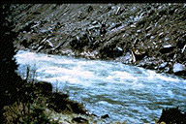
Fluvial Hydraulics CH-6
Bed-Load Transport

Slide 2
Sediment Transport Equations
Sediment transport equations used to determine CAPACITY for set of flow conditions
Capacity needed for many different analyses such as aggradation/degradation, general scour/deposition, and lateral migration
First step is to select appropriate equation:
Predicated on an understanding of the system being studied
Some formulas developed for sand-bed streams with high suspended load transport
Other equations pertain to conditions where bed-load transport dominates
Study objectives determine the portion of the sediment transport that needs to be estimated and the level of accuracy
Some formulas independently predict bed load and suspended load
Other formulas estimated bed-material load (i.e., bed load + suspended load) – usually these equations do not include wash load
Procedures exist that incorporate sediment sampling data, such as the modified Einstein procedure, that can estimate total sediment transport rate (including wash load)

Slide 3
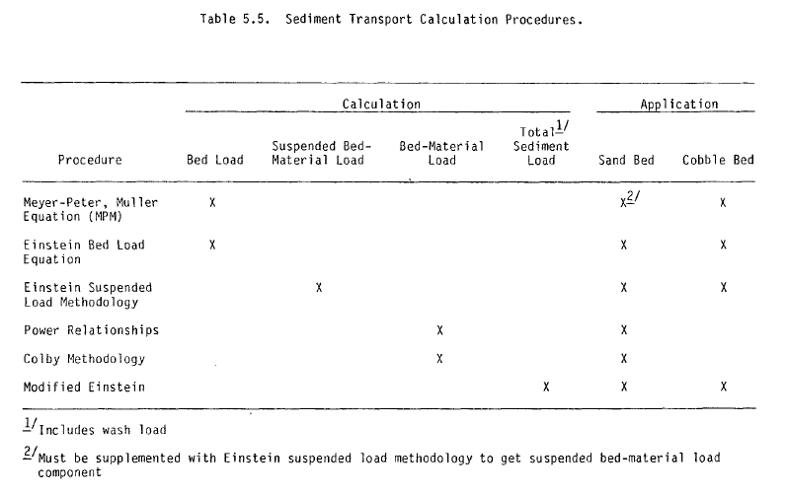
Sediment Transport Equations

Slide 4
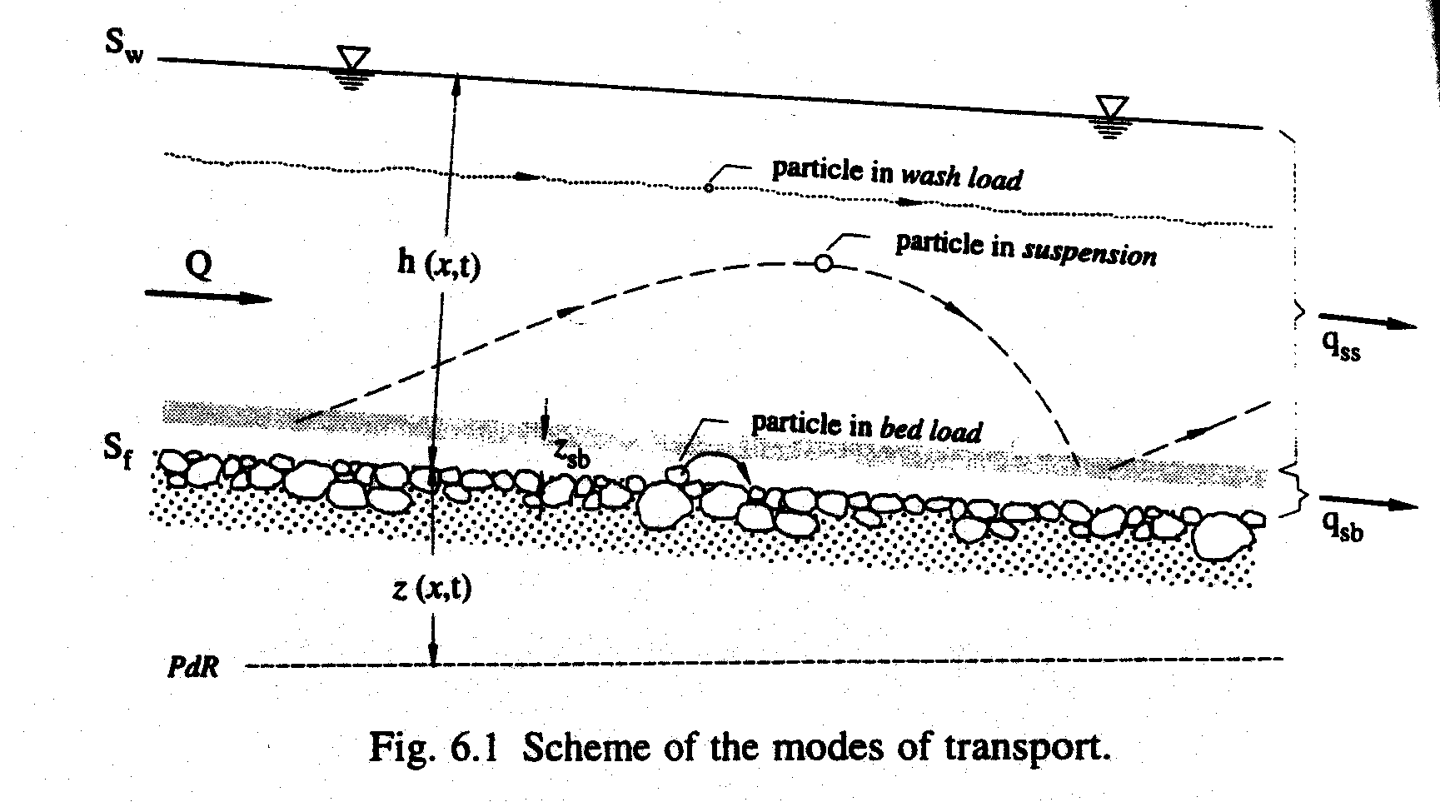
Bed Load Transport Redefined…
Transport of sediments where the solid particles glide, roll or briefly jump but stay close to the bed
Erosion of the bed (bed load transport) commences upon exceedance of the critical shear stress, τ_{o,cr}
Exists a number of formulas for predicting bed-load transport:
Many are empirical but have incorporated dimensionless parameters
More common equations for bed-load transport include:
Duboys-Type Equations (Kalinske)
Schoklitsch-Type Equations
Meyer-Peter et al. (1948) – sometimes called Meyer-Peter Muller (MPM)
Einstein’s Bed Load Equation

Slide 5
Theoretical Considerations
Consider mobile bed of uniform and noncohesive particles
Forces which lead to uniform and steady motion of a particle…
Hydrodynamic Force:
Submerged Weight of Particle:
7 Parameters: Fluid (density, viscosity), Solid (density, diameter), Flow (Depth or Hydraulic Radius, Slope and Gravity – Friction Velocity)

Slide 6
Theoretical Considerations
7 parameters can be combined into 4 dimensionless Π groups:

Slide 7
Theoretical Considerations
Transport of sediment can be expressed as a function of these 4 dimensionless variables:

Slide 8
Theoretical Considerations
Since the terms R_{h}/d and ρ_{s}/ρ are included in τ* and with τ* = f(Re*):
Expression links solid transport, q_{sb}, to shear stress
Increase in shear stress past critical is responsible for an increase in q_{sb}

Slide 9
Theoretical Considerations
We often assume the relation below can be expressed in terms of a power law:

Slide 10
Bed-Load Transport Equations
Be Careful!!!
Formulas give “reasonably satisfying results” with the parameter domain for which they were derived
Application of formulas should be done with great care!

Slide 11
Bed-Load Transport Equations
duBoys-Type Equations:
DuBoys (1879) proposed model for bed-load transport assuming that sediment moves in layers, each of which has a thickness ε
1st layer is where tractive force balances resistance force between layers:

Slide 12
Bed-Load Transport Equations
duBoys-Type Equations:
If layer between 1st and nth moves according to a linear distribution, then…
nε is the thickness of sediment material moving
Thickness moves with an average velocity of v_{s}(n-1)/2

Slide 13
Bed-Load Transport Equations
duBoys-Type Equations:
Critical condition at which sediment motion is about to begin…(n = 1)

Slide 14
Bed-Load Transport Equations
duBoys-Type Equations:
Assumptions of this equation have been shown to disagree totally with observations of bed-load transport
Bed load does not move as sliding layers (Schoklitsch, 1914)
However, there is generally good agreement between this equation and field/laboratory data
Proper use of the equation depends on correct evaluation of the characteristic sediment coefficient, χ
Sidenote: generally all bed load equations based on excess shear stress are classified as duBoys-type equations

Slide 15
Bed-Load Transport Equations
duBoys-Type Equations:
Experiments of Schoklitsch (1914) proved duBoys’ model of sliding layers to be wrong, but did show that the equation fit the data well
Uniform grains of various kinds of sand (limited data) and experimental flume experiment (small dimensions):

Slide 16
Bed-Load Transport Equations
duBoys-Type Equations:
Straub (1935) - based on work of several researchers determined average values of several sand sizes
Criticized because all data obtained from small flumes over a small range of particle sizes

Slide 17
Bed-Load Transport Equations
duBoys-Type Equations:
Zeller (1963) gives graph for metric units:

Slide 18
Bed-Load Transport Equations
duBoys-Type Equations:
Shields (1936) proposed critical shear stress relation
Intent was to present an abbreviated form of the factors influencing bed load transport
Developed a semi-empirical tractive-force equation based on 1.06<s_{s}<4.25 and 1.56<d<2.47 mm

Slide 19
Bed-Load Transport Equations
duBoys-Type Equations:
Kalinske (1947) emphasized turbulence mechanism in flow above the bed:

Slide 20
Example – Graf 6.D
An artificial channel has been constructed to divert a certain discharge from a river. This channel has an approximately rectangular cross-section with a width of B = 46.5 m and a bed slope of S_{f}=6.5 x 10⁻⁴. Uniform flow is established when the flow depth is 5.6 m. Velocity-profile measurements suggest an average velocity of 1.8 m/s and n’ = 0.0212 (due to bed roughness). Estimate the bed-load transport using the Kalinske equation. Express the solid discharge as a concentration.

Slide 21
Example – Graf 6.D
Converting q_{sb} to g_{sb}:
Sediment concentration can be expressed in a number of different ways:
Concentration by volume:
Concentration by mass:
Concentration by unit mass:

Slide 22
Example – Graf 6.D
Relationship between these concentrations:

Slide 23
Bed-Load Transport Equations
Schoklitsch-Type Equations:
Replaced excess shear stress criterion with critical water discharge (or depth):
Gilbert (1914) – expansive set of data for varying water discharge, energy grade line, and sediment properties
3 flumes of lengths 14, 31.5, and 150 ft
Flume width ranged from 0.23 to 1.96 ft
Discharge varied from 0.019 to 1.19 cfs
Eight different kinds of sand (0.305 < d < 7.01 mm)

Slide 24
Bed-Load Transport Equations
Schoklitsch-Type Equations:
Schoklitsch first proposed equations in 1935 but modified them in 1950:
Critical flow rate:

Slide 25
Bed-Load Transport Equations
Schoklitsch-Type Equations:
Schoklitsch first proposed equations in 1935 but modified them in 1950:
Sediment discharge:

Slide 26
Example – Graf 6.D
An artificial channel has been constructed to divert a certain discharge from a river. This channel has an approximately rectangular cross-section with a width of B = 46.5 m and a bed slope of S_{f}=6.5 x 10⁻⁴. Uniform flow is established when the flow depth is 5.6 m. Velocity-profile measurements suggest an average velocity of 1.8 m/s and n’ = 0.0212 (due to bed roughness). Estimate the bed-load transport using the Schoklitsch equation. Express the solid discharge as a concentration.

Slide 33
Bed-Load Transport Equations
Meyer-Peter Muller (MPM):
Switzerland research laboratory (ETH) – Meyer-Peter et al. (1934):
Laboratory flume with cross-section of 2 x 2 m and total length of 50 m (max discharge of 5 m³/s) and sediment discharge up to 4.3 kg/(s-m)
Two grain sizes: 5.05 mm and 28.6 mm
For sand, resulting bed-load equation

Slide 34
Bed-Load Transport Equations
Meyer-Peter Muller (MPM):
ETH experiments were extended to include data with particle mixtures
First attempt to include representative grain diameter with previous formulas failed
Meyer-Peter et al. (1948) proposed following equation which fit all the data:

Slide 35
Bed-Load Transport Equations
Meyer-Peter Muller (MPM):
Meyer-Peter et al. (1948) :
R_{hb} = hydraulic radius of bed
Equivalent diameter = d₅₀
ξ_{M} is a roughness parameter:
Derived with d = 3.1-28.6 mm (applicable to d > 2.0 mm)
Derived with S_{f} = 0.0004-0.020

Slide 36
Example – Graf 6.D
An artificial channel has been constructed to divert a certain discharge from a river. This channel has an approximately rectangular cross-section with a width of B = 46.5 m and a bed slope of S_{f}=6.5 x 10⁻⁴. Uniform flow is established when the flow depth is 5.6 m. Velocity-profile measurements suggest an average velocity of 1.8 m/s and n’ = 0.0212 (due to bed roughness). Estimate the bed-load transport using the Meyer-Peter et al. formulas. Express the solid discharge as a concentration.

Slide 37
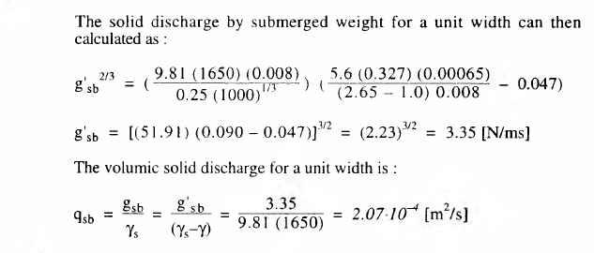

Slide 41
Sediment Transport Equations

Slide 42
Einstein’s Bed-Load Transport Equation
Developed in 1942 (empirical) and 1950 (analytical)
Probabilistic model for transport of sediment as bed load
Bed load transport is related to the fluctuations in velocity rather than the average velocity
Beginning and end of motion are expressed in probabilistic terms with considerations for the lift and particle’s weight
Built on observations/experimental evidence:
Bed load moves slowly downstream – motion of an individual particle is quick step with long intermediate stops
Average step made by any bed load particle is independent of flow condition, transport rate, and bed composition (always the same)
Different transport rates due to changes in the average time between steps and the thickness of the moving layer

Slide 43
Einstein’s Bed-Load Transport Equation
Physical Model:
Equilibrium condition of exchange of bed particles between the bed layer and the bed
# particles deposited per time per unit bed area = # particles eroded per unit time per unit bed area
Deposition:
Each particle (d) has steps of length A_{L}d and will be deposited over an area A_{L}d long with unit width
Let g_{s} = bed load rate in weight per time per width, N/(m-s)
Let i_{s} = fraction of bed load in given grain size
Then g_{s} i_{s} = rate at which given size moves through the unit width per unit time

Slide 44
Einstein’s Bed-Load Transport Equation
Physical Model:
Weight of a single particle = γ_{s}k₂d³ (k₂ = constant of grain volume)
Number of particles of a certain fraction deposited per unit time and bed area:

Slide 45
Einstein’s Bed-Load Transport Equation
Physical Model:
Erosion:
Whether a particle will be eroded depends on the availability of the particle and on flow conditions (turbulence level)
Let i_{b} = fraction of bed material in a given grain size
# particles of size d in a unit area of bed surface = i_{b} /k₁d², where k₁ = constant of grain area
Let p_{e}/t_{e} = probablility of removal, where t_{e} = time consumed by each exchange
# particles eroded per unit time and unit area:

Slide 46
Einstein’s Bed-Load Transport Equation
Physical Model:
Erosion:
No direct method is available for the determination of t_{e} – Einstein (1942) suggests a function of v_{ss}:

Slide 47
Einstein’s Bed-Load Transport Equation
Physical Model:
Bed Load Equation (Equilibrium):
Rate of deposition balances rate of erosion:
Exchange probability:
p_{e} = fraction of time during which the lift exceeds the weight of the particle at any one location
Non-intensive sediment transport → p_{e} is small and deposition is everywhere possible
Strong sediment transport → p_{e} becomes larger and deposition is not everywhere possible

Slide 48
Einstein’s Bed-Load Transport Equation
Physical Model:
Exchange probability:
Einstein (1950) suggests that p_{e} can be used to evaluate A_{L}d :
If p_{e} is small, distance traveled is constant: A_{L}d = λ_{b}d where λ_{b} is approximately 100
For larger p_{e}:
Only (1-p_{e}) particles can deposit after traveling λ_{b}d
And p_{e} particles stay in motion – would like to deposit but can’t because after λ_{b}d lift forces exceed weight
Of these p_{e} particles, p_{e} (1-p_{e}) are deposited after traveling 2λ_{b}d while p_{e}² particles are still not deposited
We can express the total travel distance as a series:

Slide 49
Einstein’s Bed-Load Transport Equation
Physical Model:
Substituting the series into the bed load equation:

Slide 50
Einstein’s Bed-Load Transport Equation
Empirical Relation (Einstein, 1942):

Slide 51
Einstein’s Bed-Load Transport Equation
Empirical Relation (Einstein, 1942):
Probability determination:

Slide 52
Einstein’s Bed-Load Transport Equation
Empirical Relation (Einstein, 1942):
Probability determination:

Slide 53
Einstein’s Bed-Load Transport Equation
Empirical Relation (Einstein, 1942):
Weak Sediment Transport:
Einstein determined these constants using the data of Gilbert (1914) and Meyer-Peter et al. (1934) – See Figure on Next Slide
All data with Φ<0.4 plots on a single curve (Curve 1) with:

Slide 54
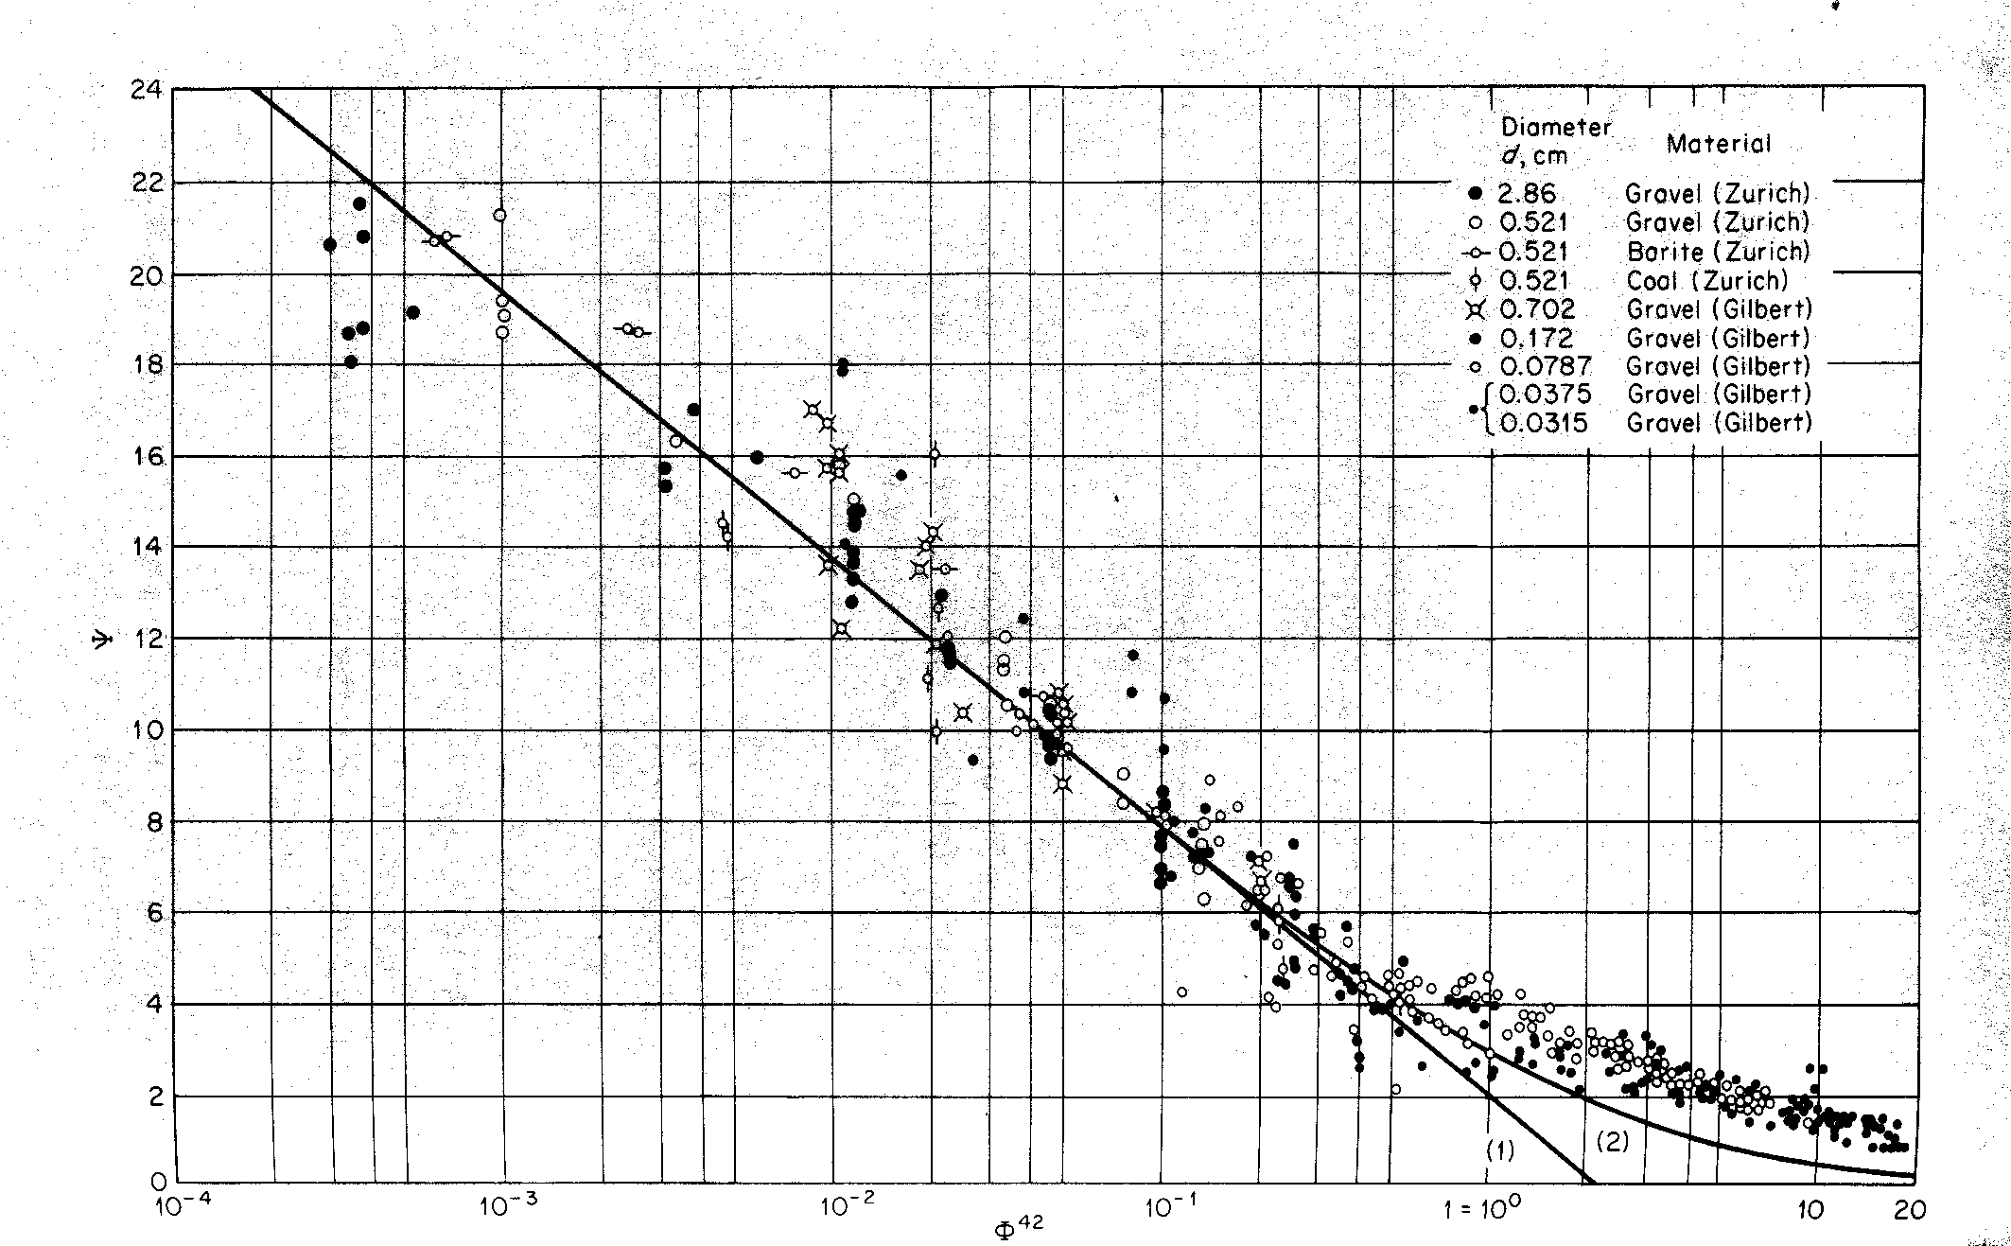
Einstein’s Bed-Load Transport Equation

Slide 55
Einstein’s Bed-Load Transport Equation
Empirical Relation (Einstein, 1942):
Strong Sediment Transport:
For Φ>0.4: Curve 2
For sand mixtures, Einstein suggested an effective diameter of 35-45% finer (d₃₅ commonly used)

Slide 56
Einstein’s Bed-Load Transport Equation
Einstein (1950) replaced empirical solution with an analytical solution:
Based on same concepts of probability of motion:

Slide 57
Einstein’s Bed-Load Transport Equation
Einstein (1950) replaced empirical solution with an analytical solution:
Based on same concepts of probability of motion:

Slide 58
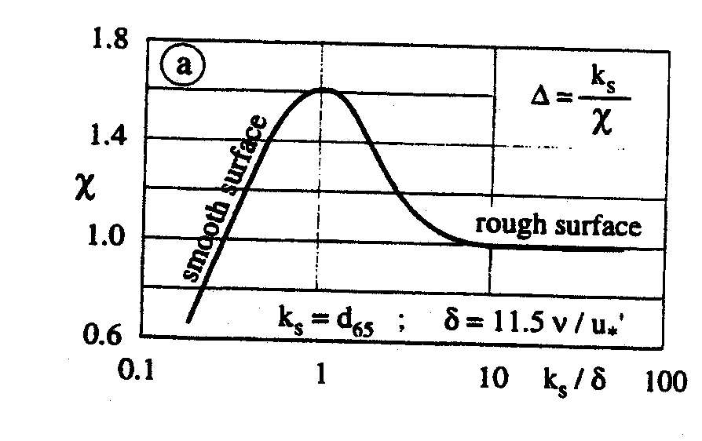
Einstein’s Bed-Load Transport Equation

Slide 59
Einstein’s Bed-Load Transport Equation
Einstein (1950) replaced empirical solution with an analytical solution:
The earlier proposed functional relationship is valid for uniform grains:
Einstein extended this function for non-uniform sediment:

Slide 60
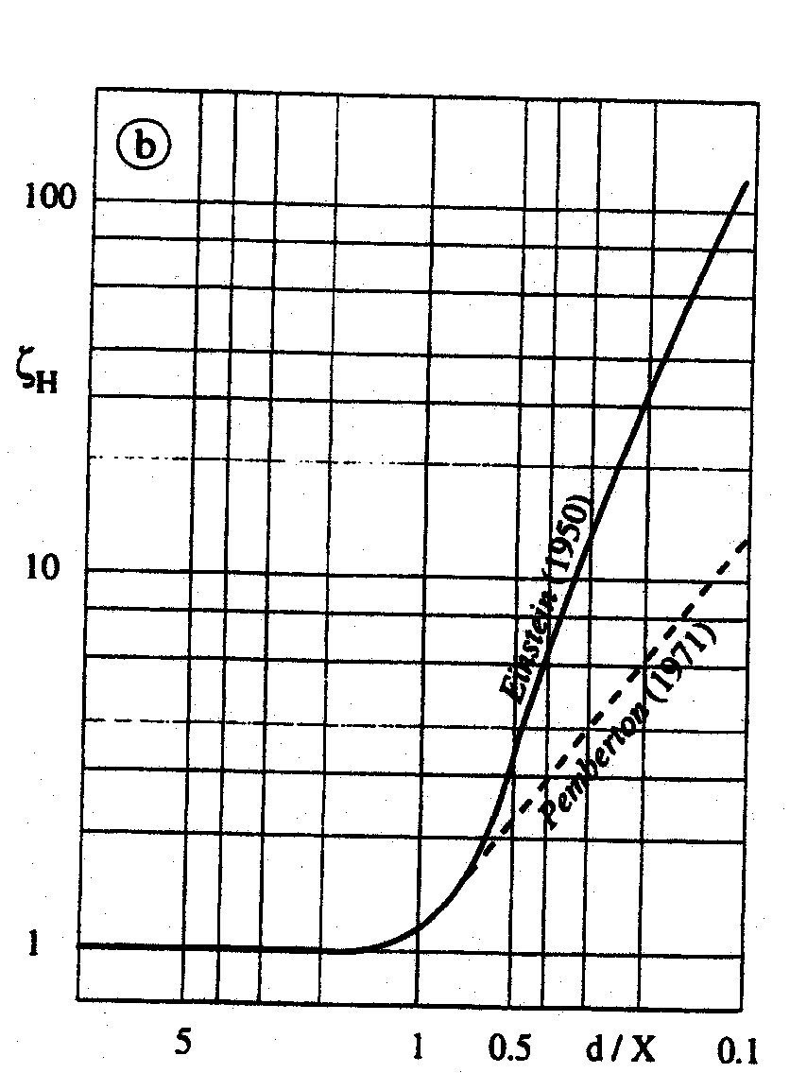
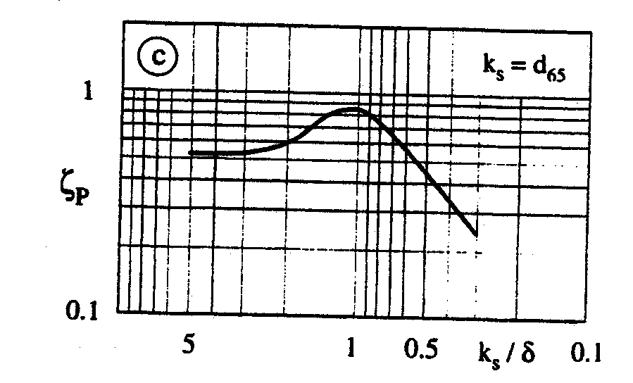
Einstein’s Bed-Load Transport Equation

Slide 61
Einstein’s Bed-Load Transport Equation
Einstein (1950) replaced empirical solution with an analytical solution:
We can even rewrite the function in simpler format:

Slide 62
Einstein’s Bed-Load Transport Equation
Proposed the following solution for p_{e} that resembled normal distribution:

Slide 63
Einstein’s Bed-Load Transport Equation
But we don’t want to have to evaluate this function:

Slide 64
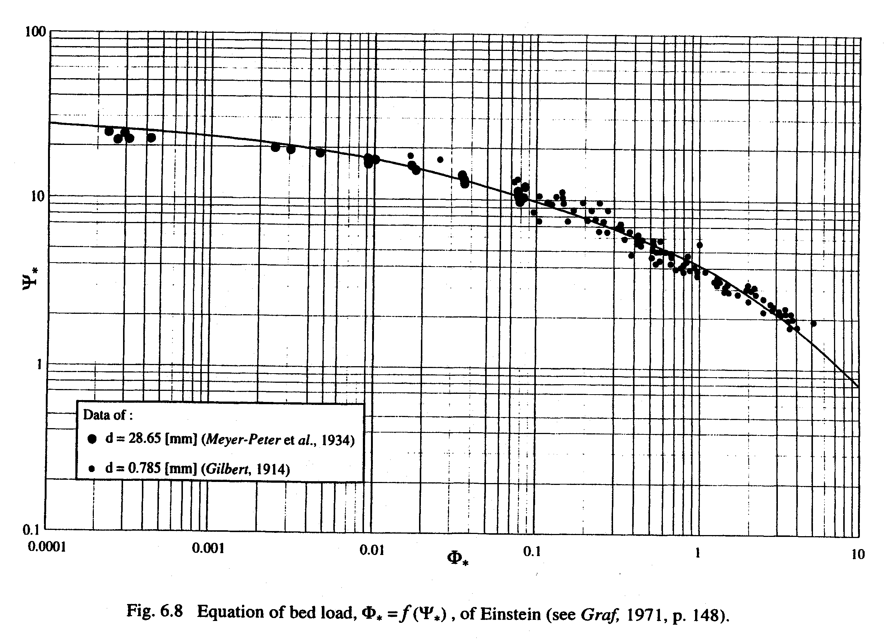
Einstein’s Bed-Load Transport Equation

Slide 65
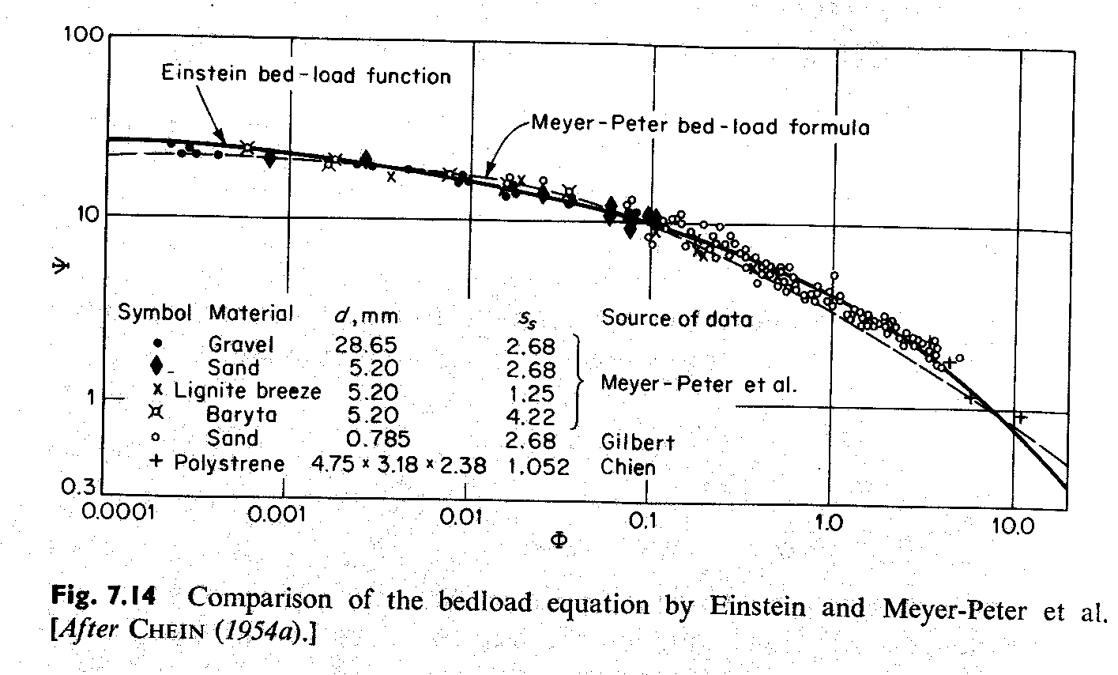
Einstein’s Bed-Load Transport Equation

Slide 66
Einstein’s Bed-Load Transport Equation
Note that Einstein never uses a “critical value for erosion”:
However, the critical shear stress from Shields matches with good agreement the value of Ψ with small Φ
Einstein equation valid for d > 0.7 mm (0.8-28.6 mm) across large range of bed slopes
Applied world-wide with “great success”

Slide 67
Example – Graf 6.D
An artificial channel has been constructed to divert a certain discharge from a river. This channel has an approximately rectangular cross-section with a width of B = 46.5 m and a bed slope of S_{f}=6.5 x 10⁻⁴. Uniform flow is established when the flow depth is 5.6 m. Velocity-profile measurements suggest an average velocity of 1.8 m/s and n’ = 0.0212 (due to bed roughness). Estimate the bed-load transport using Einstein’s formula. Express the solid discharge as a concentration.

Slide 73
Armoring
Non-cohesive beds consist of a number of different particle sizes → PSD:
Curve can be divided into fractions
Usually 4 or 5 unequal fractions after elimination of smallest 5% of finest particles (wash load) and 5% of coarsest particles
For each fraction, you can then determine:
d_{i} = average diameter
i_{sbi}q_{sbi} = bed-load transport

Slide 74
Armoring
PSD for bed material is different than that moving as bed load or suspended load:
Given fraction of the PSD of bed material (i_{bi}) different from corresponding fraction of solid discharge curve (i_{sbi})

Slide 75
Armoring
Smaller particles are more easily eroded than larger ones:
Grain-size sorting process
Accumulation of the remaining larger particles called armoring (armouring) – protects the underlying sediment
Prevents erosion during subsequent flood events due to larger particles at bed surface
Capacity for sediment transport not satisfied until armor layer is destroyed (original sediment reappears and begins to form a new armor layer)
Samples taken when armoring has occurred must be interpreted with caution!
Less than a single complete covering layer suffices for total armoring effect
Field observations suggest that a relatively stable armor layer requires a minimum of two layers of armoring particles
Question: At what location in the channel cross-section would armoring begin?

Slide 76
Armoring
Graf describes armoring as an asymptotic process:
As u* increases, smaller particles are eroded and larges ones stay in place
Corresponding friction velocity once larger ones stay in place = critical friction velocity for armoring (u_{*a,cr})
Maximum possible armored bed formed by largest particles: d₉₀ or larger
For discharges when u>u_{*a,cr}, armored bed becomes unstable and will be destroyed
Original sediment sizes will be exposed at surface and active erosion begins again
Armor can then be restored under moderate flows

Slide 77
Armoring
SCS (1977) suggests d₉₅ as representative size “paving the channels”
From Shields criterion (verify this using Shields-Yalin diagram):
SCS (1977) says that armoring is probable when d_{c} is equal to or smaller than the d₉₅ size
Percentage of bed material equal to or larger than the armor particle size (d_{a})

Slide 78
Armoring
USBR (1984) provides equation for depth of scour necessary to establish an armor layer (ΔZ_{a}):

Slide 79
Example
Consider a case where the critical particle size is 1.5 in and a representative bed-material gradation curve shows that this is the d₉₀ size. What is the depth to formation of an armor layer?

Slide 80
Armoring
Correia and Graf (1988) proposed relationship between original PSD and armor layer PSD:
Empirical relationship for prediction of the stability of the armor layer (Raudkivi, 1990):

Slide 81
Example – Graf 6.E
A mountain river with a bottom slope of 0.0062 has an approximately rectangular cross-section, being B = 23.5 m wide. Analysis of the sediment samples taken from well below the armor layer show that d₅₀ = 60 mm and d₉₀ = 200 mm and the density of sediment is 2.65. Determine the diameter of maximum possible armor. At what flow depth does the armor layer become unstable?

