Slide 1
دورة
المتحكمات المنطقية القابلة بالبرمجة
(Programmable Logic controller )
(plc)
م.د. عمار ابراهيم مجيد

Slide 2
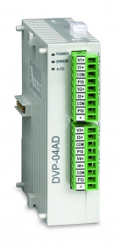
Delta DVP-04AD-S
The A/D Conversion
In industrial automation, many measuring units are transmitted by analog signals. The most frequently adopted range for the signals are voltage -10 ~ 10V and current -20 ~ 20mA. To use the analog signals as the parameters for PLC operations, you have to convert them into digital values first. For example, the voltage -10 ~ 10V is first converted into values -8,000 ~ +8,000 by an A/D module, and the PLC will read/write the control registers (CR) in the AD module by FROM/TO instructions. The signals sent back to the PLC for operations will be digital K-8,000 ~ K8,000.

Slide 3
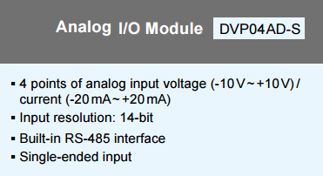

Slide 4
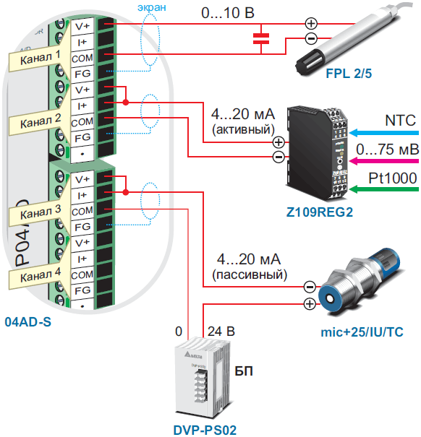

Slide 5
Features:
DVP04AD (or DVP06AD) analog signal input module receives external 4 (or 6) points of analog input signals (voltage or current) and converts them into 14-bit digital signals. The CPU can read/write the data in the module by using FROM/TO instructions in the program. There are 49 16-bit control registers in the module.
You can select voltage input or current input by the wiring. Range for voltage input: ±10V (±8,000, resolution: 1.25mV). Range for current input: ±20mA (±4,000, resolution: 5μA).

Slide 6
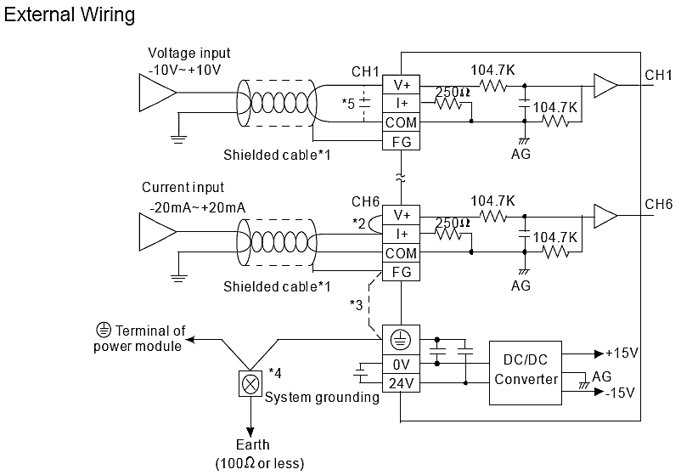

Slide 7
نهاية المحاضرة الثالثة

