Slide 1
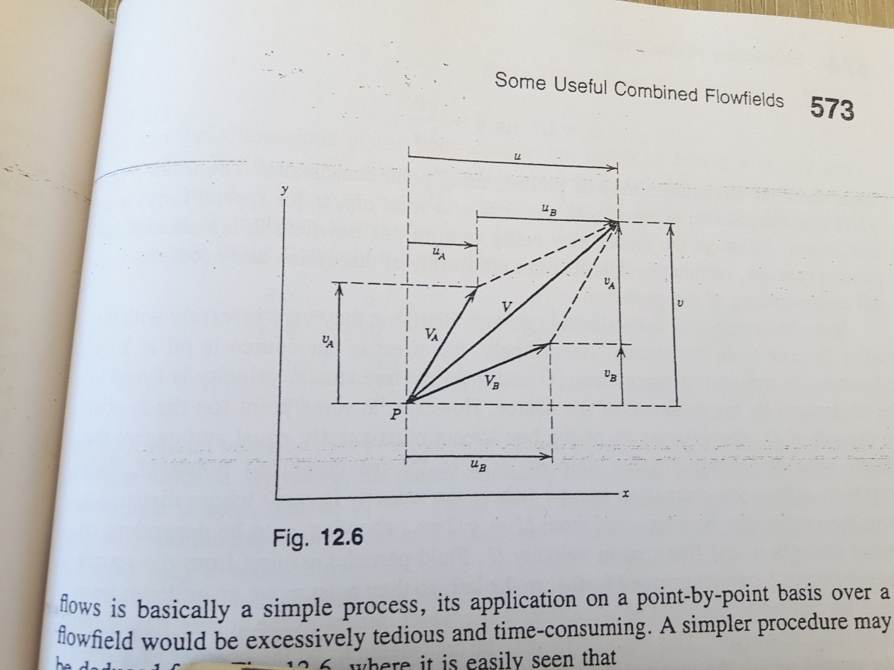
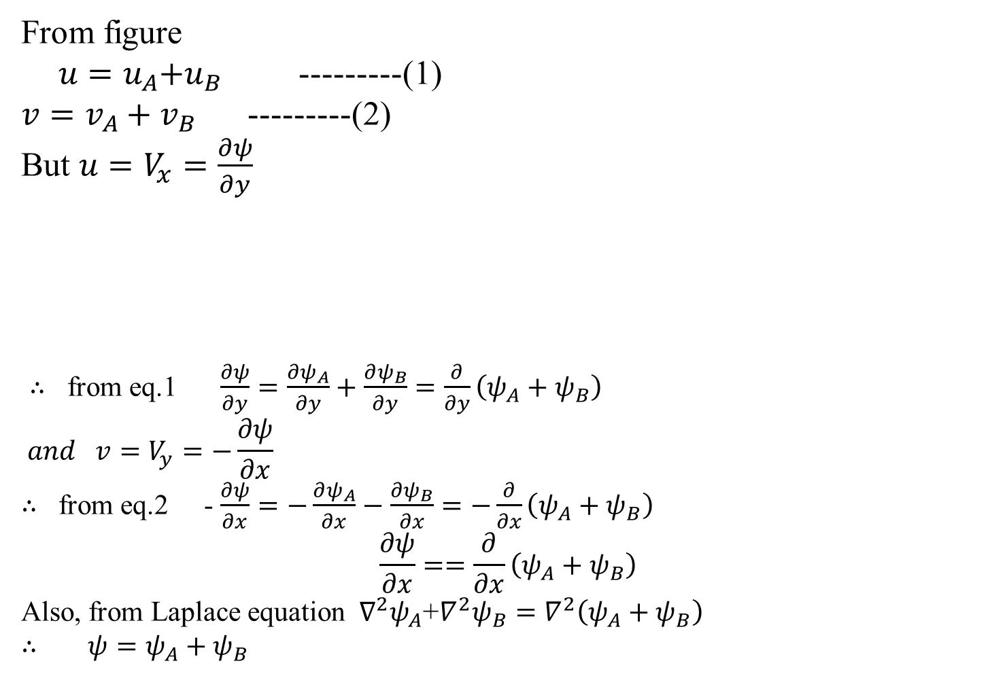
Combining Flow by Superposition
From figure
${ u=u}_{A}+u_{B}$ ---------(1)
${v=v}_{A}+v_{B}$ ---------(2)
But ${u=V}_{x}=\frac{∂ψ}{∂y}$
$∴$ from eq.1 $\frac{∂ψ}{∂y}=\frac{∂ψ_{A}}{∂y}+\frac{∂ψ_{B}}{∂y}=\frac{∂}{∂y}\left(ψ_{A}+ψ_{B}\right)$
$$and {v=V}_{y}=−\frac{∂ψ}{∂x}$$
$∴$ from eq.2 - $\frac{∂ψ}{∂x}=−\frac{∂ψ_{A}}{∂x}−\frac{∂ψ_{B}}{∂x}=−\frac{∂}{∂x}\left(ψ_{A}+ψ_{B}\right)$
$$\frac{∂ψ}{∂x}==\frac{∂}{∂x}\left(ψ_{A}+ψ_{B}\right)$$
Also, from Laplace equation $∇^{2}ψ_{A}$+$∇^{2}ψ_{B}=∇^{2}\left(ψ_{A}+ψ_{B}\right)$
$∴$ ${ψ=ψ}_{A}+ψ_{B}$
Notes:
Index / Table of Contents:
We will go over two ideas, the stream function and the velocity potential.
Why?
They are helpful in visualizing certain problems and in solving a few of them.
We have seen how to solve the NS equation in some simple cases, by
reducing the equations to a linear ODE (by assuming things like non-zero
velocity in only one direction, steady state , fully developed flow etc) or to a PDE.
We did not neglect viscosity in them.
If we neglect viscosity, the equations become very simple. We can handle a group of problems where viscosity is neglected, by employing the concept of velocity potential.
If we assume that the velocity does not have a non zero component in third direction (i.e. 1D and 2D flows only), then we can employ the idea of stream functions. (We handled 1D velocities so far, with out stream functions; but in 2D cases it becomes a bit difficult and stream functions help). This will allow us to solve some more (but not all 2D or 1D) problems.

Slide 2
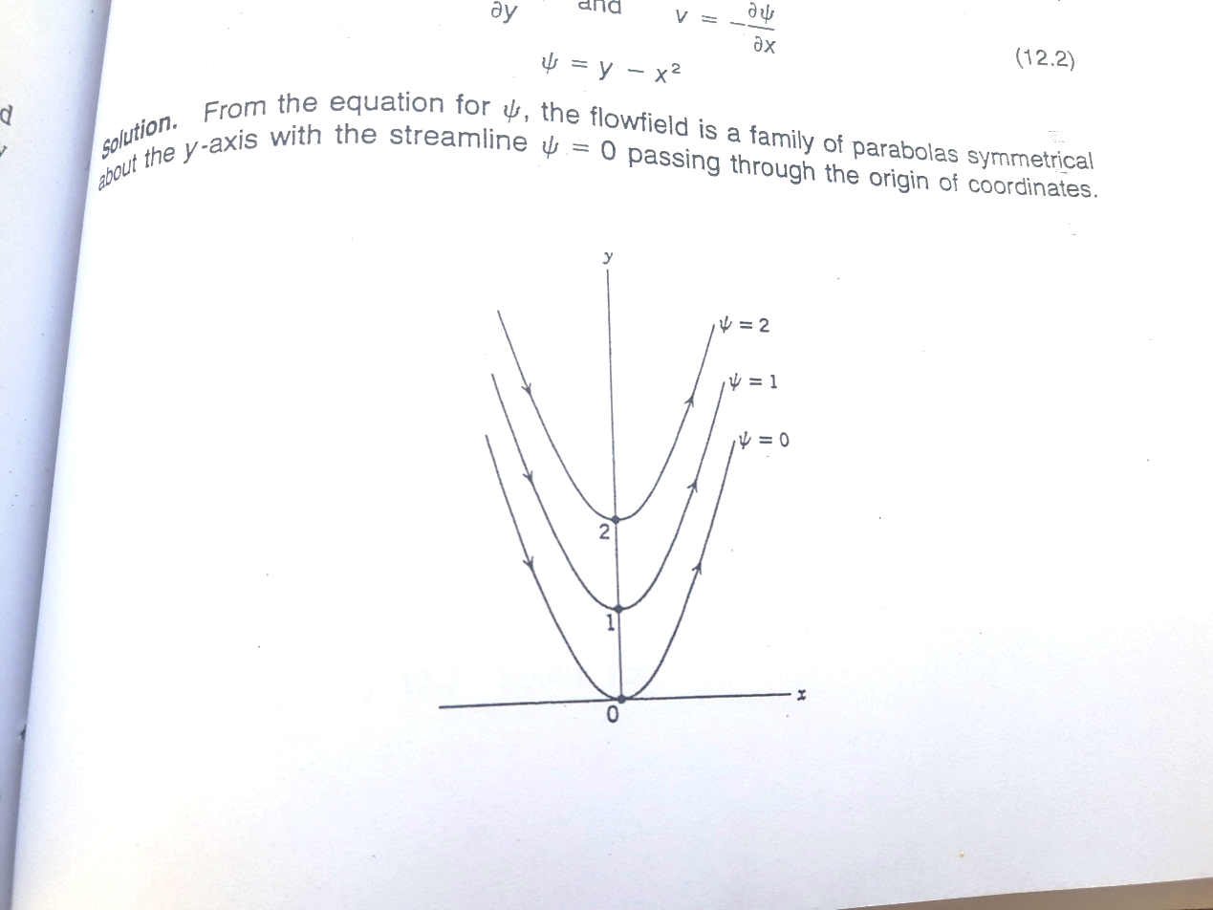
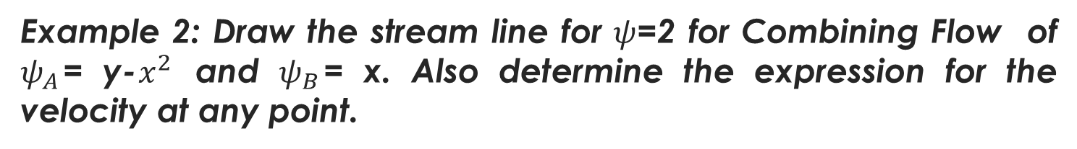
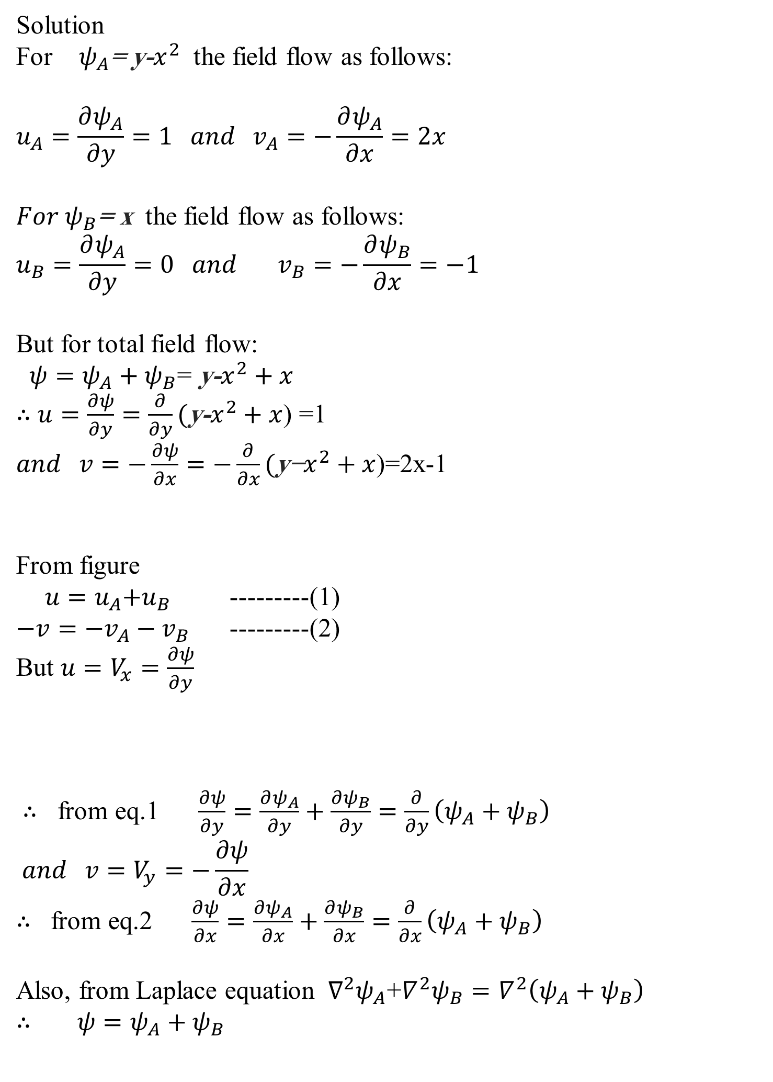
Example 2: Draw the stream line for $ψ$=2 for Combining Flow of $ψ_{A}$= y-$x^{2}$ and $ψ_{B}$= x. Also determine the expression for the velocity at any point.
Solution
For $ψ_{A}$= y-$x^{2}$ the field flow as follows:
$$u_{A}=\frac{∂ψ_{A}}{∂y}=1 and v_{A}=−\frac{∂ψ_{A}}{∂x}=2x$$
${For ψ}_{B}$= x the field flow as follows:
$$u_{B}=\frac{∂ψ_{A}}{∂y}=0 and v_{B}=−\frac{∂ψ_{B}}{∂x}=−1$$
But for total field flow:
${ψ=ψ}_{A}+ψ_{B}$= y-$x^{2}+x$
$∴$ $u=\frac{∂ψ}{∂y}=\frac{∂}{∂y}(\text{y}\text{−}x^{2}+x$) =1
$and v=−\frac{∂ψ}{∂x}=−\frac{∂}{∂x}(\text{y}\text{−}x^{2}+x$)=2x-1
From figure
${ u=u}_{A}+u_{B}$ ---------(1)
${−v=−v}_{A}−v_{B}$ ---------(2)
But ${u=V}_{x}=\frac{∂ψ}{∂y}$
$∴$ from eq.1 $\frac{∂ψ}{∂y}=\frac{∂ψ_{A}}{∂y}+\frac{∂ψ_{B}}{∂y}=\frac{∂}{∂y}\left(ψ_{A}+ψ_{B}\right)$
$$and {v=V}_{y}=−\frac{∂ψ}{∂x}$$
$∴$ from eq.2 $\frac{∂ψ}{∂x}=\frac{∂ψ_{A}}{∂x}+\frac{∂ψ_{B}}{∂x}=\frac{∂}{∂x}\left(ψ_{A}+ψ_{B}\right)$
Also, from Laplace equation $∇^{2}ψ_{A}$+$∇^{2}ψ_{B}=∇^{2}\left(ψ_{A}+ψ_{B}\right)$
$∴$ ${ψ=ψ}_{A}+ψ_{B}$
Notes:
Index / Table of Contents:
We will go over two ideas, the stream function and the velocity potential.
Why?
They are helpful in visualizing certain problems and in solving a few of them.
We have seen how to solve the NS equation in some simple cases, by
reducing the equations to a linear ODE (by assuming things like non-zero
velocity in only one direction, steady state , fully developed flow etc) or to a PDE.
We did not neglect viscosity in them.
If we neglect viscosity, the equations become very simple. We can handle a group of problems where viscosity is neglected, by employing the concept of velocity potential.
If we assume that the velocity does not have a non zero component in third direction (i.e. 1D and 2D flows only), then we can employ the idea of stream functions. (We handled 1D velocities so far, with out stream functions; but in 2D cases it becomes a bit difficult and stream functions help). This will allow us to solve some more (but not all 2D or 1D) problems.

Slide 3

$V^{2}=u^{2}$+$v^{2}$ = ${( \text{1 })}^{2}$ + ${(\text{2}\text{x}\text{−}\text{1 })}^{2}=4x^{2}−2x+2$
Now for the stream line o$f ψ$=2
$ψ$=2 $=\text{y} \text{−} x^{2}+x$
Or $y= x^{2}−x+2$
$={(x}^{2}−x+\frac{1}{4})−\frac{1}{4}+2$
$={\left(x−\frac{1}{2}\right)}^{2}−\frac{1}{4}+2$
$y= {\left(x−\frac{1}{2}\right)}^{2}+\frac{7}{4}$
$∴ y−\frac{7}{4}= {\left(x−\frac{1}{2}\right)}^{2}$
Notes:
Index / Table of Contents:
We will go over two ideas, the stream function and the velocity potential.
Why?
They are helpful in visualizing certain problems and in solving a few of them.
We have seen how to solve the NS equation in some simple cases, by
reducing the equations to a linear ODE (by assuming things like non-zero
velocity in only one direction, steady state , fully developed flow etc) or to a PDE.
We did not neglect viscosity in them.
If we neglect viscosity, the equations become very simple. We can handle a group of problems where viscosity is neglected, by employing the concept of velocity potential.
If we assume that the velocity does not have a non zero component in third direction (i.e. 1D and 2D flows only), then we can employ the idea of stream functions. (We handled 1D velocities so far, with out stream functions; but in 2D cases it becomes a bit difficult and stream functions help). This will allow us to solve some more (but not all 2D or 1D) problems.

Slide 4
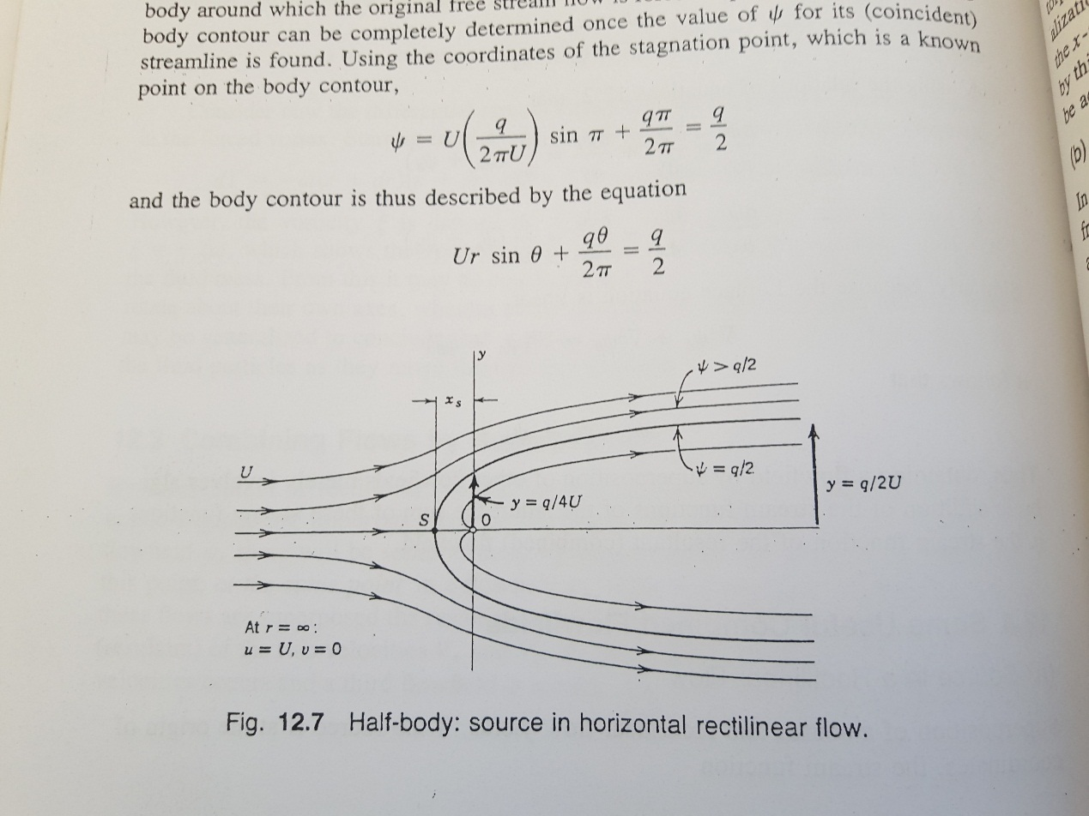
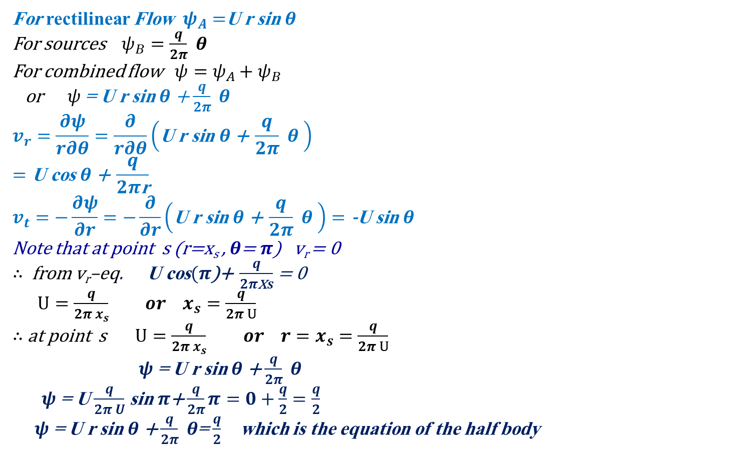
Some Useful Combined Flowfields
1- Source in a rectilinear Flow
For rectilinear Flow $ψ_{A}=$U r sin $θ$
For sources $ψ_{B}=\frac{q}{2π} θ$
For combined flow ${ψ=ψ}_{A}+ψ_{B}$
or $ψ$= U r sin $θ$ + $\frac{q}{2π} θ$
$$v_{r}=\frac{∂ψ}{r∂θ}=\frac{∂}{r∂θ}\left(\text{U} \text{r} \text{sin} θ\text{ + }\frac{q}{2π} θ \right)$$
$$=\text{U} \text{cos} θ\text{ + }\frac{q}{2π\text{r}}$$
$$v_{t}=−\frac{∂ψ}{∂r}=−\frac{∂}{∂r}\left(\text{U} \text{r} \text{sin} θ\text{ + }\frac{q}{2π} θ \right)=\text{−}\text{U} \text{sin} θ$$
Note that at point s (r=x_{s} , $θ$= $π$) v_{r} = 0
$∴$ from v_{r}–eq. $\text{U} \text{cos}(π\text{)}\text{+ }\frac{q}{2π\text{x}s}$ = 0
$U=\frac{q}{2π x_{s}} or x_{s}=\frac{q}{2π U}$
$∴$ at point s $U=\frac{q}{2π x_{s}} or {r=x}_{s}=\frac{q}{2π U}$
$ψ$= U r sin $θ$ + $\frac{q}{2π} θ$
$ψ$= U $\frac{q}{2π U}$ sin$π$+ $\frac{q}{2π}π=0+\frac{q}{2}=\frac{q}{2}$
$ψ$= U r sin $θ$ + $\frac{q}{2π} θ$=$\frac{q}{2}$ which is the equation of the half body
Notes:
Index / Table of Contents:
We will go over two ideas, the stream function and the velocity potential.
Why?
They are helpful in visualizing certain problems and in solving a few of them.
We have seen how to solve the NS equation in some simple cases, by
reducing the equations to a linear ODE (by assuming things like non-zero
velocity in only one direction, steady state , fully developed flow etc) or to a PDE.
We did not neglect viscosity in them.
If we neglect viscosity, the equations become very simple. We can handle a group of problems where viscosity is neglected, by employing the concept of velocity potential.
If we assume that the velocity does not have a non zero component in third direction (i.e. 1D and 2D flows only), then we can employ the idea of stream functions. (We handled 1D velocities so far, with out stream functions; but in 2D cases it becomes a bit difficult and stream functions help). This will allow us to solve some more (but not all 2D or 1D) problems.

Slide 5

Note that for $θ$=$\frac{π}{2}$
U r sin$\frac{ π}{2}$+ $\frac{q}{2π} \frac{π}{2}$=$\frac{q}{2}$ or $r=y=\frac{q}{4U}$
And for $θ$= 0
U r sin$(0)$+ $\frac{q}{2π} (0)$=$\frac{q}{2}$ or r sin$\left(0\right)=\frac{q}{2U}$
r $=\frac{q}{2U\text{sin} \left(0\right)}$ or or $r=∞$
Notes:
Index / Table of Contents:
We will go over two ideas, the stream function and the velocity potential.
Why?
They are helpful in visualizing certain problems and in solving a few of them.
We have seen how to solve the NS equation in some simple cases, by
reducing the equations to a linear ODE (by assuming things like non-zero
velocity in only one direction, steady state , fully developed flow etc) or to a PDE.
We did not neglect viscosity in them.
If we neglect viscosity, the equations become very simple. We can handle a group of problems where viscosity is neglected, by employing the concept of velocity potential.
If we assume that the velocity does not have a non zero component in third direction (i.e. 1D and 2D flows only), then we can employ the idea of stream functions. (We handled 1D velocities so far, with out stream functions; but in 2D cases it becomes a bit difficult and stream functions help). This will allow us to solve some more (but not all 2D or 1D) problems.

Slide 6
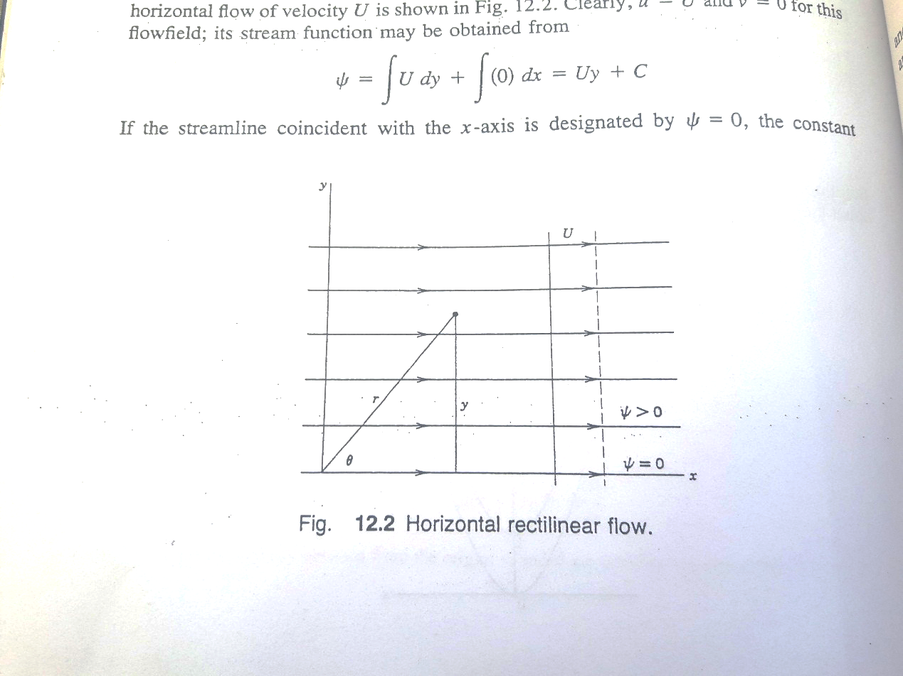
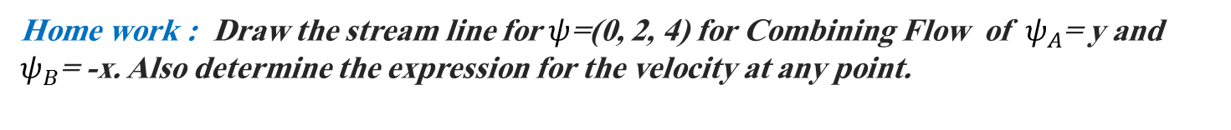
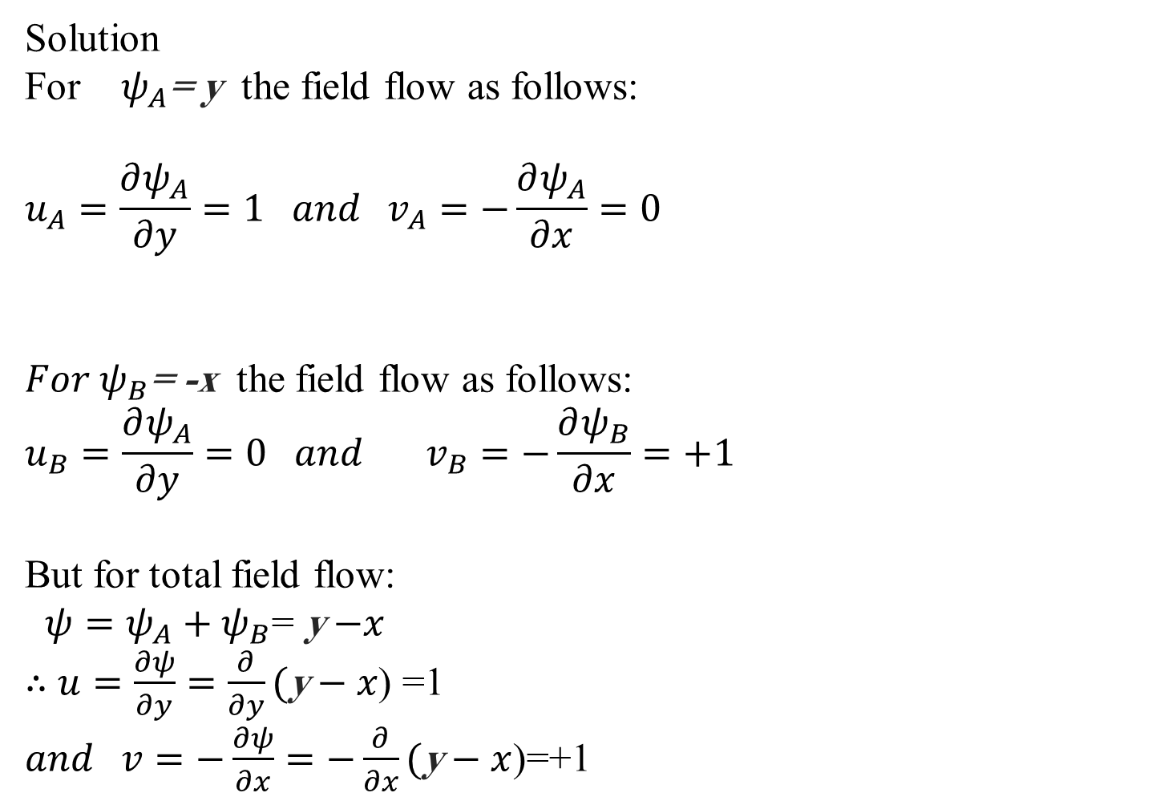
Home work : Draw the stream line for $ψ$=(0, 2, 4) for Combining Flow of $ψ_{A}$= y and $ψ_{B}$= -x. Also determine the expression for the velocity at any point.
Solution
For $ψ_{A}$= y the field flow as follows:
$$u_{A}=\frac{∂ψ_{A}}{∂y}=1 and v_{A}=−\frac{∂ψ_{A}}{∂x}=0$$
${For ψ}_{B}$= -x the field flow as follows:
$$u_{B}=\frac{∂ψ_{A}}{∂y}=0 and v_{B}=−\frac{∂ψ_{B}}{∂x}=+1$$
But for total field flow:
${ψ=ψ}_{A}+ψ_{B}$= y$−x$
$∴$ $u=\frac{∂ψ}{∂y}=\frac{∂}{∂y}(\text{y}−x$) =1
$and v=−\frac{∂ψ}{∂x}=−\frac{∂}{∂x}(\text{y}−x$)=+1
Notes:
Index / Table of Contents:
We will go over two ideas, the stream function and the velocity potential.
Why?
They are helpful in visualizing certain problems and in solving a few of them.
We have seen how to solve the NS equation in some simple cases, by
reducing the equations to a linear ODE (by assuming things like non-zero
velocity in only one direction, steady state , fully developed flow etc) or to a PDE.
We did not neglect viscosity in them.
If we neglect viscosity, the equations become very simple. We can handle a group of problems where viscosity is neglected, by employing the concept of velocity potential.
If we assume that the velocity does not have a non zero component in third direction (i.e. 1D and 2D flows only), then we can employ the idea of stream functions. (We handled 1D velocities so far, with out stream functions; but in 2D cases it becomes a bit difficult and stream functions help). This will allow us to solve some more (but not all 2D or 1D) problems.

Slide 7
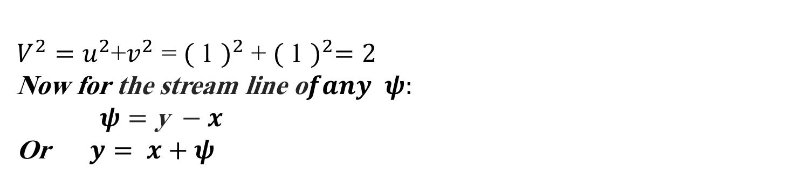
$V^{2}=u^{2}$+$v^{2}$ = ${( \text{1 })}^{2}$ + ${( \text{1} )}^{2}=2$
Now for the stream line o$fany ψ:$
$$ψ=\text{y} −x$$
Or $y= x+ψ$
Notes:
Index / Table of Contents:
We will go over two ideas, the stream function and the velocity potential.
Why?
They are helpful in visualizing certain problems and in solving a few of them.
We have seen how to solve the NS equation in some simple cases, by
reducing the equations to a linear ODE (by assuming things like non-zero
velocity in only one direction, steady state , fully developed flow etc) or to a PDE.
We did not neglect viscosity in them.
If we neglect viscosity, the equations become very simple. We can handle a group of problems where viscosity is neglected, by employing the concept of velocity potential.
If we assume that the velocity does not have a non zero component in third direction (i.e. 1D and 2D flows only), then we can employ the idea of stream functions. (We handled 1D velocities so far, with out stream functions; but in 2D cases it becomes a bit difficult and stream functions help). This will allow us to solve some more (but not all 2D or 1D) problems.

