Slide 1
Bipolar Junction Transistors
On December 23, 1947, Walter H. Brattain and John Bardeen demonstrated the amplifying
action of the first transistor at the Bell Telephone Laboratories. The advantages of this three terminal solid-state device over the tube were immediately obvious: It was smaller and lightweight; had no heater requirement or heater loss; had rugged construction;
and was more efficient since less power was absorbed by the device itself; it was instantly available for use, requiring no warm-up period; and lower operating voltages
were possible. Note in the discussion above that this chapter is our first discussion of devices with three or more terminals. You will find that all amplifiers (devices that increase the voltage, current, or power level) will have at least three terminals with one controlling the flow between two other terminals.

Slide 2
TRANSISTOR CONSTRUCTION
The transistor is a three-layer semiconductor device consisting of either two n- and one p-type layers of material or two p- and one n-type layers of material. The former is called an npn transistor, while the latter is called a pnp transistor. Both are shown in Fig. 3.2 with the proper dc biasing to establish the proper region of operation for ac amplification. The emitter layer is heavily doped, the base lightly doped, and the collector only lightly doped. The outer layers have widths much greater than the sandwiched p- or n-type material. For the transistors shown in Fig. 3.2
the ratio of the total width to that of the center layer is 0.150/0.001 1501. The doping of the sandwiched layer is also considerably less than that of the outer layers (typically, 101 or less). This lower doping level decreases the conductivity (increases the resistance) of this material by limiting the number of “free” carriers.

Slide 3
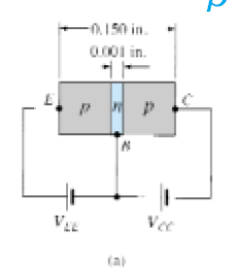
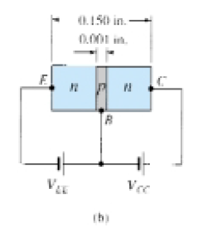

Slide 4
TRANSISTOR OPERATION
The basic operation of the transistor will now be described using the pnp transistor of Fig. 3.2a. The operation of the npn transistor is exactly the same if the roles played by the electron and hole are interchanged. In Fig. 3.3 the pnp transistor has been redrawn without the base-to-collector bias. Note the similarities between this situation and that of the forward-biased diode in Chapter 1. The depletion region has been reduced in width due to the applied bias, resulting in a heavy flow of majority carriers from the p- to the n-type material. Let us now remove the base-to-emitter bias of the pnp transistor of Fig. 3.2a as shown in Fig. 3.4. Consider the similarities between this situation and that of the reverse-biased diode of Section 1.6. Recall that the flow of majority carriers is zero, resulting in only a minority-carrier flow, as indicated in Fig. 3.4. In summary, therefore:
One p-n junction of a transistor is reverse biased, while the other is forward
biased.

Slide 5
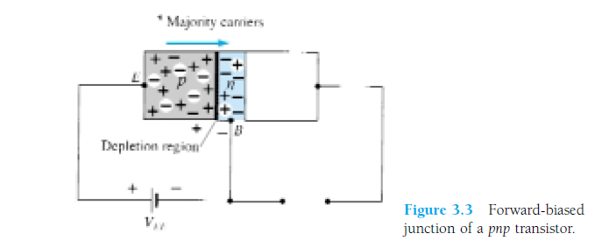
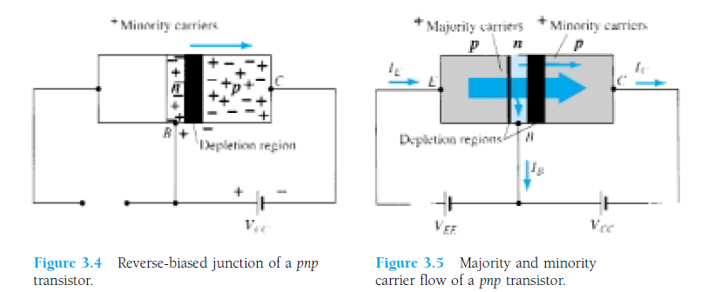

Slide 6
Applying Kirchhoff’s current law to the transistor of Fig. 3.5 as if it were a single node, we obtain
and find that the emitter current is the sum of the collector and base currents. The
collector current, however, is comprised of two components—the majority and minority carriers as indicated in Fig. 3.5. The minority-current component is called the leakage current and is given the symbol ICO (IC current with emitter terminal Open). The collector current, therefore, is determined in total by Eq. (3.2).
For general-purpose transistors, IC is measured in milliamperes, while ICO is measured in microamperes or nanoamperes. ICO, like Is for a reverse-biased diode, is temperature sensitive and must be examined carefully when applications of wide temperature ranges are considered. It can severely affect the stability of a system at high temperature if not considered properly. Improvements in construction techniques have resulted in significantly lower levels of ICO, to the point where its effect can often be ignored.

Slide 7
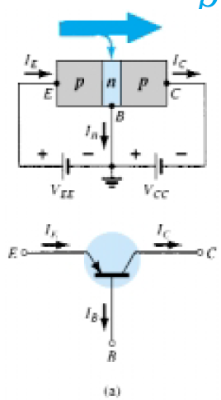
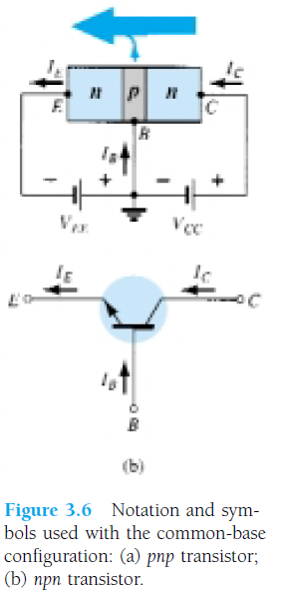
COMMON-BASE CONFIGURATION

Slide 8
All the current directions appearing in Fig. 3.6 are the actual directions as defined
by the choice of conventional flow. Note in each case that IE IC IB. Note also that the applied biasing (voltage sources) are such as to establish current in the direction indicated for each branch. That is, compare the direction of IE to the polarity or VEE for each configuration and the direction of IC to the polarity of VCC. To fully describe the behavior of a three-terminal device such as the common base amplifiers of Fig. 3.6 requires two sets of characteristics—one for the driving point or input parameters and the other for the output side. The input set for the common-base amplifier as shown in Fig. 3.7 will relate an input current (IE) to an input voltage (VBE) for various levels of output voltage (VCB).
The output set will relate an output current (IC) to an output voltage (VCB) for various levels of input current (IE) as shown in Fig. 3.8. The output or collector set of characteristics has three basic regions of interest, as indicated in Fig. 3.8: the active,

Slide 9
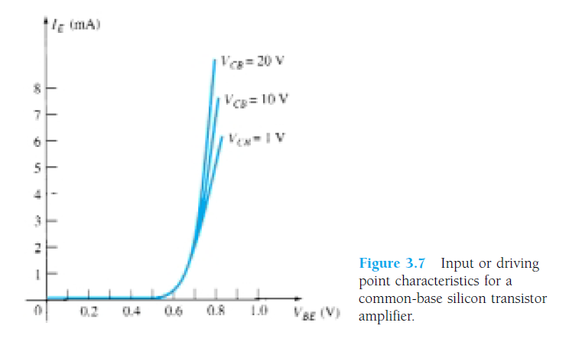

Slide 10
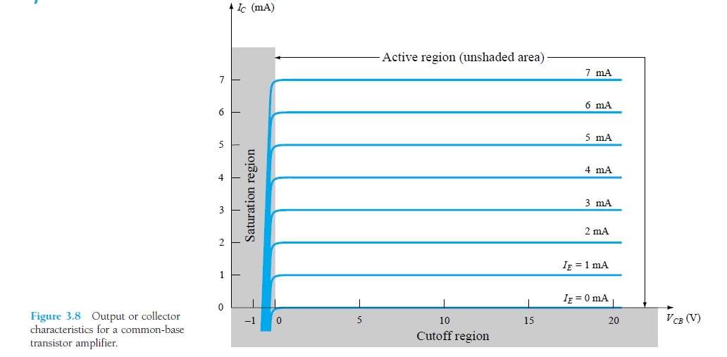

Slide 11
The active region is defined by the biasing arrangements of Fig. 3.6. At the lower end of the active region the emitter current (IE) is zero, the collector current is simply that due to the reverse saturation current ICO, as indicated in Fig. 3.8. The current ICO is so small (microamperes) in magnitude compared to the vertical scale of IC (mill amperes) that it appears on virtually the same horizontal line as IC 0. The circuit conditions that exist when IE 0 for the common-base configuration are shown in Fig. 3.9. The notation most frequently used for ICO on data and specification sheets is, as indicated in Fig. 3.9, ICBO. Because of improved construction techniques, the level of ICBO for general-purpose transistors (especially silicon) in the low- and manpower ranges is usually so low that its effect can be ignored. However, for higher power units ICBO will still appear in the microampere range. In addition, keep in mind that ICBO, like Is, for the diode (both reverse leakage currents) is temperature sensitive. At higher temperatures the effect of ICBO may become an important factor since it increases so rapidly with temperature. Note in Fig. 3.8 that as the emitter current increases above zero, the collector current increases to a magnitude essentially equal to that of the emitter current as determined by the basic transistor-current relations. Note also the almost negligible effect of VCB on the collector current for the active region. The curves clearly indicate that a first approximate on to the relationship between IE and IC in the active region is given by

Slide 12
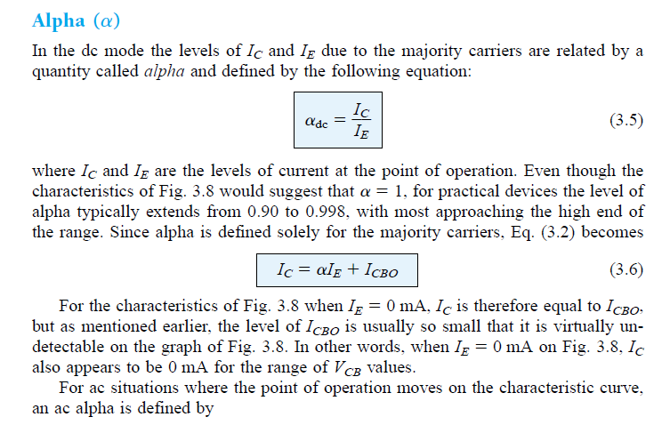

Slide 13
