Slide 1

Fluid Mechanics Lectures
2nd year/2nd semister/2018-2019/Al-Mustansiriyah unv./College of engineering/Highway &Transportation Dep.Lec.1

Slide 2
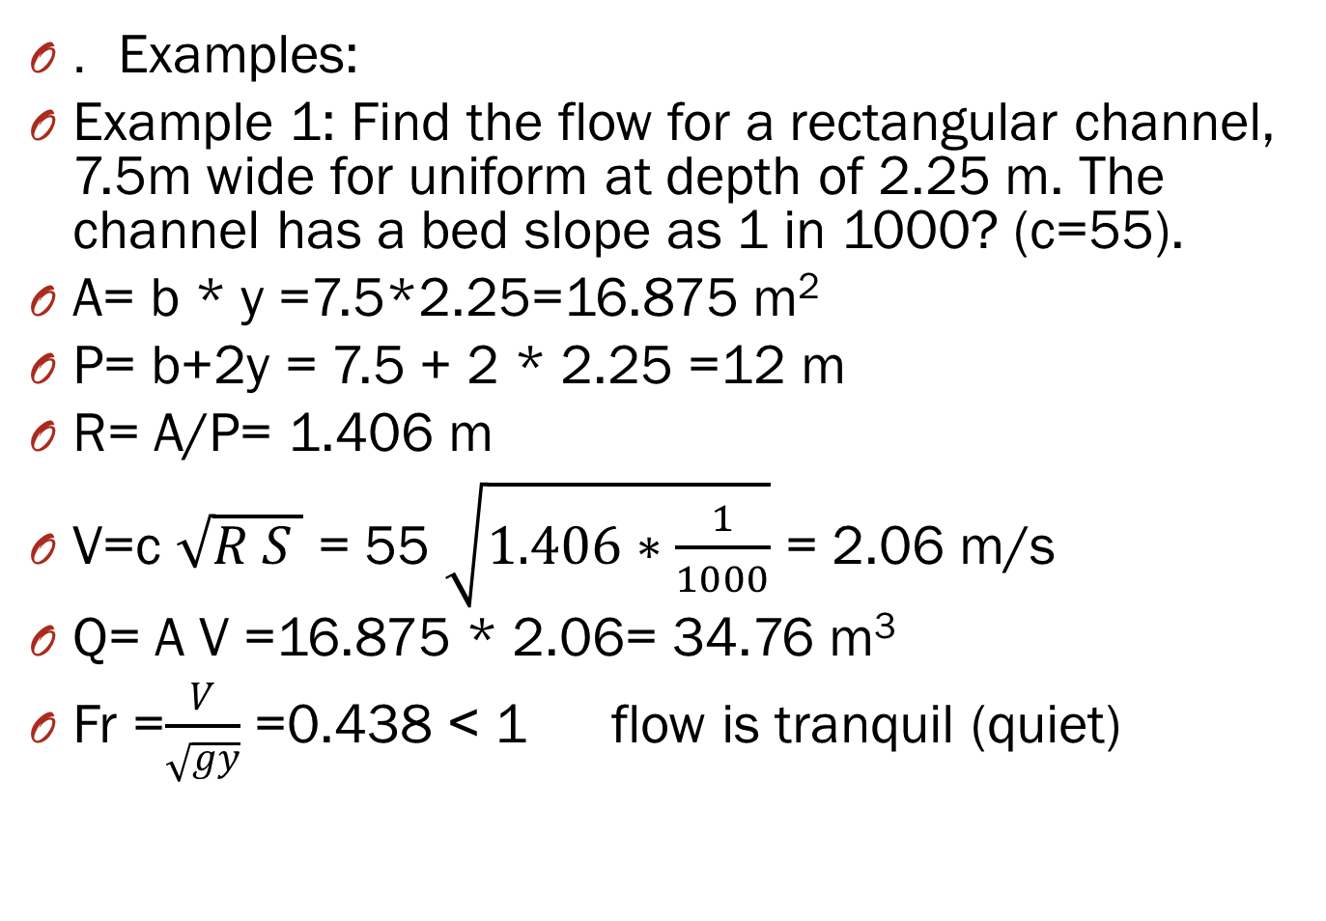
. Examples:
Example 1: Find the flow for a rectangular channel, 7.5m wide for uniform at depth of 2.25 m. The channel has a bed slope as 1 in 1000? (c=55).
A= b * y =7.5*2.25=16.875 m²
P= b+2y = 7.5 + 2 * 2.25 =12 m
R= A/P= 1.406 m
V=c $\sqrt{R S }$ = 55 $\sqrt{1.406∗\frac{1}{1000}}$ = 2.06 m/s
Q= A V =16.875 * 2.06= 34.76 m³
Fr =$\frac{V}{\sqrt{gy}}$ =0.438 ˂ 1 flow is tranquil (quiet)

Slide 3
Non-uniform flow:
1-The change in width, depth and bed slope.
2-An obstruction, constructed across the channel.
.

Slide 4
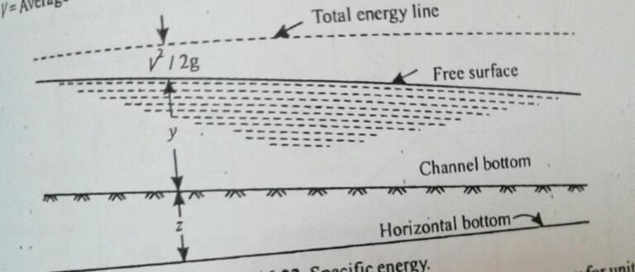
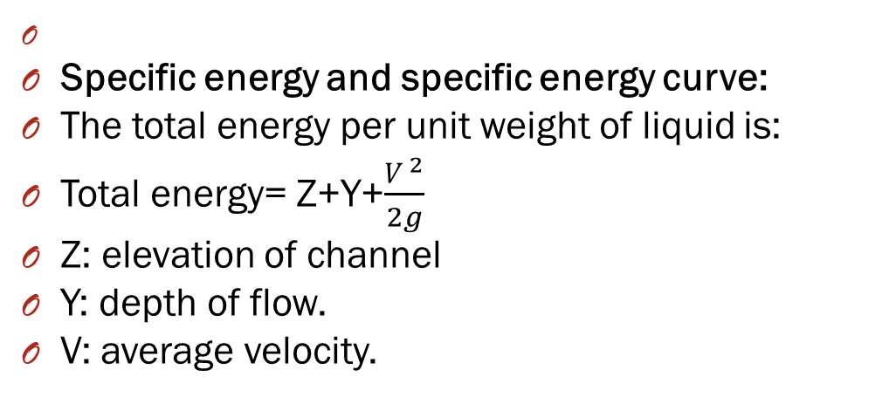
Specific energy and specific energy curve:
The total energy per unit weight of liquid is:
Total energy= Z+Y+$\frac{V ^{2}}{2g}$
Z: elevation of channel
Y: depth of flow.
V: average velocity.

Slide 5
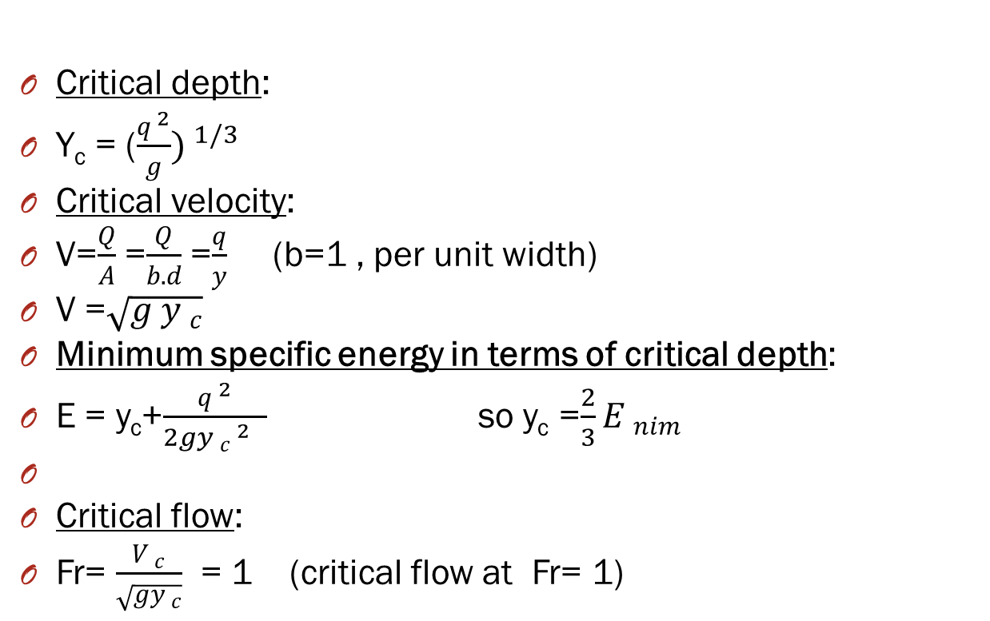
Critical depth:
Y_{c} = ($\frac{q ^{2}}{g}) ^{1/3}$
Critical velocity:
V=$\frac{Q}{A}$ =$\frac{Q}{b.d}$ =$\frac{q}{y}$ (b=1 , per unit width)
V =$\sqrt{g y _{c}}$
Minimum specific energy in terms of critical depth:
E = y_{c}+$\frac{q ^{2}}{2gy _{c} ^{2} _{ }}$ so y_{c} =$\frac{2}{3}E _{nim}$
Critical flow:
Fr= $\frac{V _{c}}{\sqrt{gy _{c}}}$ = 1 (critical flow at Fr= 1)

Slide 6
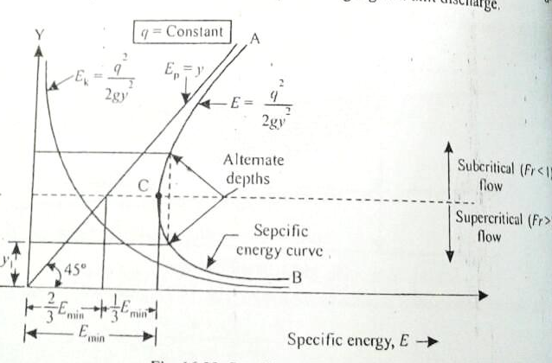
-

Slide 7
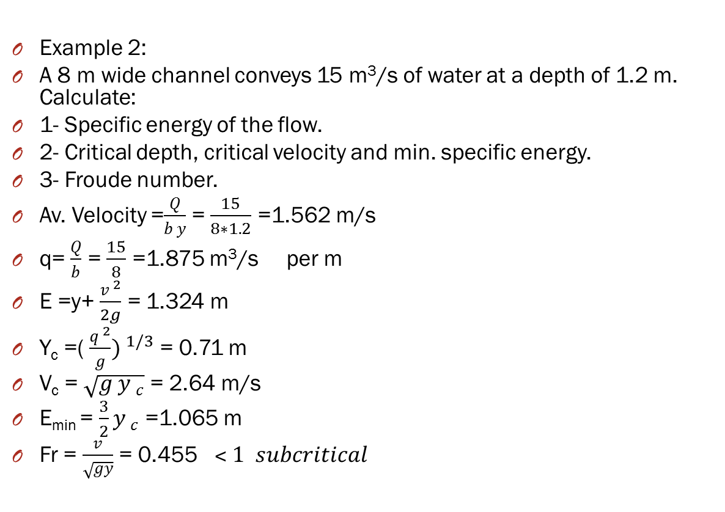
Example 2:
A 8 m wide channel conveys 15 m³/s of water at a depth of 1.2 m. Calculate:
1- Specific energy of the flow.
2- Critical depth, critical velocity and min. specific energy.
3- Froude number.
Av. Velocity =$\frac{Q}{b y}$ = $\frac{15}{8∗1.2}$ =1.562 m/s
q= $\frac{Q}{b}$ = $\frac{15}{8}$ =1.875 m³/s per m
E =y+ $\frac{v ^{2}}{2g}$ = 1.324 m
Y_{c} =( $\frac{q ^{2}}{g}) ^{1/3}$ = 0.71 m
V_{c} = $\sqrt{g y _{c}}$ = 2.64 m/s
E_{min} = $\frac{3}{2}y _{c}$ =1.065 m
Fr = $\frac{v}{\sqrt{gy}}$ = 0.455 $˂ 1 subcritical$

Slide 8
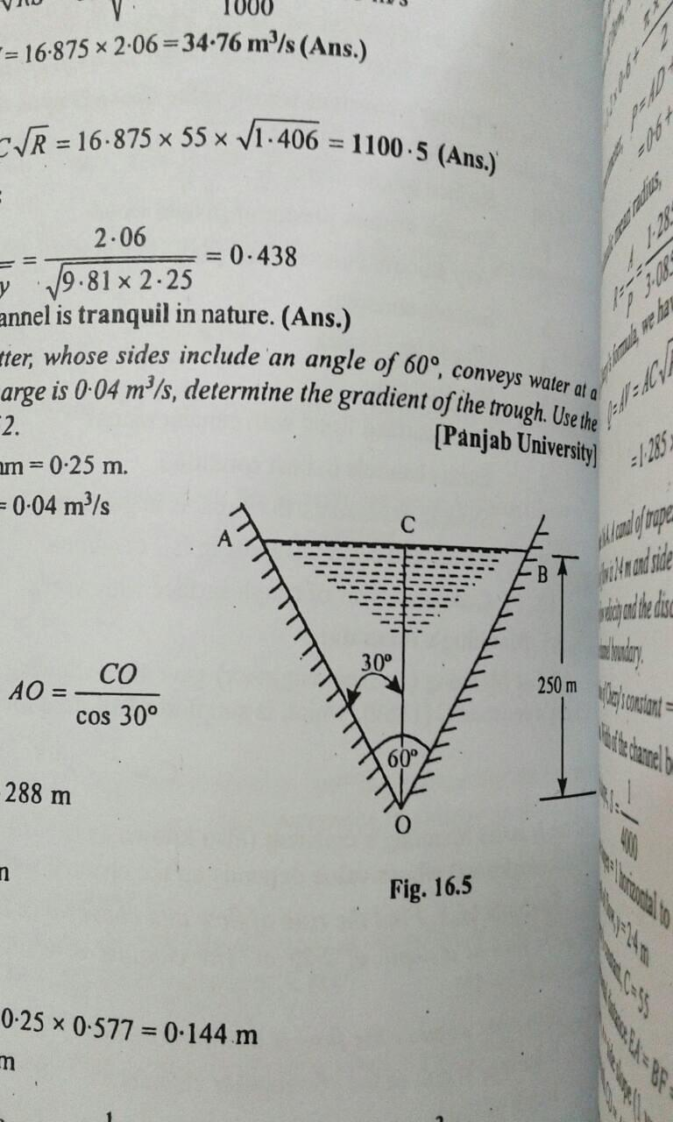
Additional examples:
1-A triangular gutter with side slope at angle 60◦ has a depth 250 mm. If the discharge is 0.04 m³/s. Find the side slope of the gutter?

Slide 9
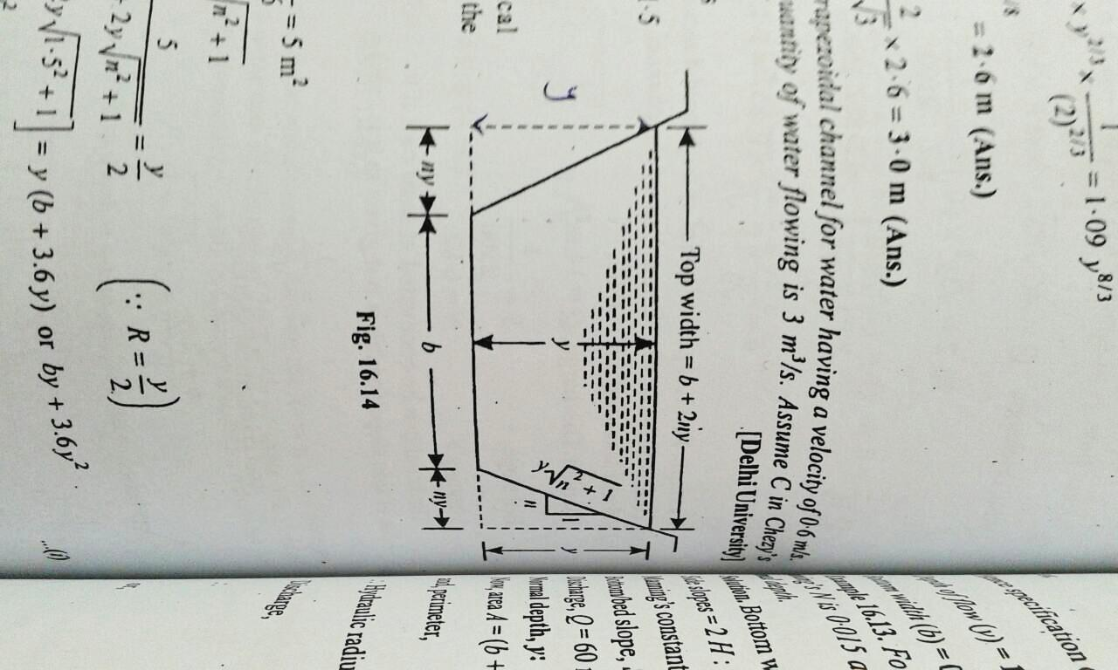
.
2-Design a trapezoidal channel of water having a velocity 0.6 m/s, channel side slope 1:1.5, flow rate 3 m³/s, c=65, hydraulic radius 10 m?
.

Slide 10
.
3-The specific energy for 3 m wide channel is to be 3 Nm/N . What would be the maximum possible discharge?

Slide 11

Thanks

