Slide 1

Fluid Mechanics Lectures
2nd year/2nd semister/2018-2019/Al-Mustansiriyah unv./College of engineering/Highway &Transportation Dep.Lec.1

Slide 2
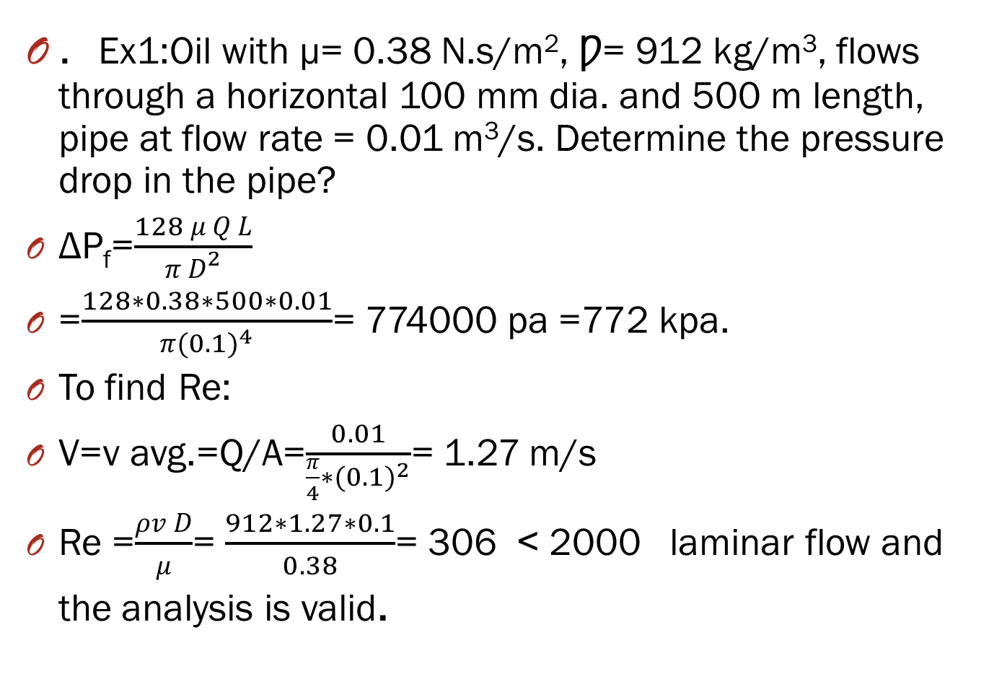
. Ex1:Oil with µ= 0.38 N.s/m², Ƿ= 912 kg/m³, flows through a horizontal 100 mm dia. and 500 m length, pipe at flow rate = 0.01 m³/s. Determine the pressure drop in the pipe?
ΔP_{f}=$\frac{128 μ Q L}{π D^{2}}$
=$\frac{128∗0.38∗500∗0.01}{π({0.1)}^{4}}$= 774000 pa =772 kpa.
To find Re:
V=v avg.=Q/A=$\frac{0.01}{\frac{π}{4}∗{(0.1)}^{2}}$= 1.27 m/s
Re =$\frac{ρv D}{μ}$= $\frac{912∗1.27∗0.1}{0.38}$= 306 ˂ 2000 laminar flow and the analysis is valid.

Slide 3
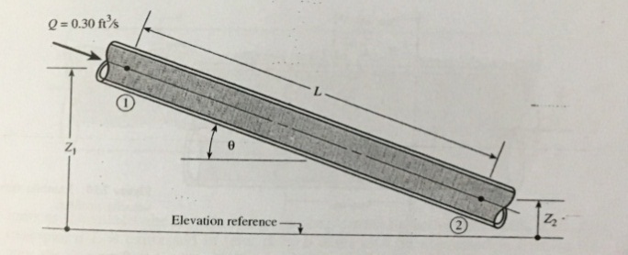
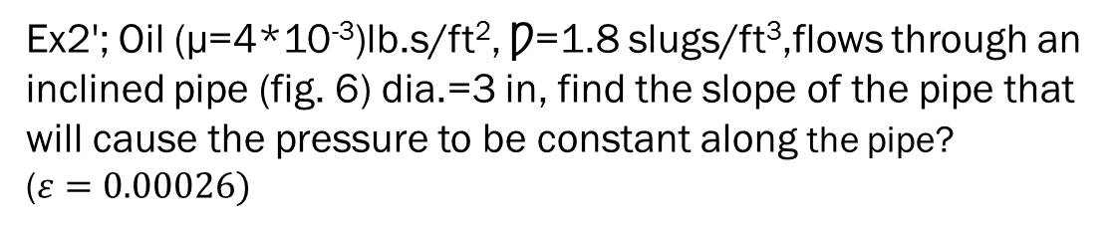

Ex2'; Oil (µ=4*10⁻³)lb.s/ft², Ƿ=1.8 slugs/ft³,flows through an inclined pipe (fig. 6) dia.=3 in, find the slope of the pipe that will cause the pressure to be constant along the pipe? ($ε=0.00026)$
.
Z₁+$\frac{v _{1} ^{2}}{2g}+\frac{P _{1}}{γ}$ ₋ $\frac{32 μ v L}{γ D^{2}}$= Z₂ +$\frac{v{ _{2}}^{2}}{2g}+\frac{P _{2}}{γ}$
P1= p2 and v1=v2
$\frac{Z1−Z2}{L}$ = $\frac{32 μ v L}{γ D^{2}}$=$\frac{32 μv}{ρgD ^{2}}$
v=vavg.=Q/A=$\frac{0.3}{\frac{π}{4}(\frac{3}{12}) ^{2}}$ =6.11 ft/s
sin$θ=\frac{Z1−Z2}{L}$
sin$θ$= $\frac{32 μv}{ρgD ^{2}}$=$\frac{(32)(4∗10 ^{−3})(6.11)}{1.8∗32.2∗(\frac{3}{12})}=0.216 ft/ft$
$$θ=12.5°$$
Re=$\frac{6.11∗\left(\frac{3}{12}\right)∗1.8}{4∗10 ^{−3}}$ = 687 ˂ 2000 laminar flow

Slide 4
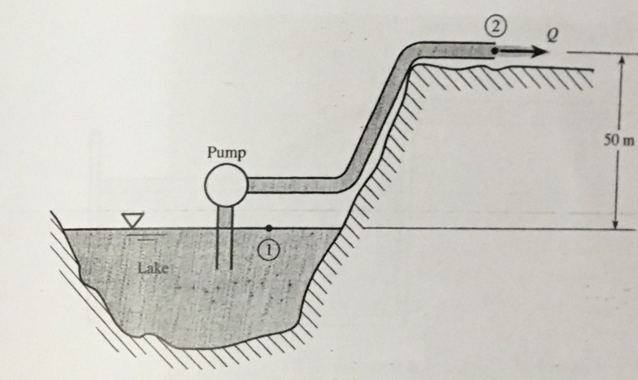
Ex3: The pump (fig.7) delivers 0.03 m³/s water from lake to the top of a hill. The cast iron pipe has a diameter of 80 mm and a length of 200 m , find the required power the pump must be deliver to the water?

Slide 5
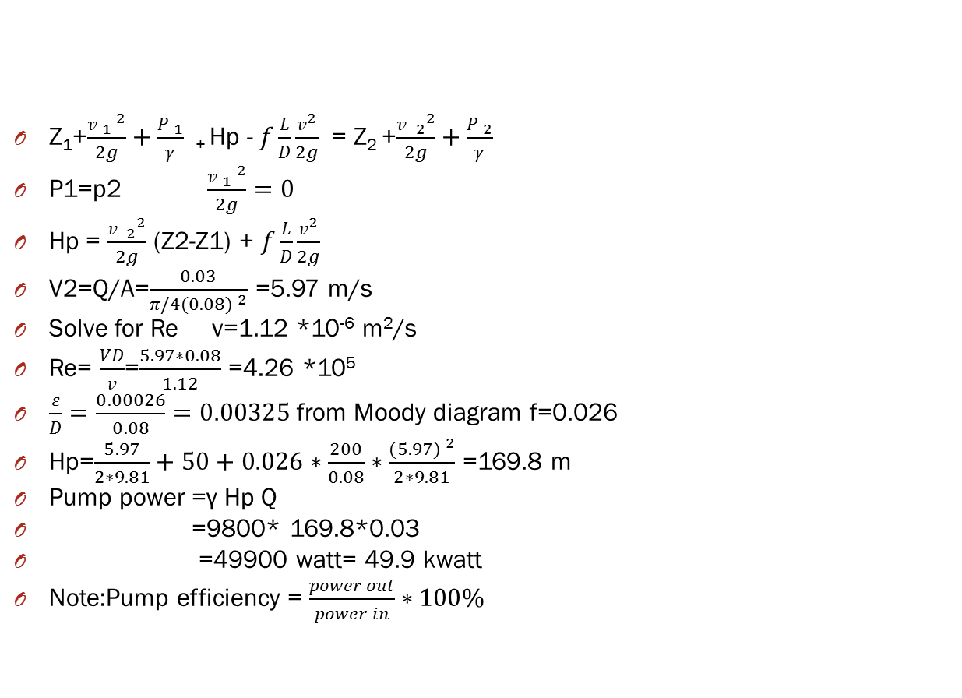
Z₁+$\frac{v _{1} ^{2}}{2g}+\frac{P _{1}}{γ}$ ₊ Hp - $f\frac{L}{D}\frac{v^{2}}{2g}$ = Z₂ +$\frac{v{ _{2}}^{2}}{2g}+\frac{P _{2}}{γ}$
P1=p2 $\frac{v _{1} ^{2}}{2g}=0$
Hp = $\frac{v{ _{2}}^{2}}{2g}$ (Z2-Z1) + $f\frac{L}{D}\frac{v^{2}}{2g}$
V2=Q/A=$\frac{0.03}{π/4(0.08) ^{2}}$ =5.97 m/s
Solve for Re v=1.12 *10⁻⁶ m²/s
Re= $\frac{VD}{v}$=$\frac{5.97∗0.08}{1.12}$ =4.26 *10⁵
$\frac{ε}{D}=\frac{0.00026}{0.08}=0.00325$from Moody diagram f=0.026
Hp=$\frac{5.97}{2∗9.81}+50+0.026∗\frac{200}{0.08}∗\frac{(5.97) ^{2}}{2∗9.81}$ =169.8 m
Pump power =γ Hp Q
=9800* 169.8*0.03
=49900 watt= 49.9 kwatt
Note:Pump efficiency = $\frac{power out}{power in}∗100\%$

Slide 6
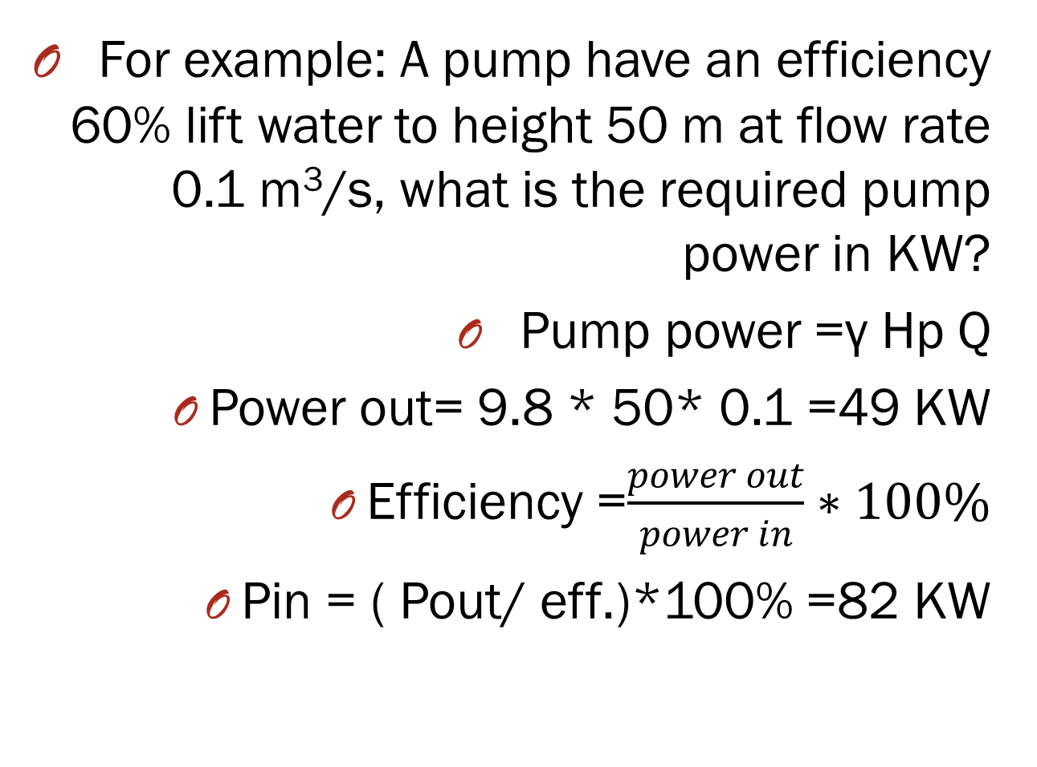
For example: A pump have an efficiency 60% lift water to height 50 m at flow rate 0.1 m³/s, what is the required pump power in KW?
Pump power =γ Hp Q
Power out= 9.8 * 50* 0.1 =49 KW
Efficiency =$\frac{power out}{power in}∗100\%$
Pin = ( Pout/ eff.)*100% =82 KW
-

Slide 7
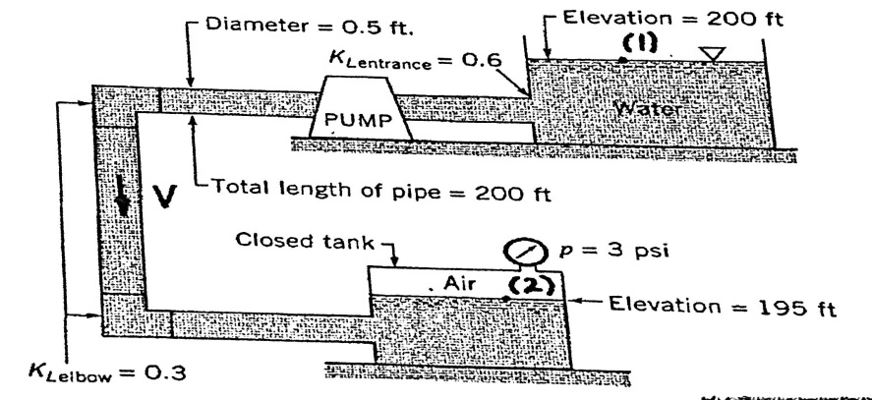
Ex4: The pump (fig.) add a 15 ft head to water being pumped when the flow rate is 1.5 ft³/s. Determine the friction factor for the pipe?

Slide 8
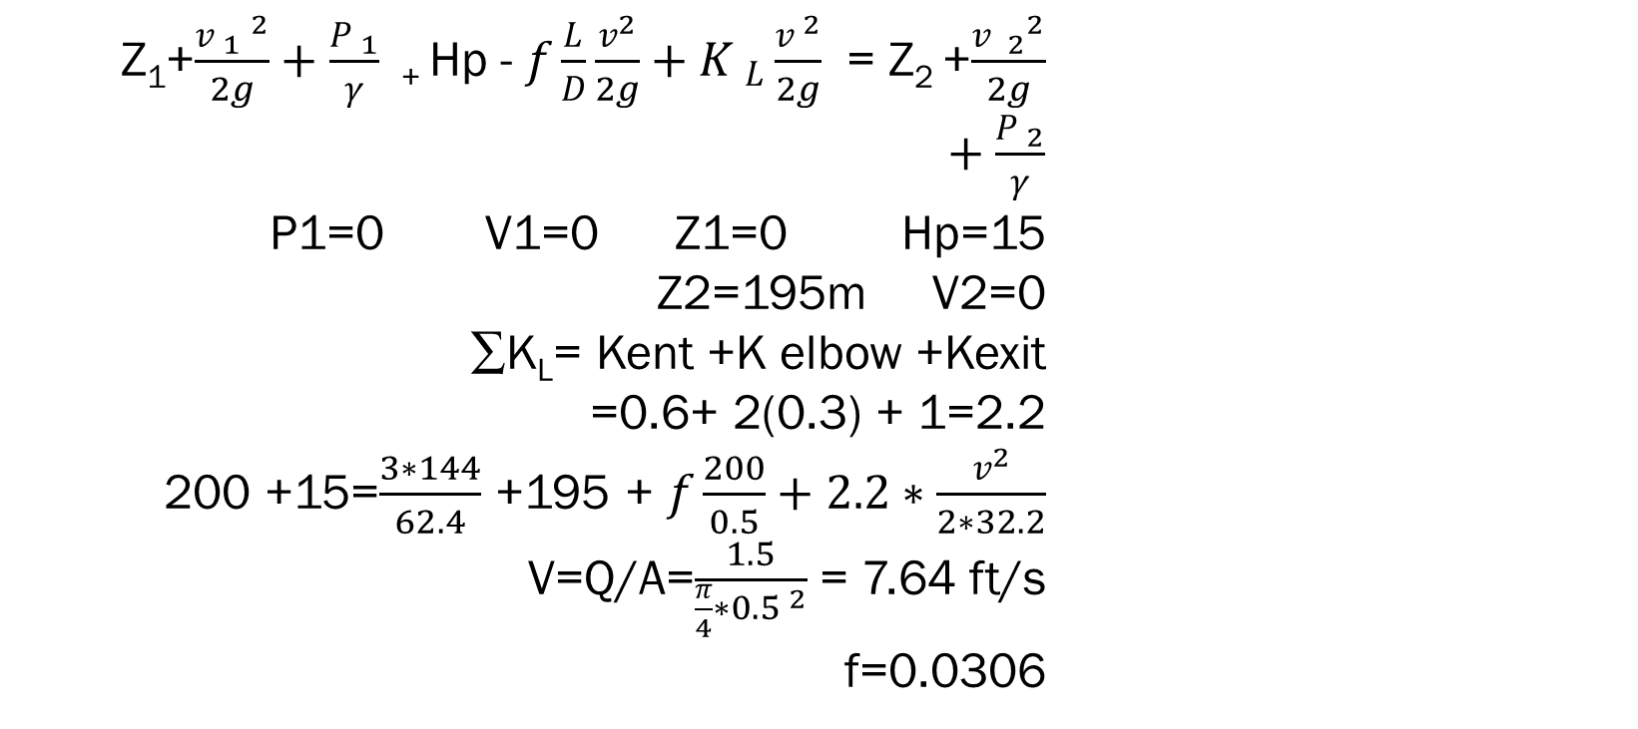
Z₁+$\frac{v _{1} ^{2}}{2g}+\frac{P _{1}}{γ}$ ₊ Hp - $f\frac{L}{D}\frac{v^{2}}{2g}+K _{L}\frac{v ^{2}}{2g}$ = Z₂ +$\frac{v{ _{2}}^{2}}{2g}+\frac{P _{2}}{γ}$
P1=0 V1=0 Z1=0 Hp=15 Z2=195m V2=0
∑K_{L}= Kent +K elbow +Kexit
=0.6+ 2(0.3) + 1=2.2
200 +15=$\frac{3∗144}{62.4}$ +195 + $f\frac{200}{0.5}+2.2∗\frac{v^{2}}{2∗32.2}$
V=Q/A=$\frac{1.5}{\frac{π}{4}∗0.5 ^{2}}$ = 7.64 ft/s f=0.0306

Slide 9
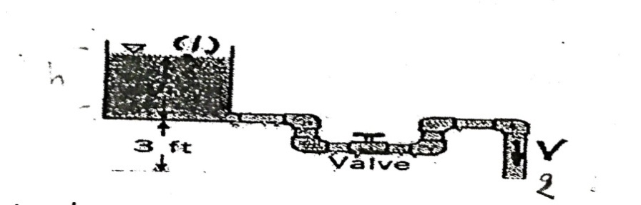
.
Ex5: When water flows from the tank shown if fig.9, find the water velocity if the water depth in tank is h= 1.5 ft , the total length of 0.6 in dia. pipe is 20 ft, and the friction factor is 0.03. The loss coefficients are 0.5 for entrance, 1.5 for each elbow and 10 for valve?
.

Slide 10

.
Z₁+$\frac{v _{1} ^{2}}{2g}+\frac{P _{1}}{γ}$ ₊ HL = Z₂ +$\frac{v{ _{2}}^{2}}{2g}+\frac{P _{2}}{γ}$
P1=P2 Z1=0 Z2=3 ft+h V1=0 V2=V AND
H_{L}=$f\frac{L}{D}\frac{v^{2}}{2g}+K _{L}\frac{v ^{2}}{2g}$
Z1=4.5 ft
4.5 = (0.3 $\frac{20}{0.6/12}+18+1)$ $\frac{v^{2}}{2∗32.2}$
V=3.06 ft/s Q=AV= $\frac{π}{4}(\frac{0.6}{12}) ^{2}(3.06)$ = 0.00601 ft ³/s

Slide 11

Thanks

