Slide 1
Fluid Mechanics Lectures 2nd year/2nd semister/2018-2019/Al-Mustansiriyah unv./College of engineering/Highway &Transportation Dep.Lec.1

Slide 2
. Ex3:A nozzle with an exit diameter of 1 in is attached to the end of 4 in dia. Horizontal pipi. (fig.5) water flows through the pipe and nozzle at a flow rate of 200 gpm, if the nozzle jet exits into the atmosphere , find the force exerted on the nozzle due to the water on the inside and the atmosphere air on the outside?

Slide 3
P1A1-P2A2-Fx=ǷQ(v2-v1)
Q1=Q2=200*231*$\frac{1}{1728}$ $\frac{1}{60}$=0.446 ft³/s
V1=Q1/A1=$\frac{0.446}{π/4(\frac{4}{12}) ^{2}}$=5.11 ft/s
V2=Q2/A2=$\frac{0.446}{π/4(\frac{1}{12}) ^{2}}$=81.8 ft/s
To find P1 Z₁+$\frac{v _{1} ^{2}}{2g}+\frac{P _{1}}{γ}$ = Z₂ +$\frac{v{ _{2}}^{2}}{2g}+\frac{P _{2}}{γ}$
0+$\frac{5.11 ^{2}}{2∗32.2}+\frac{P _{1}}{62.4}$ = 0+$\frac{81.8}{232.2}+0$
P1=6460 lb/ft²
P1 in momentum equation: 6460*$\frac{π}{4}(\frac{4}{12}) ^{2}$-0-Fx=1.94 *0.446*(81.8-5.11)
Fx=431 lb
.

Slide 4
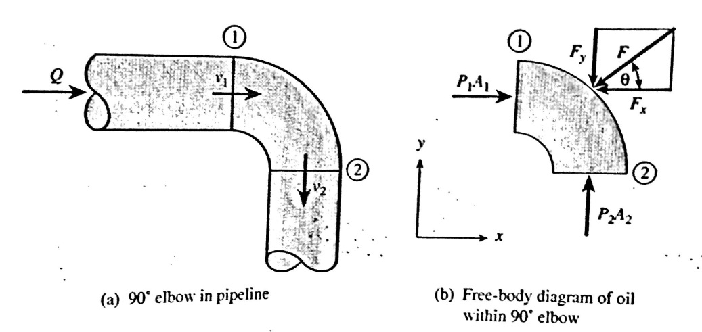
Ex: Oil (Sg=0.9) flows at rate of 0.05 m³/s through 100 mm dia (fig.5). horizontal 90 elbow connected in a pipeline as shown in fig.6 , if the pressure at sec. 1 is 200 kpa gage, find the fluid force acting on the elbow?

Slide 5
P1A1-Fx=ǷQ(0-v1)=-ǷQv1
P2A2-Fy=ǷQ(-v2-0)=-ǷQv2
V1=v2=Q/A=$\frac{0.05}{\frac{π}{4}∗0.1}$=6.37 m/s
Z₁+$\frac{v _{1} ^{2}}{2g}+\frac{P _{1}}{γ}$ = Z₂ +$\frac{v{ _{2}}^{2}}{2g}+\frac{P _{2}}{γ}$
Then 200000 *π/4-Fx= -1000*0.05*6.37
1570 –Fx=- 319 Fx=1889 N
1570-Fy=-319N Fy= 1889 N
F=$\sqrt{1889 _{ } ^{2 _{ }}+1889 ^{2}}$= 2671 N.

Slide 6
Thanks

