Slide 1

Fluid Mechanics Lectures
2nd year/2nd semister/2018-2019/Al-Mustansiriyah unv./College of engineering/Highway &Transportation Dep.Lec.5

Slide 2
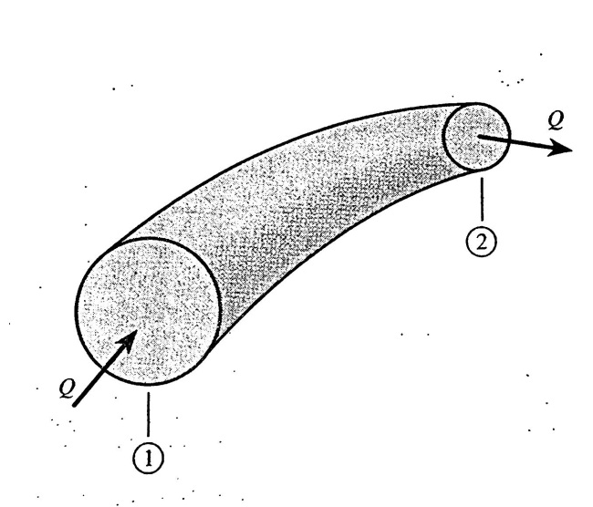
The momentum equation
It is defined as the product of the mass and the velocity of a moving body. Thus since velocity is vector quantity , the momentum of a body changes if either the magnitude or direction of its velocity changes. A net force must be applied to a body to change its momentum. This momentum principle can also be applied to a fluid moving through an arbitrary passageway, as shown in fig.1

Slide 3

.
The mass m of fluid within the passageway is equal to the product of the mass flow rate ǷQ and the time interval Δt:
m= (ǷQ) Δt
F=m*a=(ǷQ) Δt*a
F=(ǷQ) Δt*$\frac{∆v}{∆t}$
F=ǷQ(v2-v1)
F_{x}=ǷQ(v_{2x}-v_{1x})
F_{y}=ǷQ(v_{2y}-v_{1y})
F_{z}=ǷQ(v_{2z}-v_{1z})

Slide 4
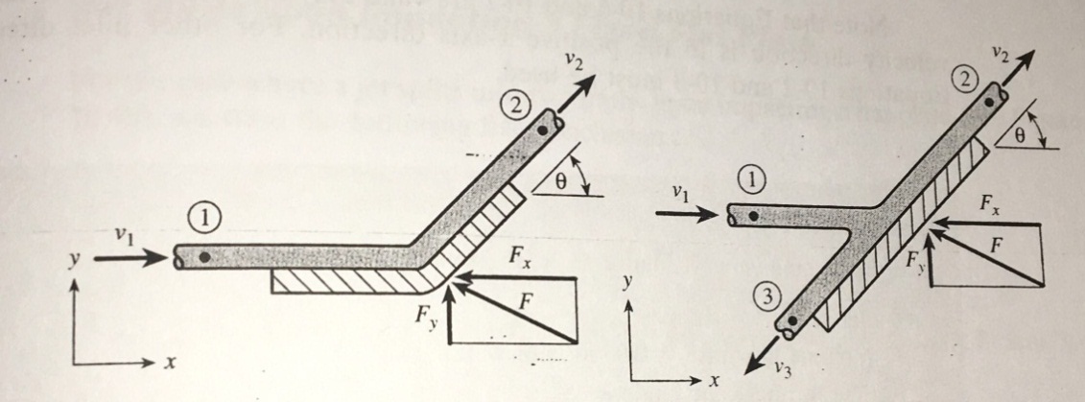
.
In fig., a free jet of fluid of cross section area A enters a fixed turning vane, since the direction of the jet velocity is changed, the jet exerts a force F on the van and the van is held in place via a support mechanism that allows the van to exert an equal force but opposite on the jet.

Slide 5
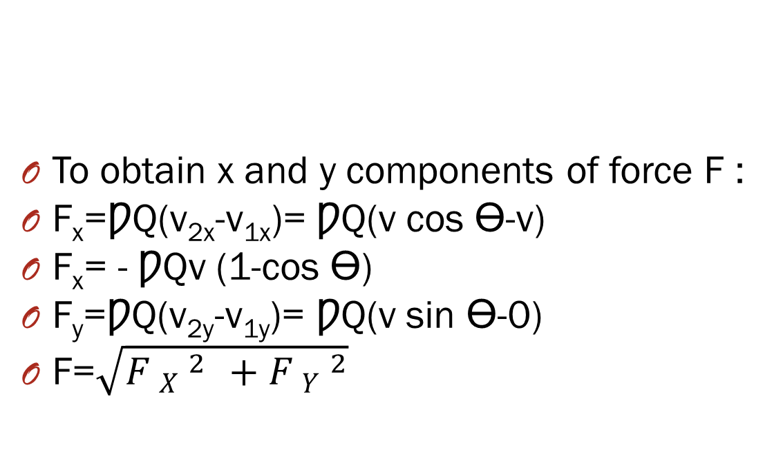
To obtain x and y components of force F :
F_{x}=ǷQ(v_{2x}-v_{1x})= ǷQ(v cos ϴ-v)
F_{x}= - ǷQv (1-cos ϴ)
F_{y}=ǷQ(v_{2y}-v_{1y})= ǷQ(v sin ϴ-0)
F=$\sqrt{F _{X} ^{2 _{ }}+F _{Y} ^{2}}$

Slide 6

)
Ex1: for the turning vane of fig.2, the following data are given: Jet velocity=10m/s, volume of flow=0.05m³/s, ϴ=45◦. Find the total force acting on the vane?
F_{x}= - ǷQv (1-cos ϴ)
=-1000*0.05*10(1-cos 45)= -147 N
F_{y}= ǷQ(v sin ϴ)
1000*0.05*10 sin 45=354 N
F=$\sqrt{F _{X} ^{2 _{ }}+F _{Y} ^{2}}$= 383 N.
-

Slide 7
.
Ex2:
For the system in fig.3, a jet of oil Sg=0.9, flows at a rate of 100 gpm from a horizontal nozzle having a 1 in dia., if the plate is inclined from the horizontal by an angle 45, fine the total force acting on the plate and floe rate up and down the surface of the plate?

Slide 8
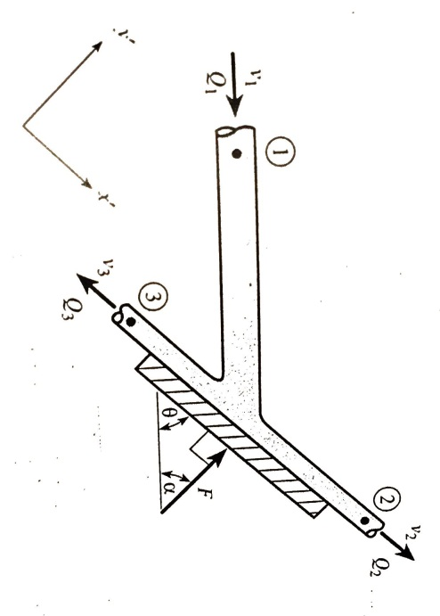
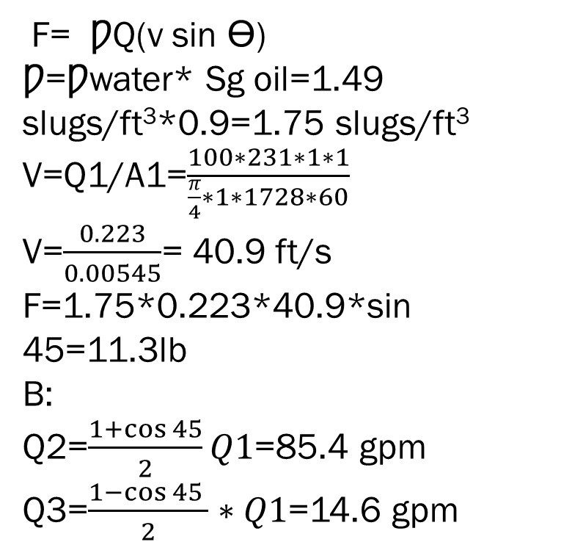
F= ǷQ(v sin ϴ)
Ƿ=Ƿwater* Sg oil=1.49 slugs/ft³*0.9=1.75 slugs/ft³
V=Q1/A1=$\frac{100∗231∗1∗1}{\frac{π}{4}∗1∗1728∗60}$
V=$\frac{0.223}{0.00545}$= 40.9 ft/s
F=1.75*0.223*40.9*sin 45=11.3lb
B:
Q2=$\frac{1+\cos{45}}{2}Q1$=85.4 gpm
Q3=$\frac{1−\cos{45 }}{2}∗Q1$=14.6 gpm

Slide 9
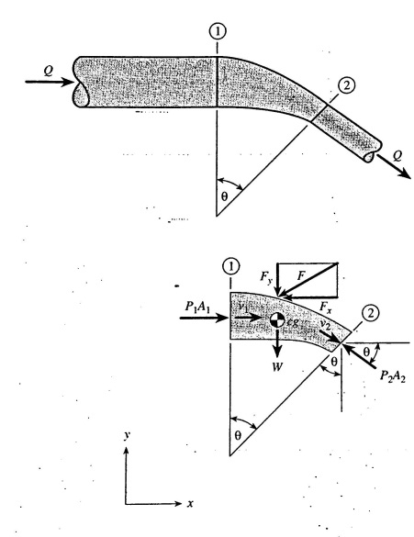
Flows through bends and nozzles in pipeline:
Fig., shows a pipeline containing a reducer type bend , here there is a change in velocity direction and magnitude due to reduction in pipe diameter, and tere is a change in pressure, from fig,:
P1A1- P2A2 cos ϴ -Fx =ǷQ(v2cos ϴ- v1)
P1A1 sin ϴ- W –Fy= ǷQ(-v2sin ϴ)

Slide 10

Thanks

