Slide 1
Fluid Mechanics Lectures 2nd year/2nd semister/2018-2019/Al-Mustansiriyah unv./College of engineering/Highway &Transportation Dep.Lec.4

Slide 2
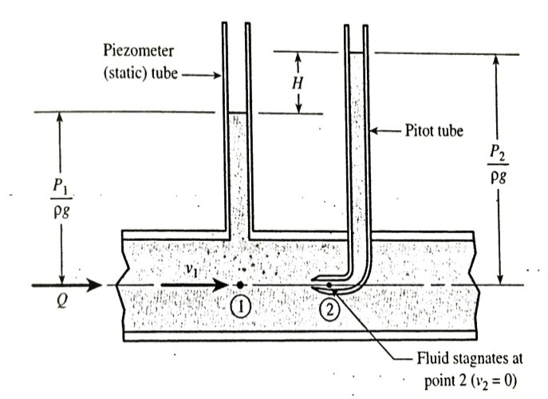
The pitot-static tube:
Fig., shows a pitot tube installed in a pipeline along with piezometer , both are pressure measuring device. Unlike, piezometer , pitot continues inward toward the centerline of the pipe. As a result the fluid that inters the inside of the pitot tube comes to a stop (stagnates), in contrast the piezometer tube allows the fluid to travel past without any change of velocity.
.
Z₁+$\frac{v _{1} ^{2}}{2g}+\frac{P _{1}}{γ}$ = Z₂ +$\frac{v{ _{2}}^{2}}{2g}+\frac{P _{2}}{γ}$
Z1=Z2 and v2=0 (stagnation point)
H=$\frac{v _{1} ^{2}}{2g}$

Slide 3
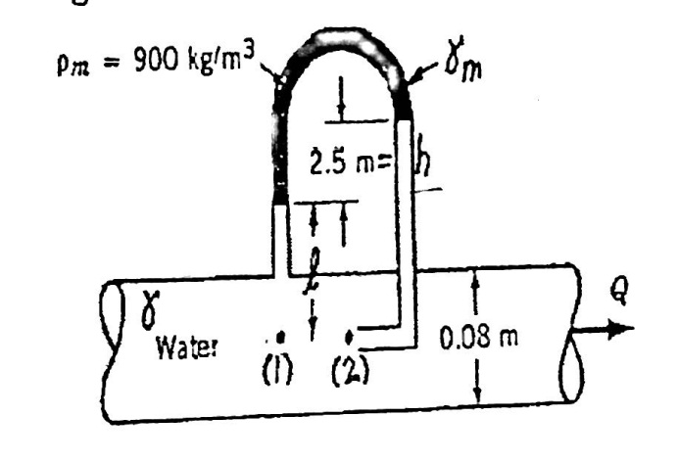
Ex:
Determine the flow rate through the pipe?
.
Z1=Z2 v2=0
$\frac{v _{1} ^{2}}{2g}+\frac{P _{1}}{γ}$ = $\frac{P _{2}}{γ}$
V1=$\sqrt{\frac{2g (P2−P1)}{γ}}$
P1-γ L-γ _{m}h+γ(L+h)=P2
So v1= $\sqrt{\frac{2g \left(1−\frac{γm}{γ}\right)h}{ }}$
=(2(9.81)(1-900/999)(2.5))^{0.5}
=2.2m/s
Q=A1V1=$\frac{π}{4}$(0.08)² (2.2)=0.0111 m³/s.

Slide 4
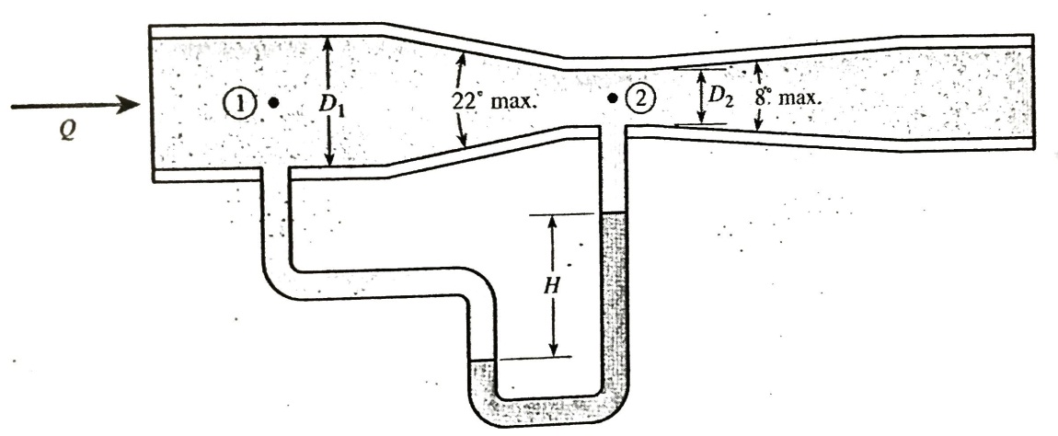
Verturi, nozzle and orifice flow meters:
Three additional used flow meters measuring that operate on the principles of Bernoullis eq. , venture, nozzle and orifice flow meters. They based on the principle that as the velocity of flow increases, a drop in pressure occurred. The measurement of the pressure drop can be used to indicate the flow rate.
Fig. , shows the venturi meter, it is installed to the pipeline whose flow rate is measured , venture meter consist of a converging section followed by a constant diameter section (throat) followed by a diverging section.

Slide 5
Z₁+$\frac{v _{1} ^{2}}{2g}+\frac{P _{1}}{γ}$ = Z₂ +$\frac{v{ _{2}}^{2}}{2g}+\frac{P _{2}}{γ}$
Z1=Z2
A1v1=A2v2
So $Cv ideal=\sqrt{\frac{2(P1−P2)}{ρ( 1−\left(\frac{A2}{A1}\right) ^{2 })}}$
To calculate the flow coefficient Cv=$\frac{V2 actual}{V2 ideal}$
Q=v2 actual A2= Cv ideal A2
Q=$Cv A2\sqrt{\frac{2(P1−P2)}{ρ( 1−\left(\frac{A2}{A1}\right) ^{2 })}}$=$Cv A2\sqrt{\frac{2(P1−P2)}{ρ( 1−\left(\frac{D2}{D1}\right) ^{2 })}}$

Slide 6
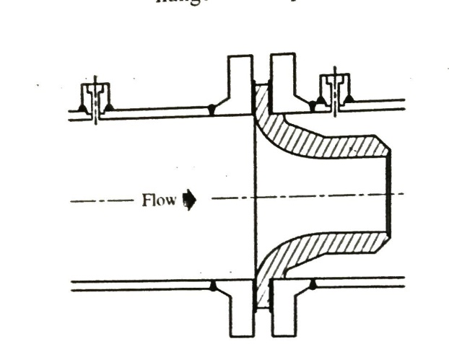
Fig., shows the nozzle meter contain a nozzle has a flange on its upstream face
-
Q=$Cn A2\sqrt{\frac{2(P1−P2)}{ρ( 1−\left(\frac{D2}{D1}\right) ^{2 })}}$ Cn discharge coefficient.

Slide 7
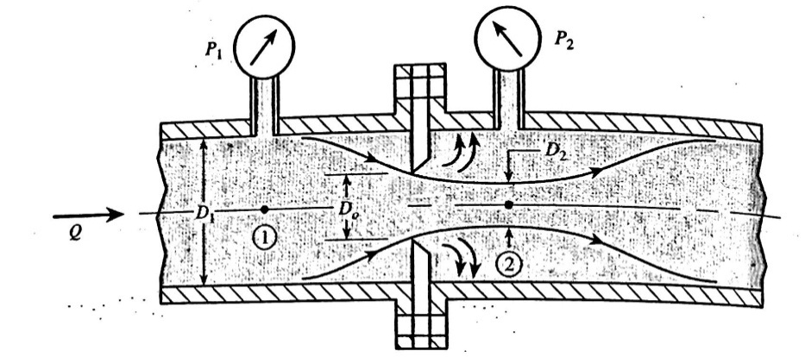
Fig., shows the orifice meter it is a simple flow meter consist of a circular plate containing a sharp edge , the upstream fluid approach the orifice it must turn inward to inter the orifice. The fluid jet cannot immediately change directions as its flow, thus the jet area continues to contract until its minimum value is obtained downstream :
Q=$C0 A0\sqrt{\frac{2(P1−P2)}{ρ( 1−\left(\frac{D0}{D1}\right) ^{2 })}}$ A0:area of the hole in the orifice plate.

Slide 8
.
Ex:
Venture meter of fig.11, has the following data:D1 3in, D20.75 in, Cv 0.98, fluid in manometer is mercury, P2-P1=10 psi, H=20 in Hg, find the flow rate in gallons per minute ?
Q=$Cv A2\sqrt{\frac{2(P1−P2)}{ρ( 1−\left(\frac{A2}{A1}\right) ^{2 })}}$
A2=$\frac{π}{4}$($\frac{0.75}{12}) ^{2}$=0.00307 ft²
Ƿwater =1.94 slugs/ft³
P1-P2=10*144=1440 lb/ft²
$\left(\frac{A2}{A1}\right) ^{2 }$=$(\frac{0.75}{3}) ^{4}$=0.00391
Q=0.98* 0.00307*$\sqrt{\frac{2∗1440}{1.94(1−0.00391)}}$=0.116 ft³/s
Q= 0.116*1728*$\frac{1}{231}$*60=52.1 gpm
P2-P1 =H(γHg- γwater)=20*1/12*(847-62.4)=1308 ib/ft²
Q $∝\sqrt{P1−P2}$ Q=52.1 *$\sqrt{\frac{1308}{1440}}$= 49.7 gpm .

Slide 9
Thanks

