Slide 1
Fluid Mechanics Lectures 2nd year/2nd semister/2018-2019/Al-Mustansiriyah unv./College of engineering/Highway &Transportation Dep.Lec.3

Slide 2
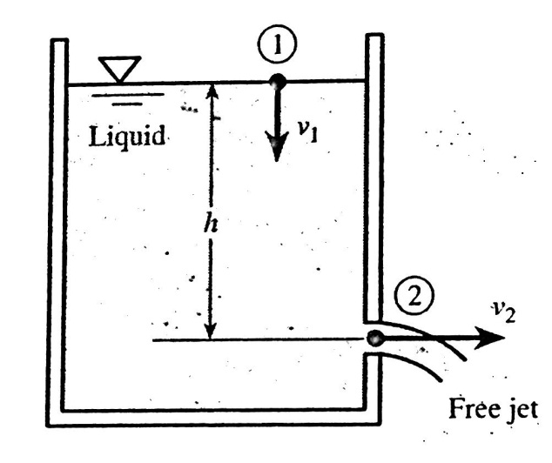
. Torricillis theorem:
The velocity of free jet of fluid is equal to:
V=$\sqrt{2gh}$
Because:
1-P1=P2 atmosphere pressure
2-v1 negligible cross sec. A1 very large compared with A2 so
v1=$\frac{A2}{A1}$ v2 (very small number)
3-Z2 can be taken as a zero number.

Slide 3
EX:for the system in fig.5, 198 h=36 ft and diameter of side opening is 2 in find the jet velocity and the volume flow rate in gpm?
V2=$\sqrt{2gh}$
=$\sqrt{ 2∗32.2∗36 }$=48.3 ft/s
Q=A2v2=$\frac{π}{4}$ (2)²*48.3*12*$\frac{1}{231 in ^{3}}$*60
=473gpm

Slide 4
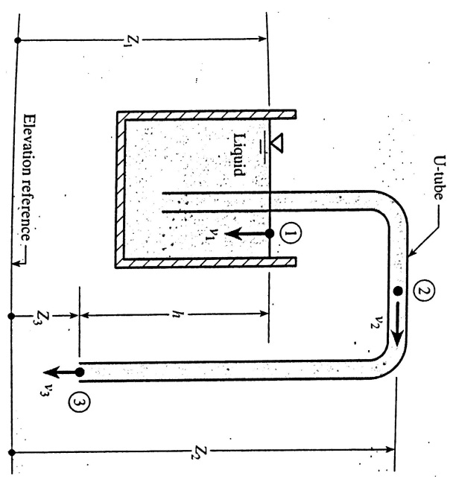
The siphon:
It is a device that is used to cause a liquid to flow from one container in an upward direction downward in to a second . as shown in fig.6,
Point 1 lies in the free surface in the container.
Point 2 lies in the U-tube at its highest elevation.
Point 3 lies in the U-tube at the lowest elevation
The output at 3 is a free jet.
If we apply Bernoullis eq. for pointe 1 &3
P1=P3, v1$≈0$ , Z1-Z3=h, so
V3=$\sqrt{2gh}$
So Q3 =A3v3
P2=γ(Z1-Z2)+γ(-v²₂/2g)

Slide 5
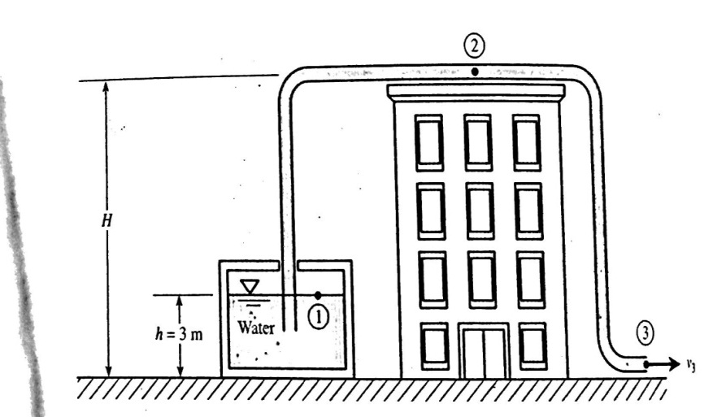
EX:
Water is siphoned from a large storage tank through 50 mm diameter hose(fig.7). Find the maximum height H of a building over which the water can be siphoned?
V3=$\sqrt{2gh}$
V3=$\sqrt{ 2∗9.8∗3}$ =7.67 m/s
V2=v3
P2=γ (Z1-Z2)-γ (v²₂/2g)
2.34-101) KPa =9800 N/m³(3-H)-9800*$\frac{7.67}{2∗9.81}$
-98700=29400 – 9800 H -29380
H=10.1 m

Slide 6
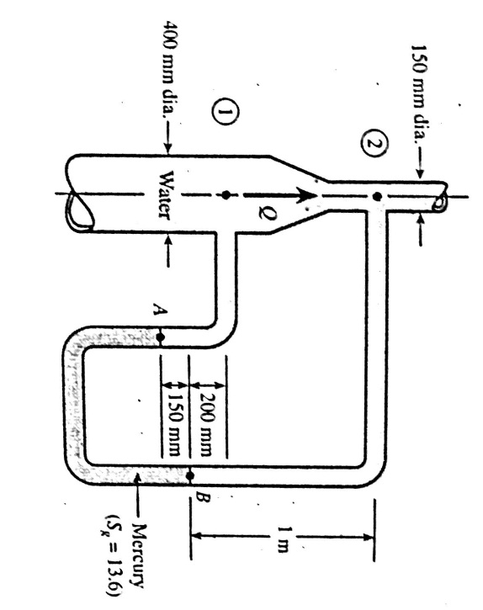
Ex: Water is flowing upward through the pipeline (fig.8) ,a manometer measures the pressure difference p1-p1. Find the volume of flow rate?
-

Slide 7
P_{B}=P₂+9800*1=P₂+9800
Pa=Pb+9800*13.6*0.15
Pa=Pb +20000P=P2+29800
P1=Pa-3430=P2+ 26370
P1-P2=26370 pa
Z₁+$\frac{v _{1} ^{2}}{2g}+\frac{P _{1}}{γ}$ = Z₂ +$\frac{v{ _{2}}^{2}}{2g}+\frac{P _{2}}{γ}$
A1v1=A2v2
V2=A1v1/A2
=$(\frac{400}{150}) ^{2}$*v1=7.11 v1
$\frac{v ^{2 _{2}}−v{ _{1} }^{2}}{2g}$=(Z1-Z2)+(P1-P2)/γ
$\frac{\left(7.11v _{1 }\right) ^{2}−v _{1 ^{2}}}{2∗9.81}$ =-(1-0.2)+$\frac{26370}{9800}$
$\frac{49.6v _{1 ^{2}}}{19.6}$=-0.8+2.69=1.89 m
V1=0.89 m/s
Q1=A1v1=$\frac{π}{4}$(0.4)²*0.86=0.108 m³/s

Slide 8
Thanks

