Slide 1

Fluid Mechanics Lectures
2nd year/2nd semister/2018-2019/Al-Mustansiriyah unv./College of engineering/Highway &Transportation Dep.Lec.2

Slide 2
. Bernoullis equation
Bernoullis equation is based on the conservation of energy law, which states that energy can be neither created nor destroyed. The total energy possessed by a given mass of fluid can be considered to consist of three type :potential, kinetic and flow energy.
Fig.2 shows fluid flowing from left to right, the total energy by a given weight w of fluid entering CV at sta.1 and the same weight of fluid leaving CV at sta.2.

Slide 3
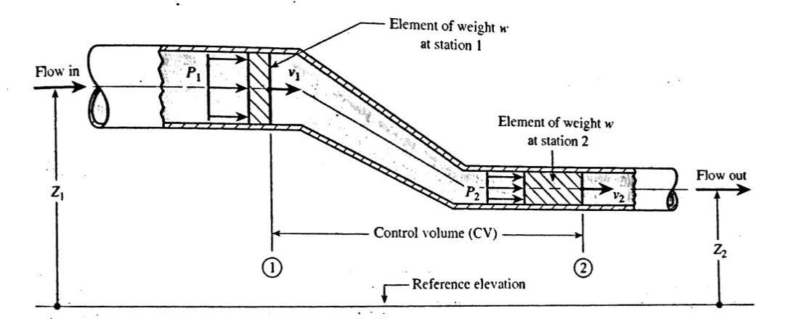

.
.
Potential energy:
The fluid element of weight w has a potential energy due to its elevation Z related to a reference plane.
PE= wz
Kinetic energy:
The fluid element of weight w moving with a velocity
KE=$\frac{1}{2}$ mv²
Flow energy;
It is the amount of work that pressure accomplishes by pushing the element of weight w at sta.1 into the CV or pushing the element of weight w at sta.2 out of CV.
FE= $\frac{Pw}{γ}$

Slide 4
Statement of Bernoullis equation:
Daniel Bernoulli an eighteen century Swiss scientist, formulated his equation by noting that the total energy possessed by the fluid in CV does not change with respect to time.
Total energy in element at 1 = total energy in element at 2
(PE+KE+FE)1=(PE+KE+FE)2

Slide 5
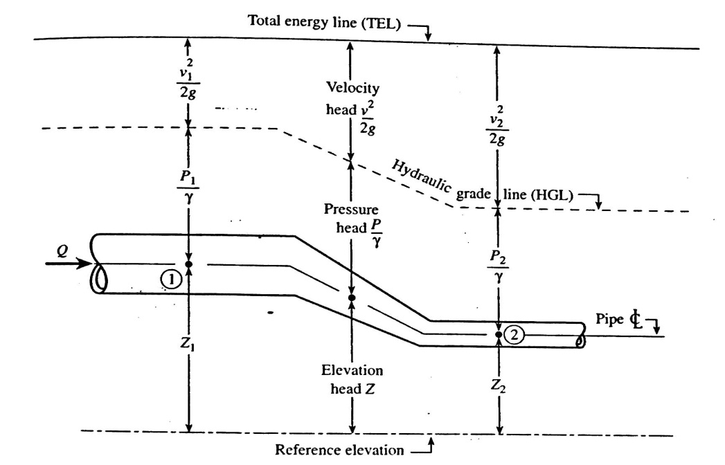

(PE+KE+FE)1=(PE+KE+FE)2
wZ₁+$\frac{1}{2}\frac{w}{g}$v₁²+$\frac{P _{1 W}}{γ}$= wZ₂ +$\frac{1}{2}\frac{w}{g}v{ _{2}}^{2}+\frac{P _{2}}{γ}w$ divide by w
Z₁+$\frac{v _{1} ^{2}}{2g}+\frac{P _{1}}{γ}$ = Z₂ +$\frac{v{ _{2}}^{2}}{2g}+\frac{P _{2}}{γ}$
Z: elevation head.
$\frac{P}{γ}$: pressure head.
$\frac{v{ _{2}}^{2}}{2g}:velocity head$

Slide 6
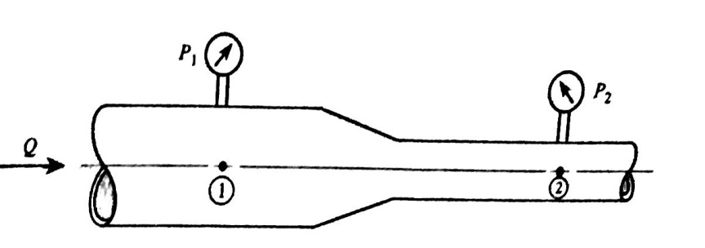

Ex1:For the pipe of fig.4 find P2 if the following data are given:p1= 20 psi, D2 =2 in and D2=1.5 in , Q=200 gpm of water?
Z₁+$\frac{v _{1} ^{2}}{2g}+\frac{P _{1}}{γ}$ = Z₂ +$\frac{v{ _{2}}^{2}}{2g}+\frac{P _{2}}{γ}$
V1= $\frac{Q}{A1}$=$\frac{200∗1∗231∗1}{\frac{π}{4}\left(\frac{2}{12}\right)∗60∗1∗1728}$
=20.4 ft/s
v2=v1(D1/D2)²
$\frac{20∗144}{62.4}$+$\frac{20.4}{2(32.2)}$ =$\frac{P2}{62.4}$ +$\frac{36.2 ^{2}}{2(32.2)}$ +46.2+6.46 = $\frac{P2}{62.4}$ +20.3
Solving for P at 2 yields :
P2= 2020 lb/ft² gage=14 psig.
-

Slide 7

Thanks

