Slide 1
T h e Mirror tool
Lecture 20

Slide 2
First example ・Mirror
1. Construct the outline fig. using the Line and Arc tools.
2. Call the Mirror tool – left-click on its tool icon in the Home/Modify
panel , pick the Mirror tool icon from the Modify toolbar,
pick Mirror from the Modify drop-down menu, or enter mi or mirror
at the command line. The command line shows:

Slide 3
Command: _mirror
Select objects:
pick ﬁrst corner Specify opposite
corner:
pick 7 found
Select objects:
right-click
Specify ﬁrst point of mirror line: end of
pick
Specify second point of mirror line: end of
pick
Erase source objects [Yes/No] N :
right-click
Command:

Slide 4
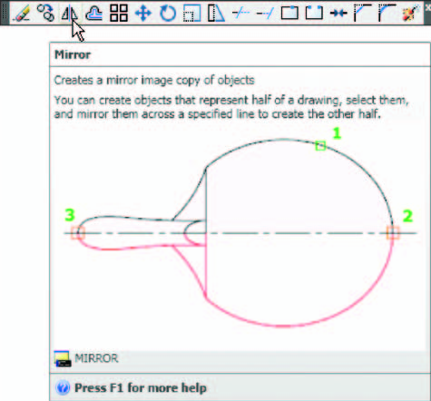

Slide 5
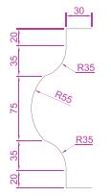
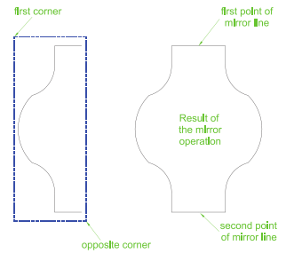

Slide 6
Second example ・Mirror 1. Construct the outline shown in the dimensioned polyline in the upper
drawing of.
2. Call Mirror and using the tool three times complete the given outline.
The two points shown in Fig. bellow are to mirror the right-hand side of
the outline.

Slide 7
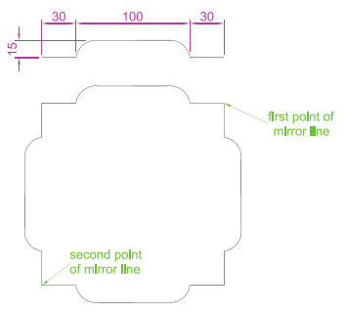

Slide 8
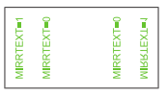
Third example ・Mirror If text is involved when using the Mirror tool, the set variable
MIRRTEXT must be set correctly. To set the variable:
Command: mirrtext
Enter new value for MIRRTEXT 1 : 0
Command:
If set to 0 text will mirror without distortion. If set to 1 text will read
backwards

