Slide 1
T h e Copy tool
Lecture 19

Slide 2
First example ・Copy
1. Construct the fig. bellow using Polyline . Do not include the dimensions.
2. Call the Copy tool – left-click on its tool icon in the Home/Modify
panel ,pick Copy from the Modify toolbar, or enter cp or
copy at the command line.

Slide 3
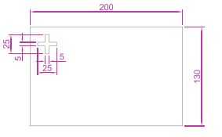

Slide 4
The command line shows:
Command: _copy Select objects:
pick the cross 1 found
Select objects:
right-click
Current settings: Copy mode Multiple
Specify base point or [Displacement/mode/Multiple]
Displacement :
pick
Specify second point or use ﬁrst point as
displacement :
pick

Slide 5
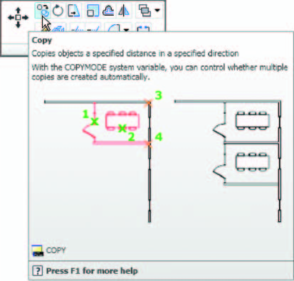
The Copy tool from the Home / Modify panel

Slide 6
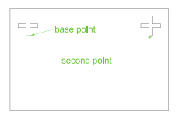

Slide 7
Second example ・Copy ・Multiple copy
1. Erase the copied object.
2. Call the Copy tool. The command line shows:
Command: _copy
Select objects:
pick the cross 1 found Select objects:
right-click
Current settings: Copy mode Multiple
Specify base point or [Displacement/mode]
Displacement :
pick
Specify second point or use ﬁrst point as
displacement :
pick

Slide 8
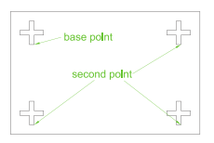
Specify second point or [Exit/Undo] Exit :
pick
Specify second point or [Exit/Undo] Exit :
pick
Specify second point or [Exit/Undo] Exit :
e (Exit)
Command :

