Slide 1
Drawing templates Lecture 18

Slide 2
Drawings were constructed in the template acadiso.dwt ,
which loaded when AutoCAD was opened. The default acadiso
template has been amended to Limits set to 420,297 (coordinates within
which a drawing can be constructed), Grid Display set to 10 , Snap Mode
set to 5 , and the drawing area Zoomed to All .
Throughout this book most drawings will be based on an A3 sheet, which
measures 420 units by 297 units (the same as Limits ).

Slide 3
N o t e
A s mentioned , if others are using the computer on which
drawings are being constructed, it is as well to save the template being
used to another ﬁ le name or, if thought necessary, to a ﬂ oppy disk.
A ﬁ le name My_template.dwt , as suggested earlier, or a name such
as book_template , can be given.

Slide 4
Adding features to the template
Four other features will now be added to our template:
● Text style – set in the Text Style dialog.
● Dimension style – set in the Dimension Style Manager dialog.
● Shortcutmenu variable – set to 0 .
● Layers – set in the Layer Properties Manager dialog.

Slide 5
Setting Text
Zoom, Pan and templates
81
CHAPTER 4
1. At the command line:
Command:
enter st (Style) right-click
2. The Text style dialog appears .In the dialog, enter 6 in the
Height ﬁ eld. Then left-click on Arial in the Font name popup list.
Arial font letters appear in the Preview area of the dialog.
3. Left-click the New button and enter Arial in the New text style
sub-dialog which appears ,and click the OK button.

Slide 6
The Text Style dialog

Slide 7
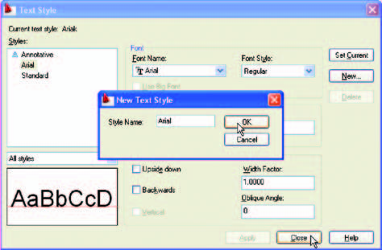
The New Text Style sub-dialog

Slide 8
4. Left-click the Set Current button of the Text Style dialog.
5. Left-click the Close button of the dialog.

Slide 9
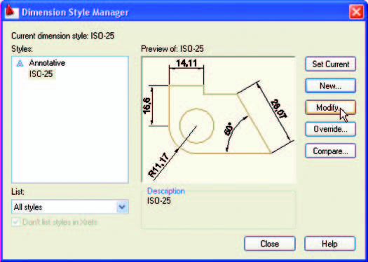
Setting dimension style
The Dimensions Style Manager dialog

Slide 10
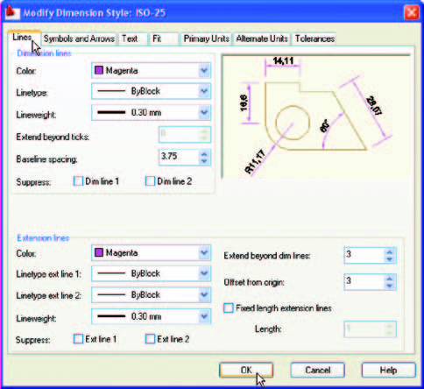
The setting for Lines in the Modify Dimensions Style dialog

Slide 11
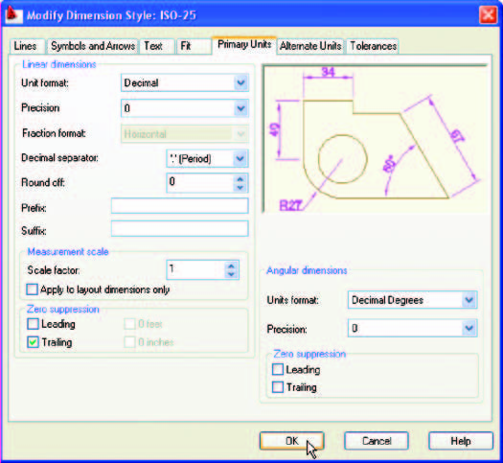
Setting Primary Units in the Dimension Style Manager

Slide 12
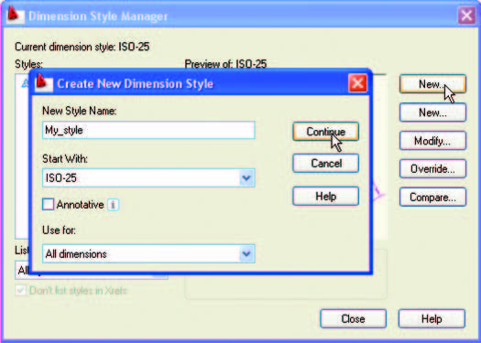
The Create New Dimension Style dialog

