Slide 1
T h e Pan tool Lecture 17

Slide 2
The Pan tools can be called with a click on the Pan icon in the Home/
Utilities panel, by the Pan button in the status bar, from the Pan submenu
of the
View drop-down menu or by entering p at the command
line. When the tool is called, the cursor on screen changes to an icon of a
hand. Dragging the hand across the screen under mouse movement allows
various parts of the drawing not on screen to be viewed. As the dragging
takes place, the black rectangle in the Aerial View window moves in

Slide 3
The Pan tool allows any part of the drawing to be viewed and/or modiﬁed. When that part of the drawing which is required is
on screen a right-click calls up the menu, from which
either the tool can be exited, or other tools can be called.

Slide 4
A Zoom Window of the drawing with its surrounding zoom rectangle showing in the Aerial View window

Slide 5
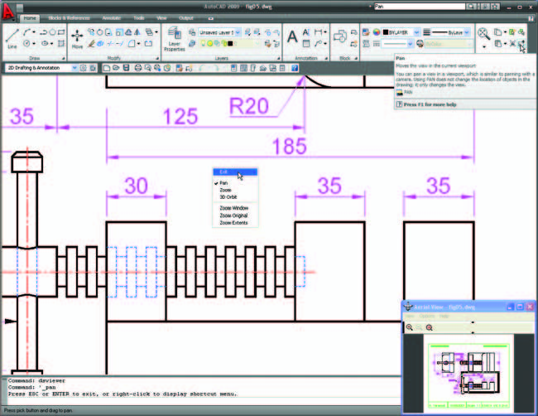
The Pan tool in action showing a part of the drawing, while the whole drawing is shown in the Aerial View window.

Slide 6
N o t e
1. If using a mouse with a wheel both zooms and pans can be
performed with the aid of the wheel.
2. The Zoom tools are important in that they allow even the smallest parts
of drawings to be examined and, if necessary, amended or modiﬁ ed.
3. The Zoom tools can be called with a click on the Zoom icon in the
Home/Utilities panel, with a click on the Zoom button in the status
bar, from the Zoom toolbar, from the sub-menu of the View drop-down
menu or by entering zoom or z at the command line. The easiest of this
choice is to enter z at the command line followed by a right-click .
4. S i milarly the easiest method of calling the Pan tool is to enter p at
the command line followed by a right-click .
5. When constructing large drawings, the Pan tool and the Aerial View
window are of value for allowing work to be carried out in any part of a
drawing, while showing the whole drawing in the Aerial View window.

