Slide 1
T h e Polyline Edit tool
Lecture 16

Slide 2
The Polyline Edit tool is a valuable tool for the editing of polylines.
First example ・Polyline Edit
1. With the Polyline tool construct the outlines 1 to 6
2. Call the Edit Polyline tool either from the Home/Modify panel or from the Modify drop-down menu, or by entering pe or pedit
at the command line, which then shows:

Slide 3
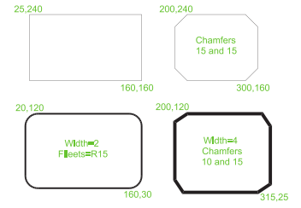

Slide 4
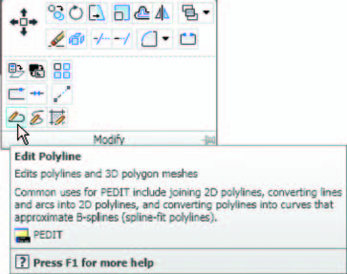

Slide 5
Command: enter pe
PEDIT Select polyline or [Multiple]:
pick pline 2
Enter an option [Open/Join/Width/Edit vertex/Fit/
Spline/Decurve/Ltype gen/Undo]: w (Width)
Specify new width for all segments: 2
Enter an option [Open/Join/Width/Edit vertex/Fit/
Spline/Decurve/Ltype gen/Undo]: right-click
Command:

Slide 6
3. Repeat with pline 3 and pedit to Width 10 .
4. Repeat with line 4 and enter s (Spline) in response to the prompt line:
Enter an option [Open/Join/Width/Edit vertex/
Fit/Spline/Decurve/Ltype gen/Undo]:
enter s
5. Repeat with pline 5 and enter j in response to the prompt line:
Enter an option [Open/Join/Width/Edit vertex/
Fit/Spline/Decurve/Ltype gen/Undo]:
enter j
The result is shown in pline 6 .
The resulting examples are shown in.

Slide 7
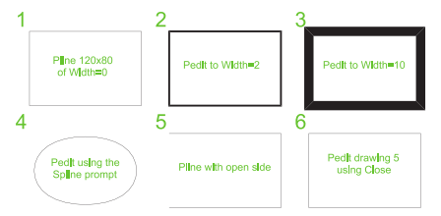

Slide 8
Example ・Multiple Polyline Edit 69
CHAPTER 3
1. With the Polyline tool construct the left-hand outlines of.
2. Call the Edit Polyline tool. The command line shows:
Command:
enter pe
PEDIT Select polyline or [Multiple]: m (Multiple)
Select objects:
pick any one of the lines or arcs
of the left-hand outlines of 1 found
Select objects:
pick another line or arc 1 found
2 total

Slide 9
Continue selecting lines and arcs as shown by the pick boxes of the lefthand
drawing
Of until the command
line shows: Select objects:
pick another line or arc 1 found 24 total
Select objects: right-click
[prompts]: w (Width)
Specify new width for all segments: 1.5
[prompts]: right-click
Command:
The result is shown in the right-hand drawing of

Slide 10
