Slide 1
Drawing Rectangle tools
Lecture 15

Slide 2
Rectangle tool ・First example
Call the Rectangle tool – either with a click on its tool icon in the Home/
Draw panel or by entering rec or rectangle at the command line. The tool can be also called from the Draw drop-down menu or Draw
toolbar. The command line shows: Command: _rectang
Specify ﬁrst corner point or [Chamfer/Elevation/ Fillet/Thickness/Width]: 25,240
Specify other corner point or [Area/Dimensions/ Rotation]: 160,160
Command:

Slide 3
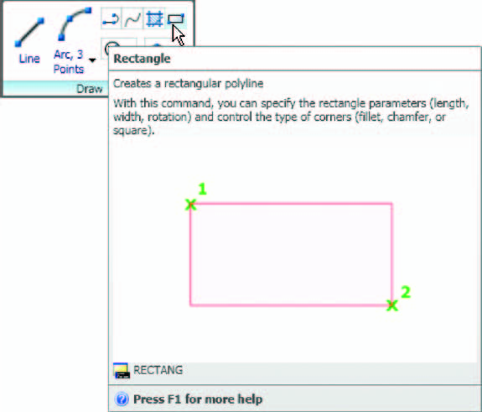

Slide 4
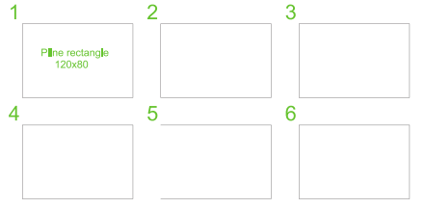

Slide 5
Specify ﬁrst corner point: 200,240
Specify other corner point: 300,160
Command:
Rectangle tool ・Third example
Command: _rectangle
Specify ﬁrst corner point or [Chamfer/Elevation/
Fillet/Thickness/Width]: f (Fillet)
Specify ﬁllet radius for rectangles 0 : 15
Specify ﬁrst corner point or [Chamfer/Elevation/
Fillet/Thickness/Width]: w (Width)
Specify line width for rectangles 0 : 1

Slide 6
Specify ﬁrst corner point or [Chamfer/Elevation/
Fillet/Thickness/Width]: 20,120
Specify other corner point or [Area/Dimensions/
Rotation]: 160,30
Command:

Slide 7
Rectangle ・Fourth example
Command: _rectang
Specify ﬁrst corner point or [Chamfer/Elevation/
Fillet/Thickness/Width]: w (Width)
Specify line width for rectangles 0 : 4
Specify ﬁrst corner point or [Chamfer/Elevation/Fillet/Thickness/Width]: c (Chamfer)
Specify ﬁrst chamfer distance for rectangles
0 : 15
Specify second chamfer distance for rectangles
15 : right-click
Specify ﬁrst corner point: 200,120
Specify other corner point: 315,25
Command:

