Slide 1
Examples of Dynamic Input
Lecture 13

Slide 2
When using Dynamic Input the selection of a prompt can be made by
pressing the down key of the keyboard ,which causes a pop-up
menu to appear. A click on the required prompt in such a pop-up menu will make that prompt active.
Dynamic Input :first example :Polyline
1. Select Polyline from the Home/Draw panel .
2. To start the construction click at any point on screen. The prompt for the Polyline appears with the coordinates of the selected point showing.

Slide 3
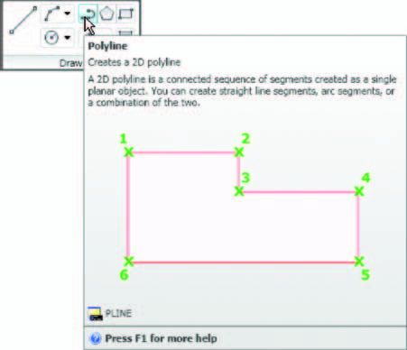
Left-click to start the drawing :

Slide 4
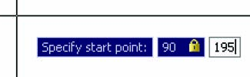
3. Move the cursor and press the down key of the keyboard. A pop-up
menu appears from which a prompt selection can be made. In the menu
click Width

Slide 5
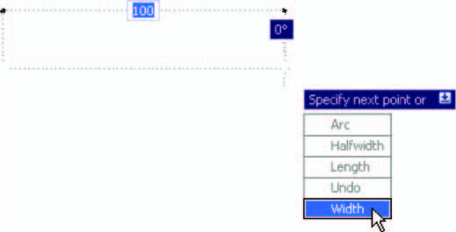

Slide 6

4. Another prompt ﬁ eld appears. At the keyboard enter the required width
and right-click . Then left-click and enter ending width or right-click if
the ending width is the same as the starting width

Slide 7

5. Drag the cursor to the right until the dimension shows the required
horizontal length and left-click
6. Drag the cursor down until the vertical distance shows and left-click .
7. Drag the cursor to the left until the required horizontal distance is
showing and right-click .

Slide 8
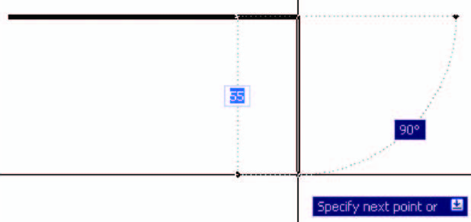

Slide 9
