Slide 1
Notes on the use of Dynamic Input Lecture 12

Slide 2
Although Dynamic Input can be used in any of the three AutoCAD
workspaces, some operators may prefer a larger working area. To
achieve this a click on the Clean Screen icon in the bottom-right-hand
corner of the AutoCAD 2009 window, produces an uncluttered workspace
area. The command palette can be cleared from screen by entering
commandlinehide at the command line. To bring it back press the keys
Ctrl 9 . These two operations produce a screen showing only title and
status bars .Some operators may well prefer working in such a larger than normal workspace.

Slide 4
Dynamic Input settings are made in the Drafting Settings dialog , brought to screen by entering ds at the command line.
When Dynamic Input is in action, tools can be called by using any of the
following
1. by entering the name of the tool at the command line;
2. by entering the abbreviation for a tool name at the keyboard; methods;

Slide 5
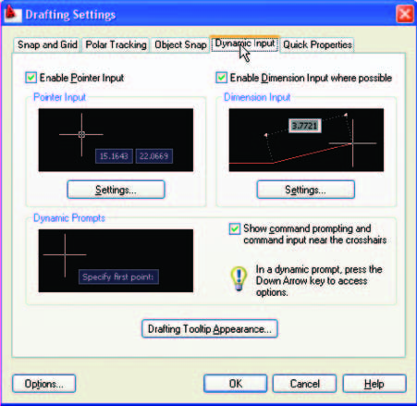
3. by selecting the tool’s icon from a toolbar;
4. by selecting the tool’s icon from a panel;
5. by selecting the tool’s name from a drop-down menu.

Slide 6
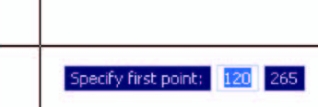
When Dynamic Input is active and a tool is called, command prompts
appear in a tooltip at the cursor position. shows the tooltip
appearing at the cursor position when the Line tool icon in the Home/
Draw panel is clicked .

Slide 7
T o commence drawing a line, either move the cursor under mouse control
to the desired coordinate point and left-click as in, or enter the
required x,y coordinates at the keyboard and left-click . To
continue drawing with Line drag the cursor to a new position and either
left-click at the position when the coordinates appear as required, or enter a required length at the keyboard, which appears in the
length box followed by a left-click .

