Slide 1
Object Snaps (Osnaps) Lecture 11

Slide 2
Object Snaps allow objects to be added to a drawing at precise positions in relation to other objects already on screen. With Object Snaps , objects can be added to the endpoints and midpoints, to intersections of objects, to centres and quadrants of circles and so on. Object Snaps also override snap points even when snap is set on.

Slide 3
To set Object Snaps – at the command line:
Command:
enter os
and the Drafting Settings dialog appears .Click the Object
Snap tab in the upper part of the dialog and click the check boxes to the
right of the Object Snap names to set them on (or off in on).

Slide 5
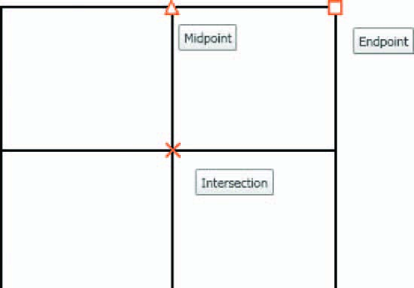
When Object Snaps are set ON , as outlines are constructed using Object
Snaps so Object Snap icons and their tooltips appear as indicated in figure bellow:

Slide 6
It is sometimes advisable not to have Object Snaps set on in the
Drafting Settings dialog, but to set Object Snap off and use Object
Snap abbreviations at the command line when using tools. The following
examples show the use of some of these abbreviations.

Slide 7
First example :Object Snap abbreviations
Call the Polyline tool:
Command: _pline
Specify start point: 50,230
[prompts]: w (Width)
Specify starting width: 1
Specify ending width 1 :
right-click
Specify next point: 260,230
Specify next point:
right-click
Command: right-click

Slide 8
PLINE
Specify start point: end of pick the right-hand
end of the pline
Specify next point: 50,120
Specify next point: right-click
Command: right-click
PLINE
Specify start point: mid of pick near the middle
of ﬁrst pline
Specify next point: 155,120
Specify next point: right-click
Command: right-click

