Slide 1
The Ellipse tool
Lecture 10

Slide 2
Ellipses can be regarded as what is seen when a circle is viewed from directly in front of the circle and the circle rotated through an angle about its horizontal diameter. Ellipses are measured in terms of two axes – a major axis and a minor axis , the major axis being the diameter of the circle, the minor axis being the height of the ellipse after the circle has been rotated through an angle

Slide 3
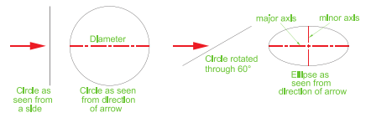
An ellipse can be regarded as viewing a rotated circle

Slide 4
To call the Ellipse tool, click on its tool icon in the Home/Draw panel , click its name in the Draw drop-down menu, click on its tool con in the Draw toolbar or enter a or arc at the command line.

Slide 5
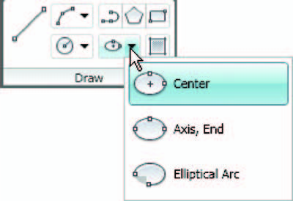

Slide 6
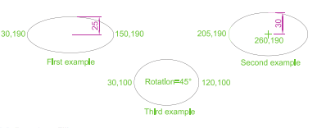

Slide 7
First example :Ellipse
Left-click the Ellipse tool icon. The command line shows:
Command: _ellipse
Specify axis endpoint of elliptical arc or [Arc/
Center]: 30,190
Specify other endpoint of axis: 150,190
Specify distance to other axis or [Rotation] 25
Command:

Slide 8
Second example :Ellipse
In this second example, the coordinates of the centre of the ellipse (the
point where the two axes intersect) are entered , followed by entering
coordinates for the end of the major axis, followed by entering the units
for the end of the minor axis.
Command:
right-click
ELLIPSE
Specify axis endpoint of elliptical arc or [Arc/
Center]: c
Specify center of ellipse: 260,190
Specify endpoint of axis: 205,190
Specify distance to other axis or [Rotation]: 30
Command:

Slide 9
Third example :Ellipse
In this third example, after setting the positions of the ends of the major
axis, the angle of rotation of the circle from which an ellipse can be
obtained is entered .
Command:
right-click
ELLIPSE
Specify axis endpoint of elliptical arc or [Arc/
Center]: 30,100
Specify other endpoint of axis: 120,100
Specify distance to other axis or [Rotation]:
r (Rotation)
Specify rotation around major axis: 45
Command:

