Slide 1
T h e Arc tool Lecture 9

Slide 2
In AutoCAD , arcs can be constructed using any three of the following characteristics of an arc – its Start point; a point on the arc ( Second point); its Center ; its End ; its Radius ; the Length of the arc; the Direction in which the arc is to be constructed; the Angle between lines of the arc. These characteristics are shown in the menu appearing with a click on the Arc tool in the Home/Draw panel

Slide 4
To call the Arc tool click on its tool icon in the Home/Draw panel, click on Arc in the Draw toolbar, click on Arc in the Draw drop-down menu, or enter a or arc at the command line. In the following examples initials of command prompts will be shown instead of selection from the menu shown bellow:

Slide 5
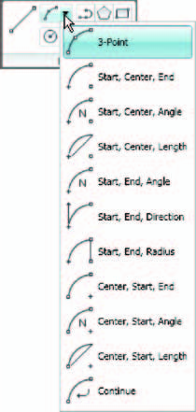

Slide 6
First example ・Arc tool
Left-click the Arc tool icon. The command line shows:
Command: _arc Specify start point of arc or
[Center]: 100,220
Specify second point of arc or [Center/End]: 55,250
Specify end point of arc: 10,220
Command:

Slide 7
Second example ・Arc tool
Command: right-click brings back the Arc sequence
ARC Specify start point of arc or [Center]: c (Center)
Specify center point of arc: 200,190
Specify start point of arc: 260,215
Specify end point of arc or [Angle/chord Length]:
140,215
Command:

Slide 8
Third example ・Arc tool
Command: right-click brings back the Arc sequence
ARC Specify start point of arc or [Center]: 420,210
Specify second point of arc or [Center/End]: e (End)
Specify end point of arc: 320,210
Specify center point of arc or [Angle/Direction/
Radius]: r (Radius)
Specify radius of arc: 75
Command:

