Slide 1
Drawing with the Polyline tool Lecture 6

Slide 2
When drawing lines with the Line tool, each line drawn is an object in its own right. A rectangle drawn with the Line tool is four objects. A rectangle drawn with the Polyline tool is a single object. Lines of different thickness, arcs, arrows and circles can all be drawn using this tool as will be shown in examples describing constructions using the Polyline tool. Constructions resulting from using the tool are known as polylines or plines .

Slide 3
The Polyline tool icon in the Home/Draw panel

Slide 4
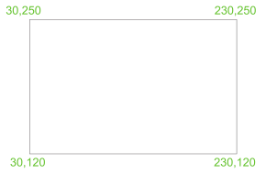
The Polyline tool can be called from the Home/Draw panel or by entering pl at the command line.
First example : Polyline tool

Slide 5
In this example enter and right-click have not been included.
Left-click the Polyline tool. The command line shows:
Command: _pline Specify start point: 30,250
Current line width is 0
Specify next point or [Arc/Halfwidth/Length/ Undo/Width]: 230,250
Specify next point or [Arc/Close/Halfwidth/Length/Undo/Width]: 230,120
Specify next point or [Arc/Close/Halfwidth/Length/Undo/Width]: 30,120
Specify next point or [Arc/Close/Halfwidth/Length/Undo/Width]: c (Close)
Command :

Slide 6
1. Note the prompts – Arc for constructing pline arcs; Close to close
an outline; Halfwidth to halve the width of a wide pline; Length
to enter the required length of a pline; Undo to undo the last pline
constructed; Close to close an outline.
2. Only the capital letter(s) of a prompt needs to be entered in upper or lower case to make that prompt effective.
3. Other prompts will appear when the Polyline tool is in use as will be shown in later examples.

