Slide 1
Undo and Redo tools Lecture 5

Slide 2
Two other tools of value when errors have been made are the Undo and Redo tools. To undo the last action taken by any tool when constructing a drawing, either left-click the Undo tool in the Standard Annotation toolbar or enter u at the command line. Regardless of which method is adopted the error is deleted from the drawing.

Slide 3
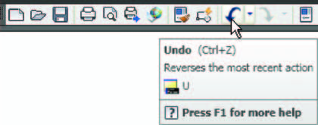
The Undo tool in the Standard Annotation toolbar

Slide 4
Everything done during a session in constructing a drawing can be undone by repeated clicking on the Undo tool icon or by entering u ’s at the command line.
To bring back objects that have just been removed by the use of Undo ’s, left-click the Redo tool icon in the Standard Annotation toolbar or enter Redo at the command line.

