Slide 1
College of Engineering,
Electrical Engineering Department
Class : Second Year
Subject : Digital Techniques
Parity Generator and Checkers
By:
Asst Lec. Besma Nazar Nadhem
Master of Science in Electrical Engineering
(Electronic and Communication)

Slide 2
Parity Generator and Checkers
Error can occurs as digital codes are being transferred from one point to another .
The errors take the form of undesired changes in the bits that make up the coded information
A 1 can change to 0 or 0 to 1 due to component malfunction or electrical noise.

Slide 3
Parity bit Generation Methods
Many systems, employ a parity bit as a means of detecting a bit error .
One of the simplest and most widely used schemes for error detection is the parity bit method
The two different method are used :
1. Even parity generator method.
2. Odd parity generator method.

Slide 4
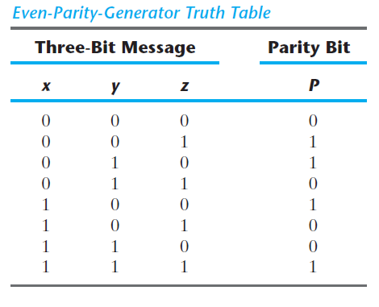
Even parity generator method :
Even parity means attaching an extra bit to a group of bits to produce an even number of 1’s as shown in table 1
Table 1

Slide 5
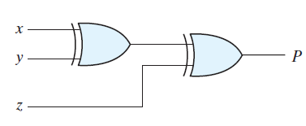
P can be expressed as a three-variable exclusive-OR function:
The logic diagram for the parity generator is shown below :

Slide 6
Odd parity generator method :
Odd parity means attaching an extra bit to a group of bits to produce an odd number of 1’s as shown in table 2
Table 2
Odd
1
0
0
1
0
1
1
0

Slide 7
P can be expressed as a three-variable exclusive-OR function:
P=x⊕y⊙z
The logic diagram for the parity generator is shown below :

Slide 8
. It is obvious from the foregoing example that parity generation and checking circuits always have an output function that includes half of the minterms whose numerical values have either an odd or even number of 1’s.
. As a consequence, they can be implemented with exclusive-OR gates.
. A function with an even number of 1’s is the complement of an odd function.
. It is implemented with exclusive-OR gates, except that the gate associated with the output must be an exclusive-NOR to provide the required complementation.

