Slide 1
T h e Erase tool Lecture 4

Slide 2
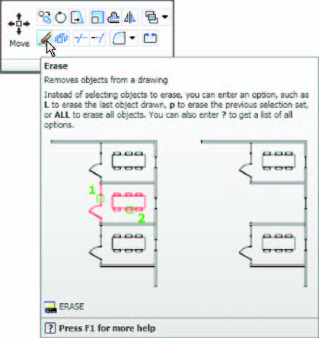
If an error has been made when using any of the AutoCAD tools, the object or objects which have been incorrectly drawn can be deleted with the Erase tool. The Erase tool icon can be selected from the Home/ Modify panel ( Fig. 4.1 ) or by entering e at the command line.
Fig.4.1:The Erase tool icon from the Home/Modify panel

Slide 3
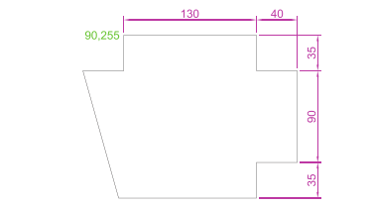
First example – Erase ( Fig.4.3 )
1. With Line construct the outline ( Fig. 4.2 ).
Fig. 4.2: First example( Erase . An incorrect outline).

Slide 4
2. Assuming two lines of the outline have been incorrectly drawn, leftclick the Erase tool icon. The command line shows:
Command: _erase Select objects:
pick one of the lines 1 found
Select objects:
pick the other line 2 total
Select objects:
right-click
Command:
and the two lines are deleted (right-hand drawing of Fig. 2.18 ).

Slide 5
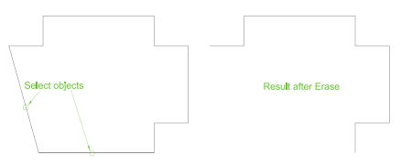
Fig. 4.4: First example (Erase).

Slide 6
Second example: Erase ( Fig. 4.5 )
The two lines could also have been deleted by the following method:
1. Left-click the Erase tool icon. The command line shows:
Command: _erase Select objects: enter c (Crossing)
Specify ﬁrst corner: pick Specify opposite corner: pick 2 found
Select objects: right-click
Command: and the two lines are deleted as in the right-hand drawing of Fig. 4.5 .

Slide 7
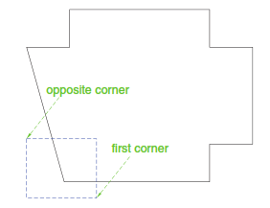
Fig. 4.5 :Second example (Erase).

