Slide 1
Drawing with the circle tool Lecture 3

Slide 2
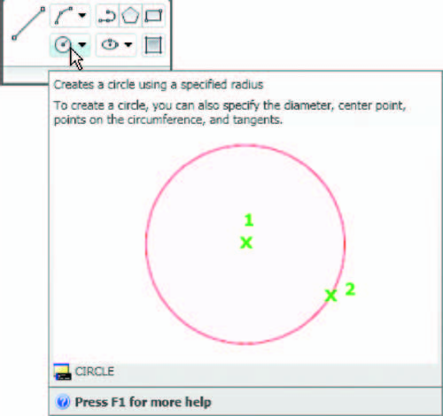
First example : Circle tool ( Fig. 3.2 )
1. Close the drawing just completed and open the acadiso.dwt template.
2. Left-click on the Circle tool icon in the Home/Draw panel
3. Enter a coordinate and a radius against the prompts appearing in the command window , followed by right-clicks . The circle ( Fig. 2.13 ) appears on screen.
Fig. 3.1 : The Circle tool from the Home/Draw panel

Slide 3
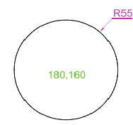
Fig. 3.1: First example(Circle tool).

Slide 4
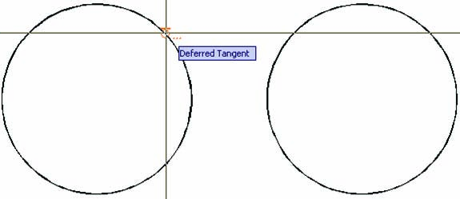
Second example: Circle tool ( Fig. 3.4 )
1. Close the drawing and open the acadiso.dwt screen.
2. Left-click on the Circle tool icon and construct two circles in the positions and radii fig(3.3).
3. Click the Circle tool again and against the ﬁ rst prompt enter t (the abbreviation for the prompt tan tan radius ), followed by a right-click
Fig. 3.3: Second example (Circle tool ・the two circles of radius 50 )

Slide 5
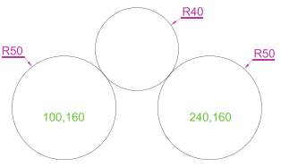
Command_circle Specify center point for circle or
[3P/2P/Ttr (tan tan radius)]: enter t right-click
Specify point on object for ﬁrst tangent of circle: pick
Specify point on object for second tangent of circle: pick
Specify radius of circle (50): enter 40 right-click
Command:
Fig. 3.4: Second example ( Circle tool. The radius-40 circle tangential to the radius-50 circles ).

Slide 6
N o t e s :
1. When a point on either circle is picked, a tip appears Deferred Tangent . This tip will only appear when the Object Snap button is set on with a click on its button in the status bar, or the F3 key of the keyboard is pressed.
2. Circles can be drawn through 3 points or through 2 points entered at the command line in response to prompts brought to the command line by using 3P and 2P in answer to the circle command line prompts.

