Slide 1
Drawing with the Line tool Lecture 2

Slide 2
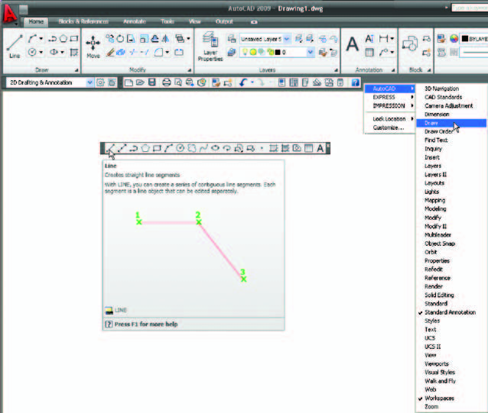
. Open AutoCAD. The drawing area will show the settings of the acadiso.dwt template – Limits set to 420,297 , Grid set to 10 , Snap set to 5 and Units set to 0
Fig. 2.1 Line and its tooltip from the Draw toolbar

Slide 3
2. Left-click on the Line tool in the Home/Draw panel or Draw toolbar(Figs 2.1 ).
N o t e :
(a) The tooltip which appears when the tool icon is clicked .
(b) The prompt Command: line Specify ﬁ rst point which appears in the command window at the command line .
3. Make sure Snap is on by either pressing the F9 key or the Snap Mode button in the status bar. Snap on will show in the command palette.

Slide 4
4. Move the mouse around the drawing area. The cursors pick box will
jump from point to point at 5 unit intervals. The position of the pick box will show as coordinate numbers in the status bar (left-hand end).
5. Move the mouse until the coordinate numbers show 60,240,0 and press the pick button of the mouse ( left-click ).
6. Move the mouse until the coordinate numbers show 260,240,0 and left-click .
7. Move the mouse until the coordinate numbers show 260,110,0 and left-click.
8. Move the mouse until the coordinate numbers show 60,110,0 and left-click.
9. Move the mouse until the coordinate numbers show 60,240,0 and leftclick. Then press the Return button of the mouse ( right-click). The line rectangle ( Fig. 2.2 ) appears in the drawing area.

Slide 5
Fig. 2.2 : First example ( Line tool).

Slide 6
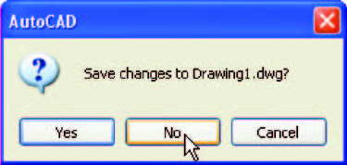
Second example : Line tool ( Fig. 2.4)
1. Clear the drawing from the screen with a click on the drawing Close button of the AutoCAD drawing area. Make sure it is not the AutoCAD 2009 window button.
2. The warning window ( Fig. 2.3 ) appears in the centre of the screen. Click its No button.
3. Left-click on New … in the File drop-down menu and from the Select template dialog which appears double-click on acadiso.dwt .
Fig. 2.5 :The AutoCAD warning window.

Slide 7
4. Left-click on the Line tool icon and enter ﬁ gures as follows at each prompt of the command line sequence: Command: _line Specify ﬁrst point: enter 80,235 right-click
Specify next point or [Undo]: enter 275,235 right-click
Specify next point or [Undo]: enter 295,210 right-click
Specify next point or [Close/Undo]: enter 295,100 right-click
Specify next point or [Close/Undo]: enter 230,100 right-click
Specify next point or [Close/Undo]: enter 230,70 right-click
Specify next point or [Close/Undo]: enter 120,70 right-click
Specify next point or [Close/Undo]: enter 120,100 right-click
Specify next point or [Close/Undo]: enter 55,100 right-click
Specify next point or [Close/Undo]: enter 55,210 right-click
Specify next point or [Close/Undo]: enter c (Close) right-click

Slide 8
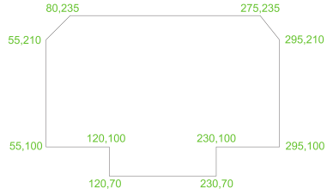
Command:
The result is as shown in Fig. 2.4.
Fig. 2.4 Second example ( Line tool)

