Slide 1
Introduction to AutoCAD
First class

Slide 2
Lecture 1
AutoCAD 2009 is designed to work in a Windows operating system.
In general, to open AutoCAD 2009, either double-click on the AutoCAD shortcut in the Windows desktop ,or right-click on the icon, followed by a left-click on Open in the menu which then appears.

Slide 3
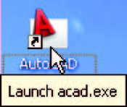
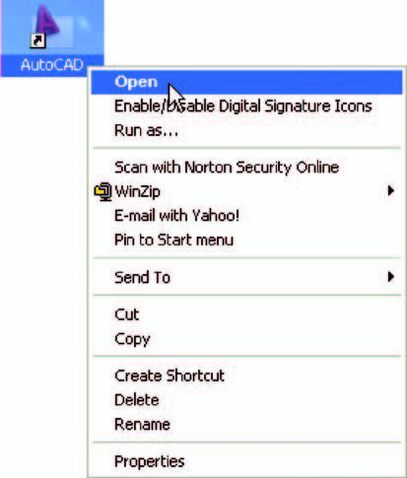
Fig. 1 .1 The right-click menu which appears from the shortcut icon

Slide 4
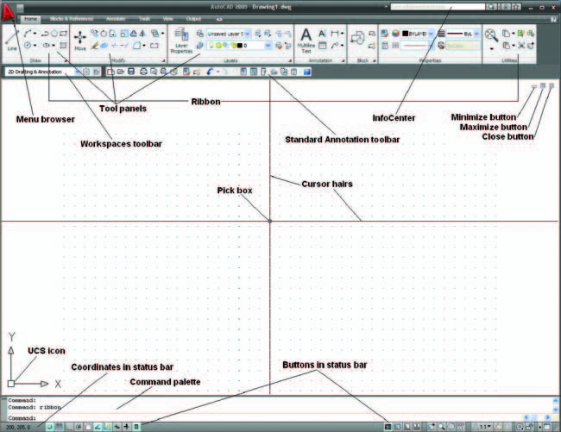
When AutoCAD 2009 is opened a window appears, the window depending upon whether a 3D Modeling. In this example the 2D Drafting & Annotation workspace is shown and includes the Ribbon with Tool panels ( Fig. 1.2 ).
Fig. 1.3 The AutoCAD 2009 2D Drafting & Annotation workspace showing its various parts

Slide 5
This 2D Drafting & Annotation workspace shows the following details:
● Ribbon : which includes tabs, each of which when clicked will bring a set of panels containing tool icons. Further tool panels can be seen clicking the appropriate tab.
● Menu Browser icon: A left-click on the arrow to the right of the A symbol at the top-left-hand corner of the AutoCAD window causes the Menu Browser menu to appear.
● Workspaces Switching menu: appears with a click on the Workshop Switching button in the status bar .
● Command palette : can be dragged from its position at the bottom of the AutoCAD window into the AutoCAD drawing area.

Slide 6
Buttons at the left-hand end of the status bar :
● Snap Mode : also toggled using the F9 key, when snap on, the cursor under mouse control can only be moved in jumps from one snap point to another.
● Grid Display : also toggled using the F7 key, when set on a series of grid points appears in the drawing area.
Ortho Mode : also toggled using the F8 key, when set on, lines etc., can only be drawn vertically or horizontally.
● Polar Tracking : also toggled using the F10 key, when set on, a small
tip appears showing the direction and length of lines etc., in degrees and units.
● Object Snap :also toggled using the F3 key, when set on an OSnap icon appears at the cursor pick box.

Slide 7
● Object Snap Tracking : when set on, lines etc., can be drawn at exact coordinate points and precise angles.
● Allow/Disallow Dynamic UCS : also toggled by the F6 key. Used when constructing 3D solid models.
● Dynamic Input : also toggled by F12 . When set on, the x,y coordinates and prompts show when the cursor hairs are moved.
● Show/Hide Lineweight : when set on, lineweights show on screen. When set off, lineweights only show in plotted/printed drawings.
● Quick Properties : a right-click brings up a pop-up menu, from which a click on Settings … causes the Drafting Settings dialog to appear.

Slide 8
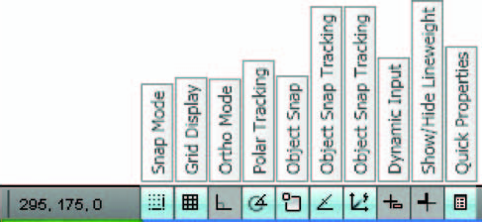
Fig. 1.3 The buttons at the left-hand end of the status bar

Slide 9
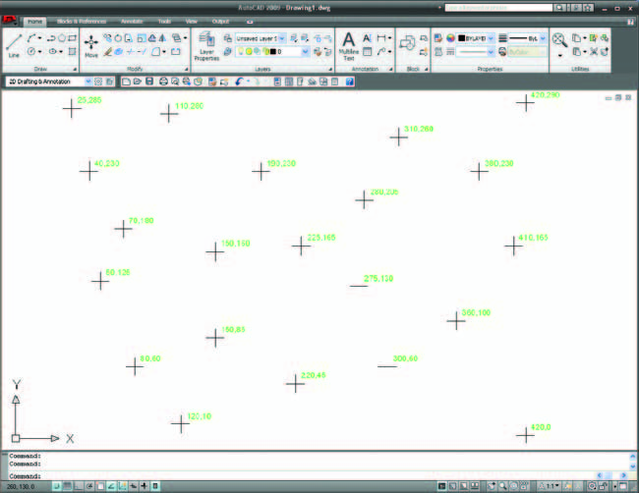
The AutoCAD coordinate system
In the AutoCAD 2D coordinate system, units are measured horizontally in terms of X and vertically in terms of Y. A 2D point can be determined in terms of X,Y (in this book referred to as x,y ). x,y 0,0 is the origin of the system. The coordinate point x,y 100,50 is 100 units to the right of the origin and 50 units above the origin. The point x,y 100, 50 is 100 units to the left of the origin and 50 points below the origin. Figure 1.4 shows some 2D coordinate points in the AutoCAD window.
Fig. 1.4: The 2D coordinate points in the AutoCAD coordinate system

Slide 10
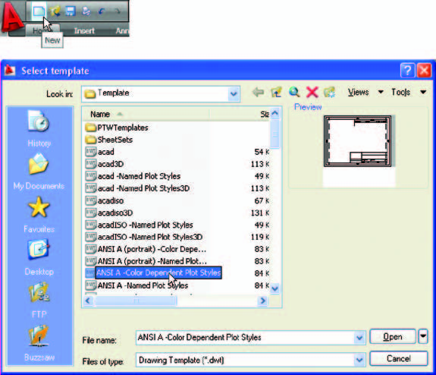
Drawing templates
Drawing templates are ﬁ les with an extension .dwt . Templates are ﬁ les which have been saved with predetermined settings – such as Grid spacing, Snap spacing etc. Templates can be opened from the Select template dialog ( Fig. 1.5 ) called by clicking the New … icon at the topleft-hand corner of the AutoCAD window. An example of a template ﬁle being opened is shown in Fig.1.5 . In this example the template will be opened in Paper Space and is complete with a title block and borders.
Fig. 1.5 A template selected for opening in the Select template dialog

Slide 11


Adapt this template as follows:
1. In the command palette enter (type) grid followed by a right-click (or pressing the Enter key). Then enter 10 in response to the prompt which appears, followed by a right-click .
2. In the command palette enter snap followed by right-click . Then enter 5 followed by a right-click .

Slide 12
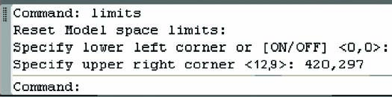
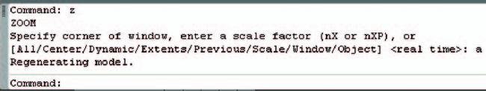
3. In the command palette enter limits , followed by a right-click. Right click again. Then enter420,297and right-click .
4. In the command palette enter zoom and right-click . Then in response to the line of prompts which appears enter a (for All) and right-click.

Slide 13
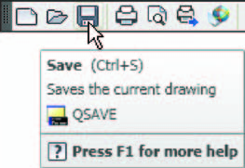
6- Click the Save icon in the Standard Annotation toolbar fig.(1.6) .The Save Drawing As dialog appears. In the Files of type pop-up list select AutoCAD Drawing Template (*.dwt) . The templates already in AutoCAD are displayed in the dialog. Click on acadiso.dwt , followed by another click on the Save button.
Fig. 1.28 Click Save

