Slide 1
College of Engineering,
Electrical Engineering Department
Class : Second Year
Subject : Digital Techniques
Karnaugh Map Method
By:
Asst Lec. Besma Nazar Nadhem
Master of Science in Electrical Engineering
(Electronic and Communication)

Slide 2
Karnaugh Map Method
A Karnaugh map is a graphical representation of the logic system.
It can be drawn directly from either minterm (sum-of-products) or maxterm (product-of-sums) Boolean expressions.
Drawing a Karnaugh map from the truth table involves an additional step of writing the minterm or maxterm expression
depending upon whether it is desired to have a minimized sum-of-products or a minimized product of sums expression.

Slide 3
Construction of a Karnaugh Map
An n-variable Karnaugh map has $2^{n}$ squares, and each possible input is allotted a square.
In the case of a minterm Karnaugh map, ‘1’ is placed in all those squares for which the output is ‘1’, and ‘0’ is placed in all those squares for which the output is ‘0’.
. 0s are omitted for simplicity. An ‘X’ is placed in squares corresponding to ‘don’t care’ conditions
.The choice of terms identifying different rows and columns of a Karnaugh map is not unique for a given number of variables

Slide 4
.The only condition to be satisfied is that the designation of adjacent rows and adjacent columns should be the same except for one of the literals being complemented. Also, the extreme rows and extreme columns are considered adjacent.
Karnaugh maps, or K-maps, are often used to simplify logic problems with 2, 3 or 4 variables.
For the case of 2 variables, we form a map consisting of $2^{2}$=4 cells as shown in Figure

Slide 5
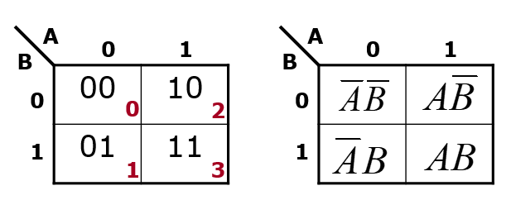
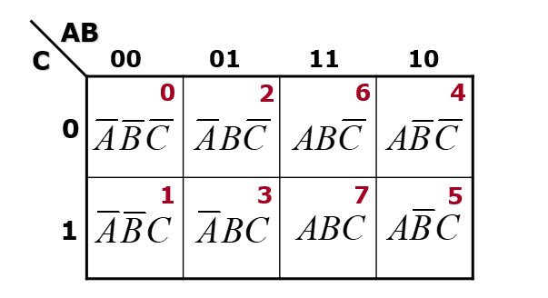
3 variables Karnaugh map
$2^{3}$=8

Slide 6
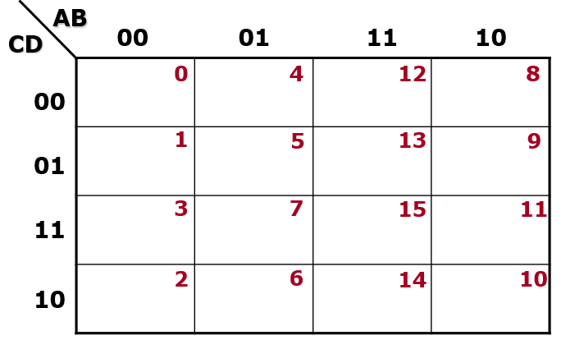
4 variables Karnaugh map
$2^{4}$=16

Slide 7
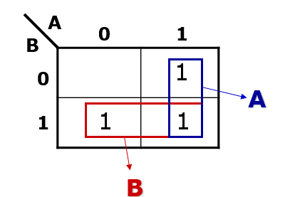
Example
The map for a 2-input OR gate
looks like this:
A | B | Y
0 | 0 | 0
0 | 1 | 1
1 | 0 | 1
1 | 1 | 1
A+B

Slide 8
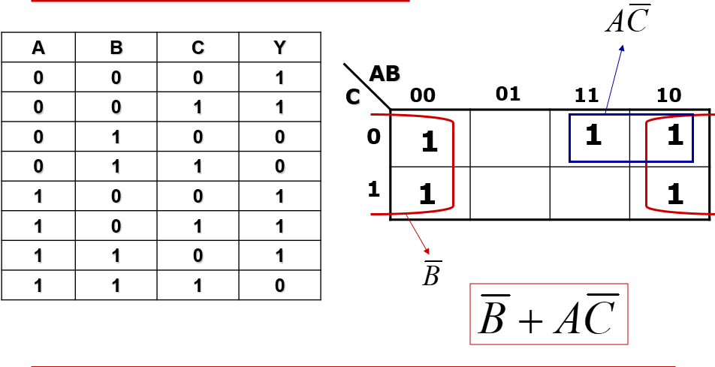
Example

Slide 9
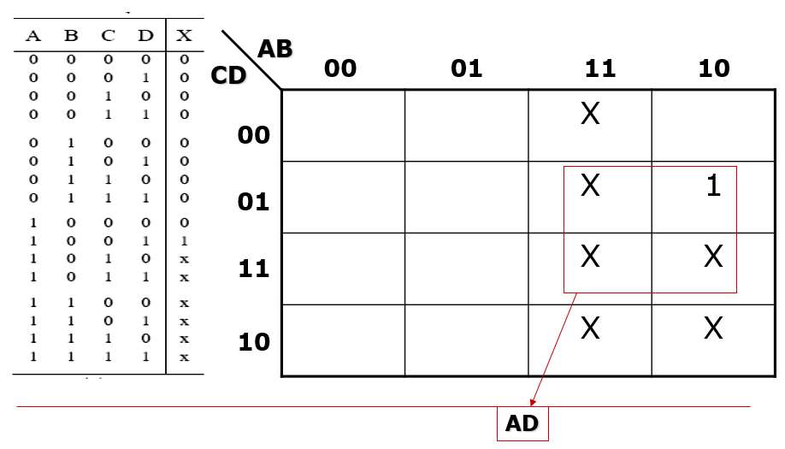
Don’t care term

