Slide 1
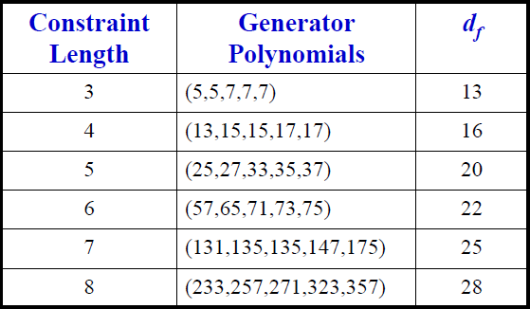
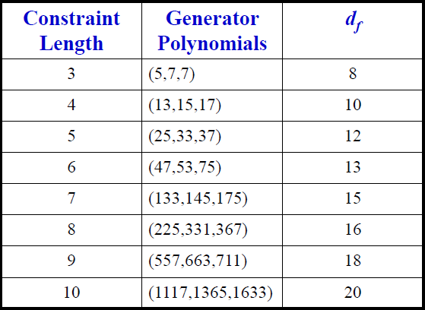
convolutional Codes with Code Rate 1/5
Convolutional codes with code rate 1/3

Slide 2
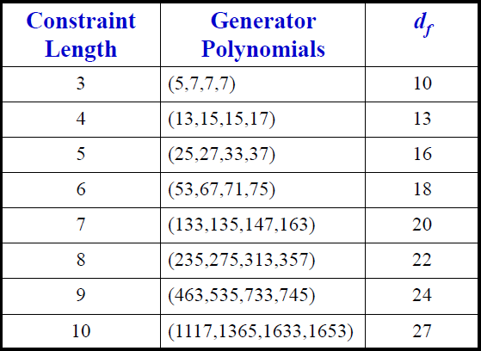
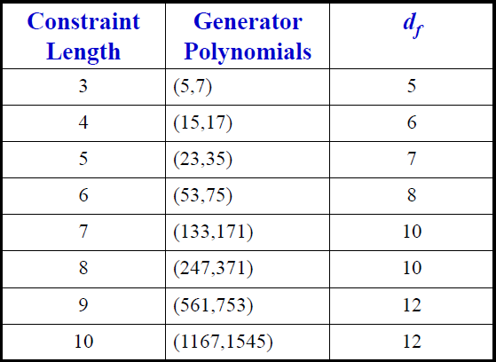
Convolutional codes with code rate 1/4
Convolutional codes with code rate 1/2

