Slide 1
Electronic Physics
Dr. Ghusoon Mohsin Ali
Conductivity of Extrinsic Semiconductor.
σ = n eμ + p eμ
i n i p
For n-type
σ = n eμ + p eμ
n n n n p
Since
(nn) >>( pn )
σ = n eμ
n n n
and if nn=ND then σ _{n} = N_{D}eμ_{n}
For p-type
σ = n eμ + p eμ
p p n p p
Since (pp) >>(np)
= p eμ
p p p
and if pp=NA then
= N eμ
p A p
Example
P-type sample with l=6mm, A=0.5mm², R=120Ω. Calculate majority and minority carriers if intrinsic carrier density is 2.5×10¹⁹/ m³. Given μn=0.38m²/Vs, μp=0.18m²/Vs .
Solution
R = ρ ^{l} =
l
A σA
σ = p eμ
p p p

Slide 2
Electronic Physics
Dr. Ghusoon Mohsin Ali
2
ni =np pp
p
₌ σ _{p}
= ^{100} = 3.46×10²¹ / m³
p
eμ 1.6 ×10⁻¹⁹ × 0.18
p
_{n} 2
n = ^{i} = 1.9 ×10¹⁷ / m³
p
p
p
Drift Current Density
An electric field is applied to a semiconductor will produce force on
electrons and holes so that they will experience a net acceleration and net movement. This net movement of charge due to an electric field is called
drift. The net drift of charge gives rise to a drift current. The current density due to electrons drift
J = neμ E
n n
The current density due to electrons drift
J = peμ E
p p
The total current density due to electrons and holes drift
J = J + J = neμ E + peμ E
n p n p
Example
Calculate the drift current density in a gallium arsenide sample at T=300 K, with doping concentration Na=0, Nd=10²²/m³, µn=0.85m²/V.s,
µp=0.04m²/V.s, E=10 V/cm, ni=2.2×10¹⁷/m³.
Solution

Slide 3
Electronic Physics
Dr. Ghusoon Mohsin Ali
Since ND>>Na then it is n-type
n ≈ N − N
n D
n ≈ 10²² / m³
A
The minority hole concentration is
_{n} 2
p = ^{i} = 3.24×10² / m³ n
J = (1.6 ×10⁻¹⁹ )(0.85)(10²² )(10³ )= 136×10⁴ A / m²
Diffusion Current Density
It is gradual flow of charge from a region of high density to a region of
low density. Current density due to electron diffusion is
J = eD ^{dn}
n
^{n} dx
Current density due to hole diffusion is
J = −eD ^{dp}
p
^{p} dx
Where Dn, Dp (cm²/s) are electron and hole diffusion constants, respectively.
dn dx dp dx
Density gradient of electrons
Density gradient of holes

Slide 4
Electronic Physics Dr. Ghusoon Mohsin Ali
Total Current Density
The total current density is the sum of these four components
J = enμ E + epμ E + eD ^{dn} − eD ^{dp}
n p
^{n} dx ^{p} dx
Einstein Relation
This relation between the mobility and diffusion coefficient.
D
D
p
kT
n ₌
μ μ
=
n
p
e
D = ^{kT} μ = ^{μ}
e 39
Example
Determine the diffusion coefficient, assume the mobility is 1000cm²/V.s
at T=300K.
Solution
D = ^{kT} μ = 0.0259×1000 = 25.9cm² / s
e
Rcombination
Recombination that result from the collision of an electron with a hole.
This process is the return of a free electrons in the conduction band to valence band, there is a net recombination rate by difference between the recombination and generation rates.
L = D τ L = D τ
n n p p
Where L the distance traveled by charge carrier before, recombination τ life time.

Slide 5
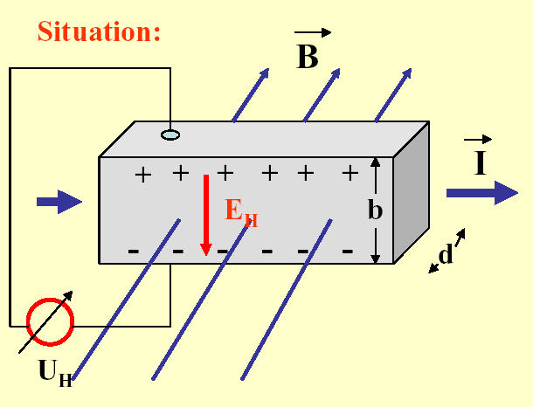

Electronic Physics Dr. Ghusoon Mohsin Ali
Hall Effect:
As shown there is a current Ix resulting from an applied electric field Ex in
x- direction an electrons will drift vx. A magnetic field By (wb/m²) is superposed on applied electric field Ex , whereby the current Ix and the magnetic flux By are perpendicular to each other. The electrons will experience a Lorentz force Fz perpendicular to Ix and By ( in z direction)
F = ev B
z x y
Thus the electrons under the influence of this force will tend to crowds one face in the sample. This collection of electrons to one side establish an electric field in z-direction is known Hall effect EH or Ez. Resulting a voltage VH between the upper and the lower faces of the sample is observed:
On the other hand
eE = ev B
z
x y
the current density Jx is given by:
E = v B
J_{x} = σE_{x}
J = nev
x x
z
x y
VH
Fig. 5.7. Hall measurement situation

Slide 6
Electronic Physics
Dr. Ghusoon Mohsin Ali
J
E = ^{x} B
z
ne
y
J
I I
₌ x ₌ x
A bd
x
Hall coefficient
R
₌ 1
ne
H
Where n is the total number of charge carrier per volum
I
E = R
x _{B}
z
^{H} bd
y
V
I
H _{= R}
x _{B}
b
^{H} bd
y
V = R
H H
I
x _{B}
d
y
I
n = ^{x} B
V ed
y
H
Where all the quantities in the right-hand side of the equation can n measured. Thus the carrier concentration and carrier type can e obtained directly from the Hall measurement.
J = σE = neμE
x x x
I neμV
x ₌ x
A
L

Slide 7
Electronic Physics
Dr. Ghusoon Mohsin Ali
I L
_{μ =} x
neV A
x
Example
Determine the majority carrier concentration and mobility, sample 10⁻¹cm length and 10⁻²×10⁻³cm² cross section area, given Hall effect parameters Ix=1mA, Vx=12.V, B=5×10⁻²tesla, VH=-6.25mV.
Solution
The negative Hall voltage indicate n-type semiconductor
I
n = ^{x} B
V ed
y
H
− (10⁻³ )(5×10⁻² )
n =
21 −3
(1.6×10⁻¹⁹ )(10⁻⁵ )(−6.25×10⁻³ )
= 5×10 m
I L
_{μ =} x
neV A
x
(10⁻³ )(10⁻³ )
μ =
2
(1.6×10⁻¹⁹ )(5×10²¹)(12.5)(10⁻⁴ )(10⁻⁵ )
= 0.1m /V.s

Slide 8
Electronic Physics Dr. Ghusoon Mohsin Ali
Problems
Q1: Calculate the drift current density in silicon sample. If T=300 K, Nd=10²¹/m³, Na=10²⁰/m³V, µn=0.85m²/V.s, µp=0.04m²/V.s, E=35
V/cm..
(Ans: 6.8×10⁴A/m²).
Q2: A cubic doped n-type silicon semiconductor sample at T=300 K,
µn=0.85m²/V.s, R=10kΩ, J=50A/cm² when 5V is applied. Calculate
ND.
.
Q3: Determine 10mm×1mm×1mm sample, a magnetic field 0.2wb/m² is superposed on applied voltage 1mV. Calculate Hall voltage if electrons density 7×10²¹/m³μn=0.4 m²/Vs.

