Slide 1
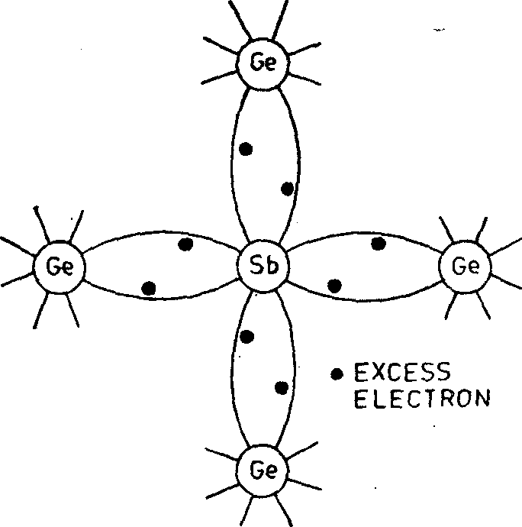
Electronic Physics Dr. Ghusoon Mohsin Ali
Extrinsic Semiconductors
The real power of semiconductors is realized by adding small, controlled
amount of specific dopant, or impurity atoms. The doping process can greatly alter the electrical characteristics of the semiconductor. The doped semiconductor called extrinsic semiconductors, which is the primary reason that we can fabricate the various semiconductor devices. The usual doping are:
1. V group atoms having five valence electrons (arsenic, antimony, phosphorus) or
III group atoms having three valence electrons (gallium, indium, aluminum, boron).
2.
V group doping atom is known as donor atom because it donates one electron to the conduction band of pure semiconductor. The III group atom, on the other hand, is called acceptor atom because it accepts one electron from the semiconductor atom.
Extrinsic semiconductors can be subdivided into two classes:
n-type semiconductors
p-type semiconductors.
(i) n-type Extrinsic Semiconductor.
Fig. 5.1 Schematic bond representation for n-type germanium doped with antimony

Slide 2
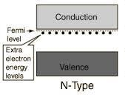







Electronic Physics Dr. Ghusoon Mohsin Ali
This n-type is obtained when a V Group material like antimony (Sb) is added to pure semiconductor crystal; each antimony atom forms covalent bonds with the surrounding four germanium atoms with four of its five electrons. The fifth electron is loosely bound to the antimony atom. Hence, it can be easily excited from the valence band to the conduction band, practically every antimony atom introduced one conduction electron without creating a positive hole, and makes the pure semiconductor an n-type (n for negative) extrinsic. In terms of energy levels, the fifth antimony electron has an energy level (called donor level) just below the conduction band. Usually, the donor level is 0.01 eV below conduction band for germanium and 0.054 eV for silicon. In n-type semiconductor, electrons are the majority carriers (nn) while holes the minority carriers (pn), (nn) >>( pn ).
Fig. 5.2 The energy band diagram showing the discrete donor energy state
E E
N(E) f(E,T)
N(E)
Ec
Electrons
Ec
EF
Ev
N(E)(1-
N(E)
Holes
Fig. 5.3 The density of states function N(E), the Fermi-Dirac distribution function f(E), and areas representing electron and hole concentrations for the case when EF is above the intrinsic Fermi energy.

Slide 3
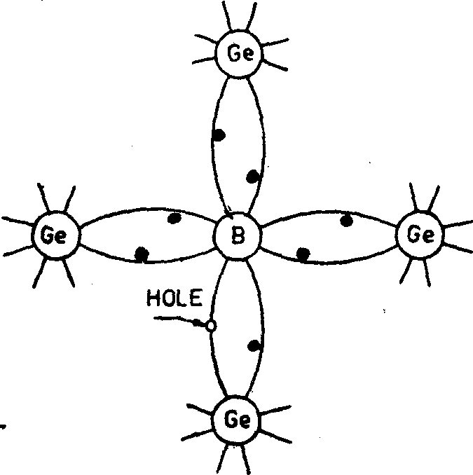
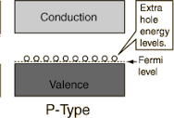
Electronic Physics
(ii) p-type Extrinsic Semiconductor.
Dr. Ghusoon Mohsin Ali
Fig. 5.4 Schematic bond representation for p-type germanium doped with boron
Fig. 5.5 The energy band diagram showing the discrete acceptor energy state
This p-type is obtained when a III Group material like boron (B) is added to pure semiconductor crystal. In this case, the three valence electrons of boron atom form covalent bonds with four surrounding
germanium atoms but one bond is left incomplete and gives rise to a hole
Thus, boron which is called an acceptor impurity causes as many positive holes in a germanium crystal as there are boron atoms thereby producing a p-type (p for positive). Accordingly, holes form the majority carriers (pp) whereas electrons form the minority carriers(np), (pp) >>(np). Fermi level shifts nearer to the valence band, the acceptor level lies immediately above the Fermi level. Conduction is by means of hole movement.

Slide 4







Electronic Physics
Dr. Ghusoon Mohsin Ali
law mass of action
E
ni²=ni pi=nn pn=np pp
E
N(E) f(E,T)
N(E)
Electrons
Ec
EF
N(E)
Holes
N(E)(1-f(E,T))
Fig. 5.6 The density of states function N(E), the Fermi-Dirac distribution function f(E), and areas representing electron and hole concentrations for the case when EF is below the intrinsic
Fermi energy.
Majority and Minority Carriers
In a piece of pure semiconductor, no free charge carriers are available at
0°K, as its temperature is raised to room temperature, some of the covalent bonds are broken by heat energy and as a result, electron-hole pairs are produced. These are called thermally-generated charge carriers/
An intrinsic semiconductor can be converted into a:
p-type semiconductor by the addition of an acceptor impurity(NA) adds a large number of holes to it. Hence, in p-type holes (pp)both added (NA)and thermally-generated (pi)
p = N + p
p A i
N-type semiconductor by the addition of an donor impurity(ND) adds a large number of electrons to it. Hence, in
n = N + n
n D i
N-type electrons (nn) both added (ND) and

Slide 5
Electronic Physics
Dr. Ghusoon Mohsin Ali
thermally-generated (ni)
Example
Calculate the number of free electrons in pure silicon at ordinary temperatures. If one silicon atom out of every million atoms is replaced by an arsenic atom, how many free electrons per cubic meter are there? If
density 2.33×10³ kg/m³, atomic weight 28.086, Eg=1.1eV.
Solution
n = N N exp(−Eg / 2kT ) = 1.46×10¹⁶ / m³
i v c
N × Density
N = ^{Avo} = 5×10²⁸ / m³ Atomicweight
No. of impurity atom=ND
N =
5×10²⁸
22
3
D
10⁶
= 5×10 / m
n = N + n = 5×10²² +1.467×10¹⁶
n D i
n = 10¹⁶ (5×10⁶ +1.467) ≈ 5×10²²
n
Example
Calculate the number of electrons and holes in silicon if Fermi energy is
0.25 below the conduction. At T=300K, the value of Nc=2.8×10²⁵/m³ and Nv=1.04×10²⁵/m³.
Solution
If we have the bandgap energy of silicon is 1.12 then the Fermi level will be 0.87 eV above Ev
n = N_{c} exp(−(E_{c} − E_{F} ) / kT)

Slide 6
n = (2.8×10²⁵ )exp(−(0.25) / 0.0259) = 1.8×10¹⁹ m⁻³
p = N_{v} exp(−(E_{F} − E_{v} ) / kT)
Electronic Physics
Dr. Ghusoon Mohsin Ali
p = (1.04×10²⁶ )exp(−(0.87) / 0.0259) = 2.7 ×10¹⁰ m⁻³
The change in the Fermi level is a function of the donor and acceptor impurity concentration.
Compensated Semiconductor
Compensated Semiconductor is one that contain both donor and acceptor impurities in the same region. During the manufacture of Semiconductor devices n-type material may have to be changed to p-type by addition acceptor impurities NA and the reverse also required.
If ND>>NA NA>>ND NA=ND
n-type p-type intrinsic
Neutrality Base: +ve charge= -ve charge
p + N ⁺ = n + N ⁻
D
A
n² = np
i
And if
N − N >> n
Then it is n-type
D
A
i
n ≈ N
N
n
D A
if
N − N >> n
Then it is p-type
A
D
i
p ≈ N − N
p A D

Slide 7
Electronic Physics
Dr. Ghusoon Mohsin Ali
Example
Calculate the number of electrons and holes in n-type silicon. At T=300K, if the value of ND=10²²/m³ and NA=0. ni=1.5×10¹⁶/m³
Solution
N − N >> n
D A i
n ≈ N − N
≈ 10²² / m³
n D
A
_{n} 2
_{p =} i
n
n
n
(1.5×10¹⁶ )²
p =
₁₀22
= 2.25×10¹⁰ / m³
n
Example
In silicon at ordinary temperatures calculate majority and minority
carriers for (i) donor impurities 2.4×10¹⁹/m³ (ii) donor impurities 2.4×10¹⁹/m³
and acceptor impurities 4.8×10¹⁹/m³. Eg=1.12eV.
Solution
(i)
n = N N exp(−Eg / 2kT ) = 1.46×10¹⁶ / m³
i
v c
majority carriers
n = N = 2.4 ×10¹⁹ / m³
n D
minority carriers
_{n} 2
(1.46×10¹⁶ )²
p = ^{i} =
= 0.896×10¹³ / m³
n
n
n
2.4 ×10¹⁹

Slide 8
Electronic Physics
Dr. Ghusoon Mohsin Ali
(ii)
p-type
N > N
A D
N_{A} − N_{D} >> n_{i}
= 4.8×10¹⁹ − 2.4×10¹⁹
is
N_{A} − N_{D}
= 2.4×10¹⁹ / m³
2.4×10¹⁹>1.46×10¹⁶/m³
p ≈ N − N = 2.4×10¹⁹ / m³
p A D
_{n} 2
n = ^{i} = 0.896×10¹³ / m³
p
p
p
Example
In silicon at ordinary temperatures calculate majority and minority carriers if doped with 3×10²²/ m³ acceptor impurities and 2.9×10²²/m³ donor impurities Eg=1.1eV.
Solution
Is
N − N >> n
D A i
N − N = 2.9×10²² − 3×10²²
D A
=1×10²¹ / m³
ni=1.46×10¹⁶/m³ 10²¹>>1.46×10¹⁶/m³
then pp=NA-ND=1×10²¹/m³
_{n} 2
n = ^{i} = 2.152×10¹¹ / m³
p
p
p

Slide 9
Electronic Physics Dr. Ghusoon Mohsin Ali
Problems
Q1: Calculate electrons and holes concentration in a germanium sample . If T=300 K, Nd=5×10¹⁹/m³, Na=0. Assume that ni=2.4×10¹⁹/m³.
(Ans: 5.97×10¹⁹/m³, 9.65×10¹⁸/m³)
Q2: Calculate holes and electrons concentration in compensated silicon p-type sample. If T=300 K, Nd=3×10²¹/m³, Na=10²²/m³. Assume that ni=1.5×10¹⁶/m³.
(Ans: 7×10²¹/m³, 3.2×10¹⁰/m³)

