Slide 1
Electronic Physics Dr. Ghusoon Mohsin Ali
The magnetic quantum number (m) can be any integer between -l and +l. If l = 2, m can be either -2, -1, 0, +1, or
+2.
s: | l = 0 | has 1 orbital
p: | l = 1 | has 3 orbitals
d: | l = 2 | has 5 orbitals
f: | l = 3 | has 7 orbitals
Spin quantum number – ms
This fourth quantum number describes the spin of the electron.
  Electrons in the same orbital must have opposite spins.
  Possible spins are clockwise or counterclockwise, spin quantum number ms is arbitrarily assigned the numbers +¹/2
and -¹/2.
Pauli Exclusion Principle:
No two electrons in an atom have the same set of four quantum numbers
Electron configuration:The electron configuration for chlorine is (Z=17)
1s² 2s² 2p⁶ 3s² 3p⁵
The large numbers represent the energy level.
The letters represent the sublevel.
The superscripts indicate the number of electrons in the sublevel
Example

Slide 2
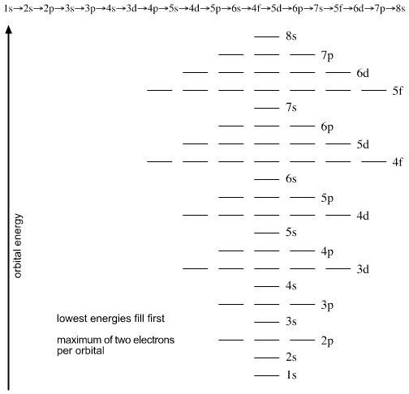
Electronic Physics Dr. Ghusoon Mohsin Ali
1s² 2s² 2p⁵ means "2 electrons in the 1s subshell, 2 electrons in the 2s subshell, and 5 electrons in the 2p subshell"
Fig. 1.4. The sequence of orbital filling is, from the bottom of this diagram, upwards.
The electrons in the outermost orbital are known as valence electrons and determine the physical and chemical properties of the elements. An arrangement of element in term of their valence electrons forms the basis

Slide 3
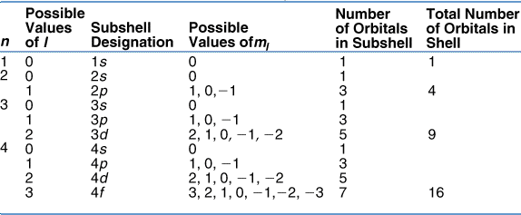
Electronic Physics Dr. Ghusoon Mohsin Ali
of the periodic table. Elements in the groups І to VІІ have from one to seven valence electrons respectively.
Interatomic forces are caused by electrons in outer shell (valence shell).
Atoms with 8 electrons in their outer shell ( completely filled s and p sub shell they are very stable. Most other elements attempt to reach this stable structure by one of three mechanics:
Losing electrons:-potassium (Z=19) 1s² 2s² 2p⁶ 3s² 3p⁶ 4s¹ losing 4s electron leaving the potassium ion with stable structure.
Gaining electrons:-chlorin (Z=17) 1s² 2s² 2p⁶ 3s² 3p⁵ can have a stable filled shell if they receive one electron.
Sharing electrons:-silicon 1s² 2s² 2p⁶ 3s² 3p² share 4 electrons with 4 other silicon atoms each of which also shares silicon atom.
There are three very important ways in which binding energy provided to form a stable structure. These are ionic bond, covalent bond, metallic bond.
Table 1.2. Relationship among values of n, l and ml

Slide 4
Electronic Physics Dr. Ghusoon Mohsin Ali
The Energy-band Theory of Crystals
Most metals and semiconductors are crystalline in structure. A crystal
consists of a space array of atoms or molecules (ions) built up by regular
repetition in three dimensions of some fundamental structural unit. The electronic energy levels discussed for a single atom do not apply to the same atom in a crystal. When atoms form crystals it is found that the energy levels of the inner-shell electrons are not affected appreciably by the presence of the neighboring atoms. However, the level of the outer- shell electrons is changed considerably, since these electrons are shared by more than one atom in a crystal. For example consider a crystal of Si consist of N atoms. If the atoms are so far apart that the interaction between them negligible. The outer two subshell of Si contain two s electrons and two p electrons. There are 2N electrons completely filling the 2N possible s level. Since the p atomic sub shell has six possible states with 2N electrons. Because the coupling between atoms, the crystal becomes an electronic system which must obey the Pauli exclusion principle. The separation between level are small, but since N is very large (5×10²² cm⁻³), this large number of discrete but closely spaced energy levels called energy band. The 2N states of s band are completely filled with 2N electrons, the p band of 6N states which only 2N of its levels has occupied by electrons. Note that there is an energy gap between two bands and this gap decrease as the atomic spacing decreases. These bands will overlap for small enough distance. The 6N upper states merge with the 2N lower states, giving total of 8N levels, half of which are occupied by the available electrons. At this spacing each atom has given up four electrons to the band, these electrons can no longer be said to orbit in s or p subshell of an isolated atom, but rather they belong to the crystal as a whole. At the crystal lattice spacing, we find the valance band filled with 4N electrons separated by a forbidden

Slide 5
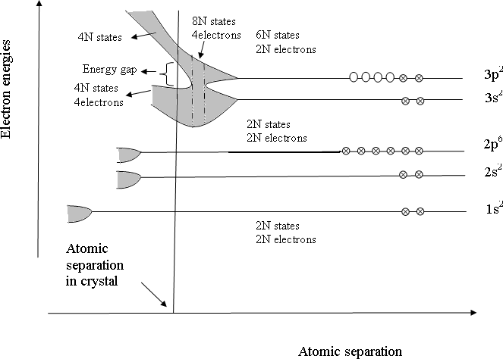





Electronic Physics Dr. Ghusoon Mohsin Ali
band (Eg) from an empty band consisting of 4N additional states. This upper vacant band is called the conduction band.
(a)
Vacuum level
E0
χ Electron affinity
Conduction band
Ec
Energy gap
Eg
Valence band
Ev
Electron
(b)
Fig.1.5. Formation of energy bands for electrons in a silicon crystal with a diamond-type lattice structure

Slide 6
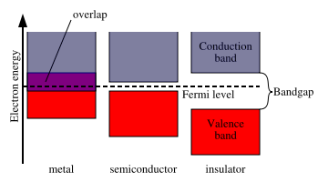
Electronic Physics Dr. Ghusoon Mohsin Ali
The most electrical properties of importance to engineers are related to the upper two bands of energy levels called the conduction band and valence band. The valence band contains energies of the same level as those of valence electrons. The conduction band energies are the empty levels above the valence band. Electrons in the valence band can leave their band to join conduction band if given sufficient energy to jump the forbidden energy band gap (Eg).
The size of Eg is a prime factor to determining a solid is conductor, an insulator or semiconductor.
Fig. 1.6. The size of Eg to determine a solid is conductor, an insulator or semiconductor
Conductors contain a large number of electrons in the conduction band at room temperature. No energy gap exist and the valence and conduction band overlap.
An insulator is a material in which the energy gap is so large that practically no electron can be given enough energy to jump this gap.
A semiconductor is a solid with an energy gap small enough for electrons to cross from valence band to conduction band at room temperature Silicon (Eg=1.1eV), Germanium (Eg=0.7eV)

Slide 7
Electronic Physics Dr. Ghusoon Mohsin Ali
Problems
Q1: Calculate the radius r of orbit and velocity of an electron with total energy of -3.4 eV in hydrogen atom.
(Ans:- 2.1164Å, 1.0936 ×10⁶
m/s)
Q2: Write all quantum number for the final electron for potassium Z=19 and chlorine Z=17.
Q3: An electron drop from n=2 to ground state calculate
The energy of emitted radiation
The radius when n=2
Compare between the wavelength of an electron exist in a stable orbit n=1 and the wavelength of dust particle of mass 1×10⁻⁶kg and velocity 1ms⁻¹
(Ans:- 10.19eV, 0.212nm, 1.05×10⁻¹⁰m, 6.626×10⁻²⁹m)
Q4: Calculate the energy momentum and de Broglie wave length of electron accelerated from rest by 200V.
(Ans:3.2×10⁻¹⁷J, 7.639×10⁻
²⁴kg.m.s⁻¹,0.867×10⁻¹⁰m)
Q5: An electron drops from specific energy level to ground state (n=1) in hydrogen atom. The energy difference between these two levels is 12.75 eV. Calculate the initial state of the electron and λ of the emitted radiation. (Ans: ni = 4, 972.54 Å)

