Slide 1
Knoop and Vickers Microindentation Hardness
Both Brinell's and Rockwell tests are used in macroscales. Two other hardness-testing techniques are Knoop and Vickers (sometimes also called diamond pyramid). For each test a very small diamond indenter having pyramidal geometry is forced into the surface of the specimen. Applied loads are much smaller than for Rockwell and Brinell, ranging between 1 gf and 1000gf. In the Vickers test, the force is applied smoothly, without impact, and held in contact for 10 to 15 seconds. The force must be controlled precisely. After removing the force, both diagonals are measured and the average is used to calculate the HV. Careful specimen surface preparation (grinding and polishing) may be necessary to ensure a well-defined indentation that may be accurately measured. The Knoop and Vickers hardness numbers are designated by HK and HV, respectively, and hardness scales for both techniques are approximately equivalent. Knoop and Vickers are referred to as microindentation-testing methods on the basis of indenter size. Both are well suited for measuring the hardness of small, selected specimen regions. furthermore, The Knoop indenter is similar to the Vickers indenter except that the diamond pyramid has unequal length edges, resulting in an impression that has one diagonal with a length approximately seven times the shorter diagonal, thus Knoop is used for testing very hard materials such as ceramics.

Slide 2
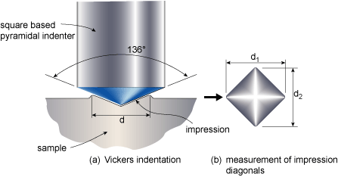
Figure (4) Vickers Hardness test
HV = F/A , where A is resulting area of indentation
A= d² / 2 sin (136/2) A= d² / 1.854
So, HV= 1.854 F / d² , F in KgF and d = d₁ +d₂ / 2 in (mm)
HV = KgF/ mm²
HV can be converted to SI units
HV= 1.854 x (9.8) F / d² = 18.16 F/ d² ( MPa)

Slide 3
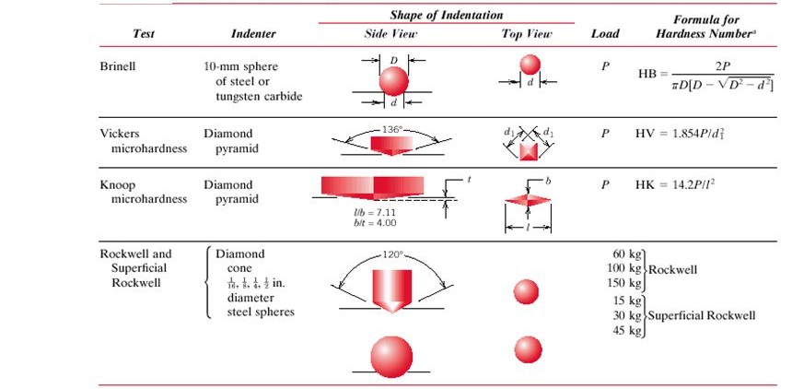
Types of Hardness tests

Slide 4
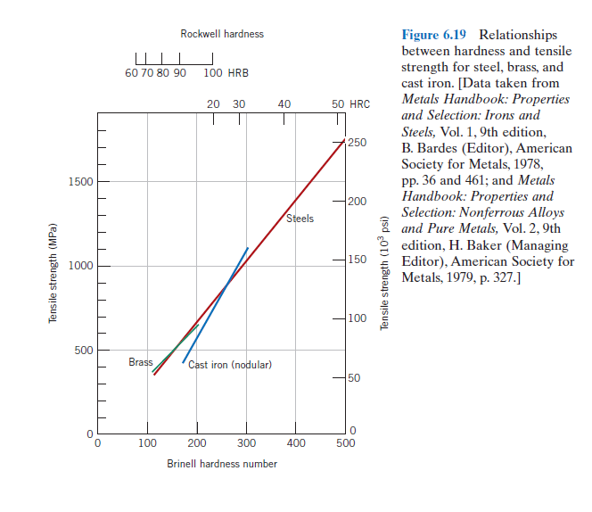
Correlation Between Hardness and Tensile Strength
Both tensile strength and hardness are indicators of a metal’s resistance to plastic deformation. Consequently, they are roughly proportional, as shown in Figure (5),for tensile strength as a function of the HB (Brinell Hardness) for cast iron, steel, and brass. The same proportionality relationship does not hold for all metals, as Figure (5) indicates. As a rule of thumb for most steels, the HB and the tensile strength are related according to:
TS (MPa) = 3.45 x HB
5

Slide 5
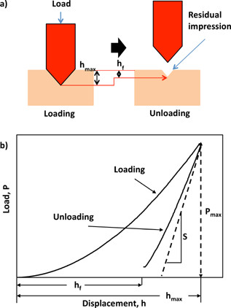
Nanoidentation : It is used for thin film materials. In nanoindentation small loads and tip sizes are used, so the indentation area may only be a few square micrometres or even nanometres. Instead, an indenter with a geometry known to high precision (usually a Berkovich tip about 20 nm radius , which has a three-sided pyramid geometry) is employed. During the course of the instrumented indentation process, a record of the depth of penetration is made, and then the area of the indent is determined using the known geometry of the indentation tip. While indenting, various parameters such as load and depth of penetration can be measured. A record of these values can be plotted on a graph to create a load-displacement curve (such as the one shown in Figure 6).
hc

Slide 6
These curves can be used to extract mechanical properties of the material such as :
Hardness H = P_{max} / A_{c}
(area of contact) A_{c} = π( tan(θ) h_{c})² = 24.5 h_{c}²
h_{c} = depth of contact
θ = 70.32⁰ for Berkovich tip
2- Young's modulus: The slope of the curve dP/dh upon unloading is indicative of the stiffness of the contact.
3- fracture toughness (ability of materials containing crack to resist fracture KIC)
4- elastic and plastic energy

