Slide 1
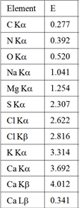
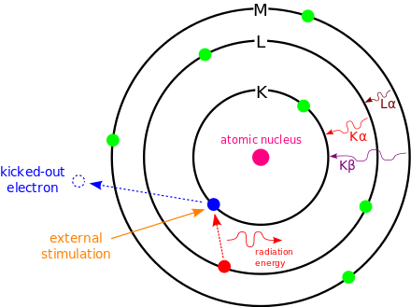
Energy dispersion x-ray ( EDX) resulting as incident electron strike unexcited atoms, electrons from inner shell will be ejected and leave a hole. Electrons from higher shell will fill the hole and release excess energy as x-ray which is used EDX or ejecting the third electeon known as Auger electron. Since each atom in periodic table has a unique electronic structure with a unique set of energy levels, both x-ray emission and Auger are used to determine chemical compositions of the sample.
Table of x-ray emission for some elements.

Slide 2
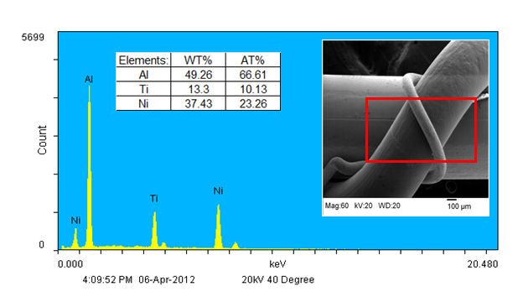
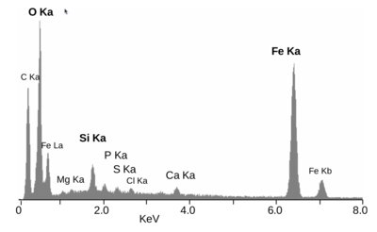
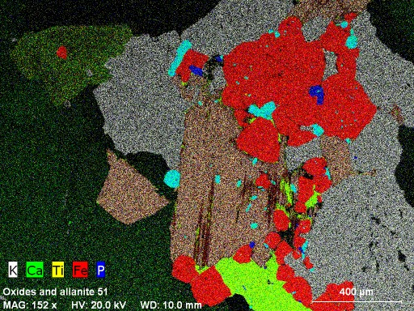
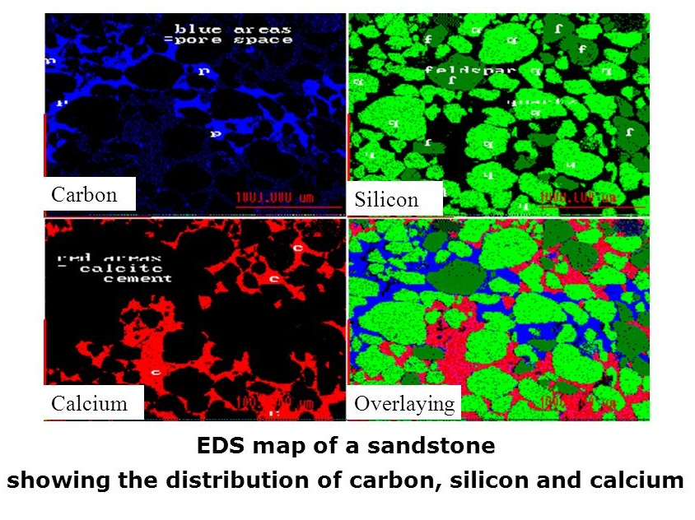

Slide 3
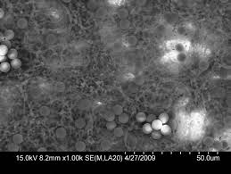
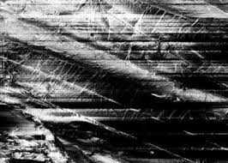
Defect in SEM imaging :
Charging
As explained before, the incident electrons are entered to the specimen and loss their energy when the specimen is conductive. If specimen is not conductive, the incident electrons will accumulate at the surface ( that is charging ), and number of electrons exit from the specimen is less than electrons hit the specimen. Charging causes the SEM image appears in in broken way.
Figure -7- charging effect on SEM images

Slide 4
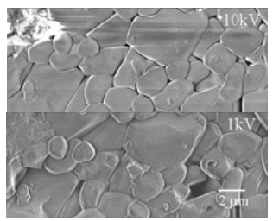
Charging could be prevented by :
Coating with a thin film of conductive metals ( Au, Pt )
Low – accelerating voltage:
The number of secondary electrons increased as the accelerating voltage is decreased. This means, the number of SE electrons are equal to the number of incident electrons at low accelerating voltage. So, even the non-conductive materials such as ceramic can be imaged without charging.
Fig -8- Compare between high voltage mode and low voltage mode of insulator materials

