Slide 1
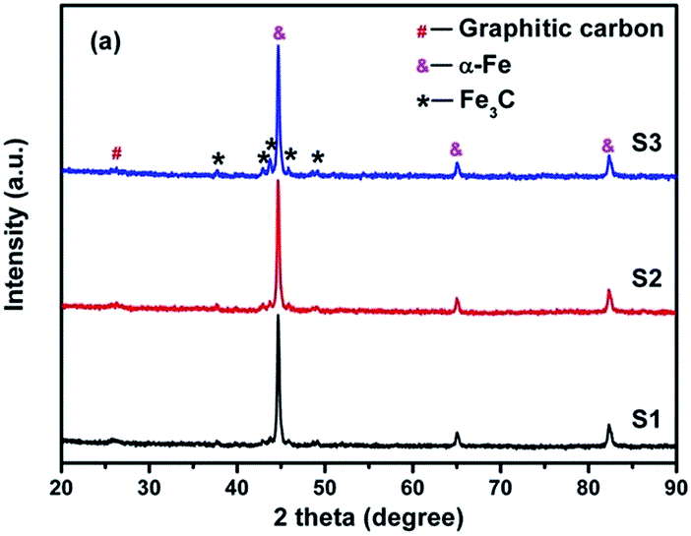
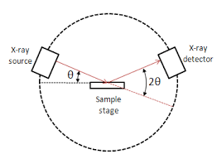
Phase identification
Identification of crystalline substance and crystalline phases in a specimen is achieved by comparing the specimen diffraction spectrum with spectra of known crystalline substances. X-ray diffraction data from a known substance are recorded as a powder diffraction file (PDF). Most PDFs are obtained with Cu (Kα) radiation (wave length = 1.54 A⁰ )

Slide 2
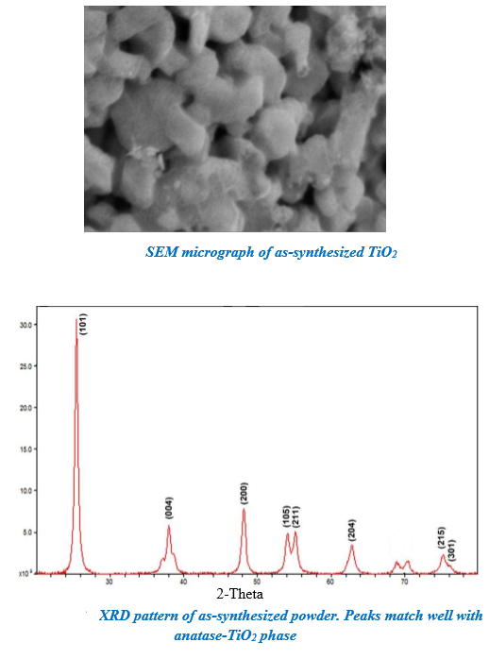
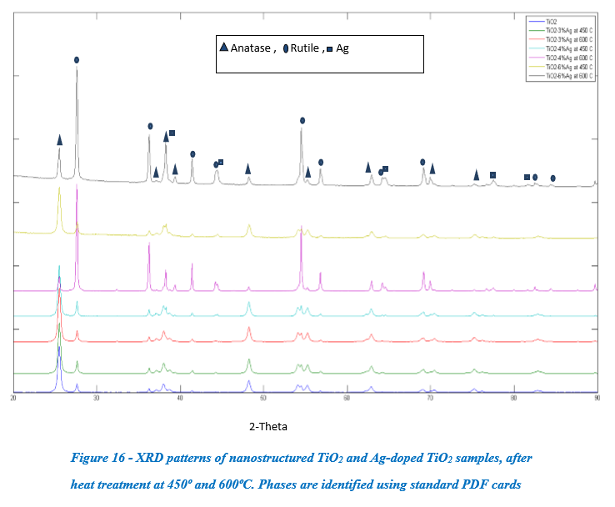
Particles size = 100 nm , crystalline size is 20 nm.

Slide 3
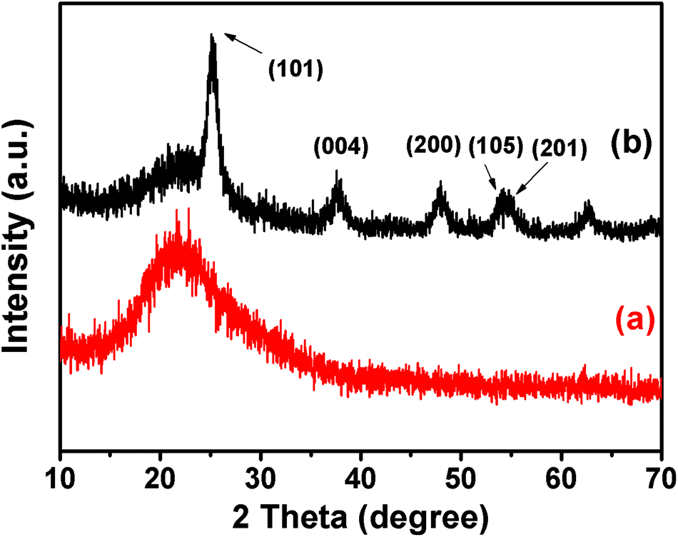

Slide 4
Crystalline size determination
D=Kλ / (β cos θ).
K= 0.9 ( shape factor), D= crystal size, β = fWHM ( full width half max of the peak) in Rad , θ = bragg's angle
Rad = (22 * FWHM) / (7 * 180) = FWHM * 0.01746
Residual stress
In real life XRD peaks can be affected by stresses inside the material which are the effect of thermal or mechanical processing, or chemical contamination. Such effects can give rise to peak broadening (especially with grain size) and if residual stresses are present, peak shifting.

