Slide 1
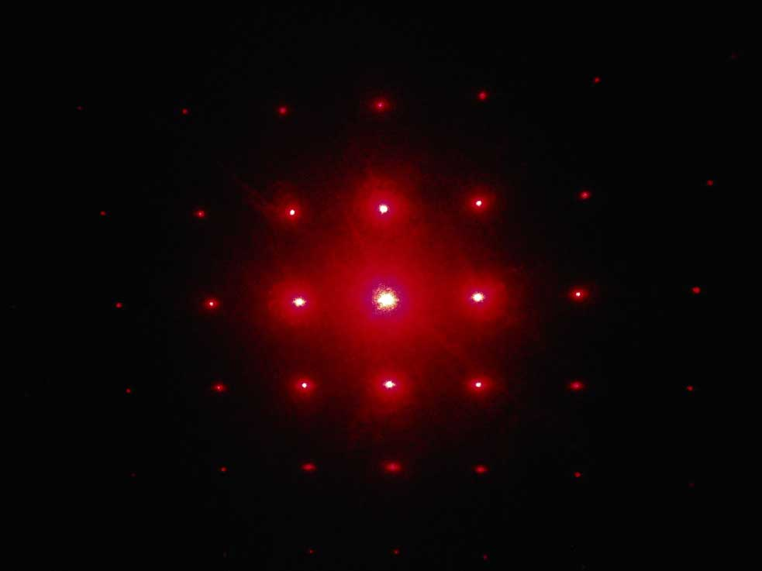
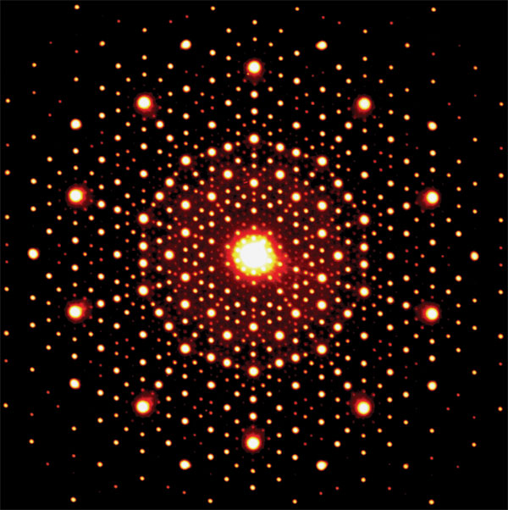
Diffraction in TEM
Samples can exhibit diffraction contrast, whereby the electron beam undergoes Bragg scattering, which in the case of a crystalline sample. Selected area electron diffraction (SAED) can be used to determine whether a specimen is single crystal, polycrystalline, or amorphous; identify the crystallographic structure, symmetry, and orientation of samples; measure the lattice parameter; identify if more than one phase is present. Single spots appear only when the beam is diffracted by a single crystal. Polycrystalline materials gives ring patterns analogous
Fig -6- SAED for single crystal (left image), polycrystalline ( right image)

Slide 2
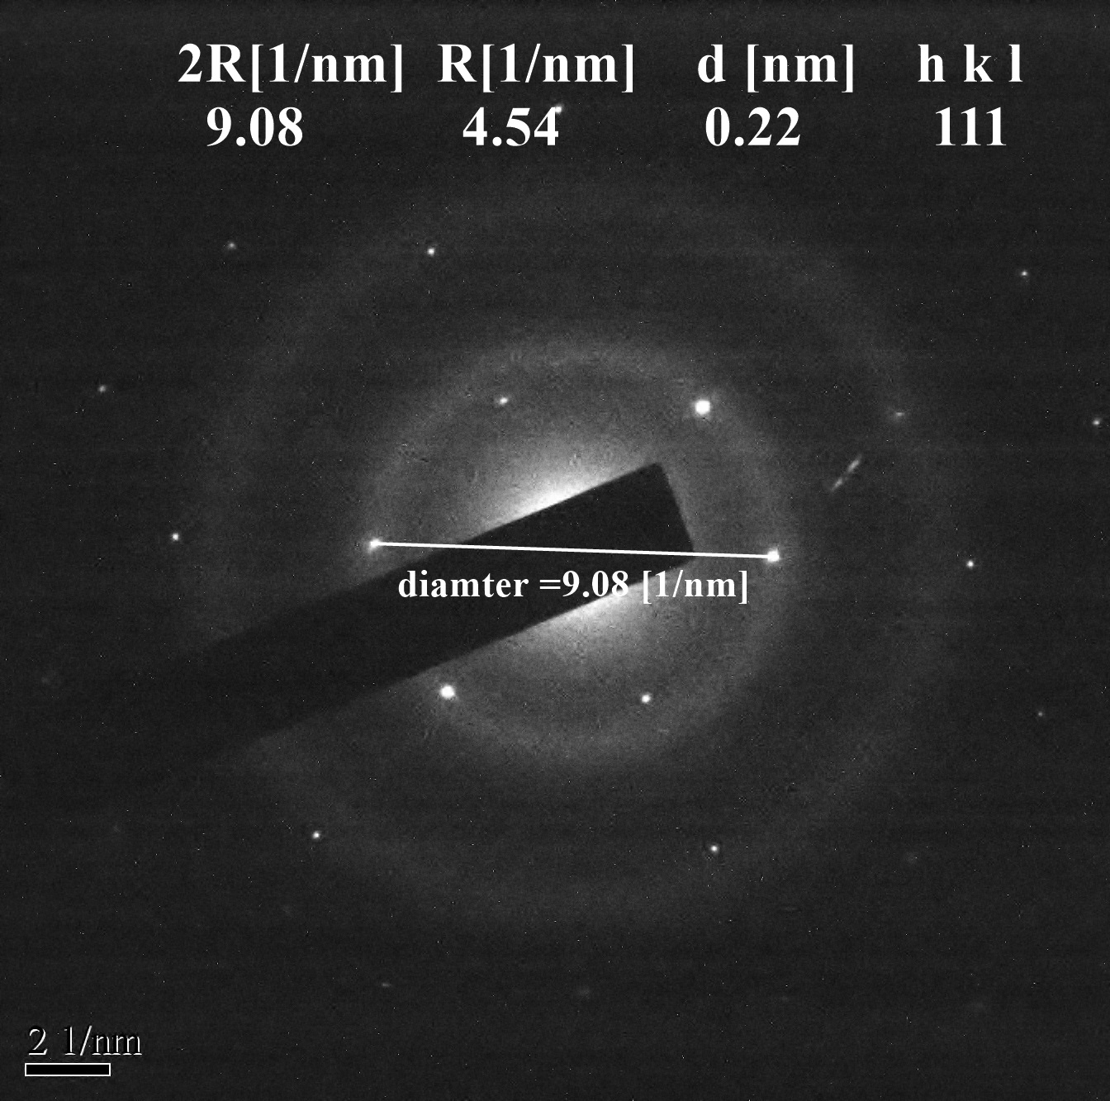
Fig -7- SAED pattern of polycrystalline materials

Slide 3
Electron energy-loss spectroscopy (EELS)
Electron energy-loss spectroscopy (EELS) is an analytical technique that measures the change in kinetic energy of electrons after they have interacted with a specimen. Electron energy-loss spectroscopy (EELS) involves measurement of the amount of energy needs to remove the electron from the shells
Zero-loss peak at 0 eV: It mainly contains electrons that still have the original beam energy E₀, i.e., they have only interacted elastically or not at all with the specimen ( incident electrons do not loss any energy).
Low-loss region (< 100eV) Here, the electrons that have induced plasmon oscillations occur.
High-Loss region (> 100eV) For the ionization of atoms, a specific minimum energy, the critical ionization energy E_{C} or ionization threshold, must be transferred from the incident electron to the expelled inner-shell electron, which leads to ionization edges in the spectrum at energy losses that are characteristic for an element. Thus, EELS is complementary toX-ray spectroscopy, and it can be utilized for qualitative and quantitative element analysis as well.

Slide 4
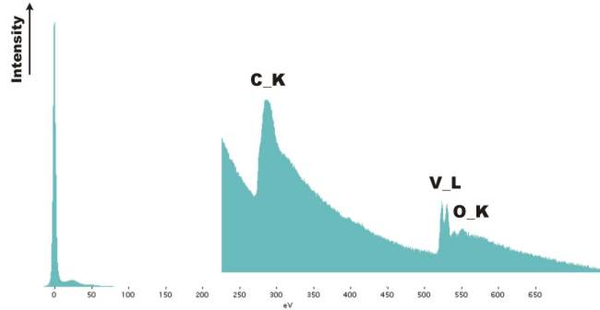
Fig -8- EELS of Vanadium oxide nanotube

