Slide 1
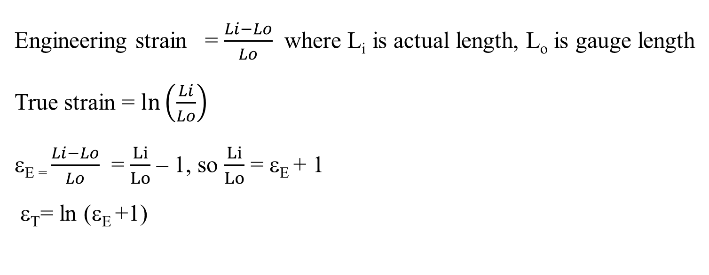
True stress and True strain
From fig 4 , the decline in the stress necessary to continue deformation past the maximum, point M, seems to indicate that the metal is becoming weaker. However, the cross-sectional area is decreasing rapidly within the neck region, where deformation is occurring. The stress, as computed from Equation 1, is on the basis of the original cross sectional area before any deformation, and does not take into account this reduction in area at the neck. Sometimes it is more meaningful to use a true stress–true strain scheme. True stress is defined as the load F divided by the instantaneous cross-sectional area over which deformation is occurring (i.e., the neck, past the tensile point)
Engineering strain = $\frac{Li−Lo}{Lo}$ where L_{i} is actual length, L_{o} is gauge length
True strain = $\ln\left(\frac{Li}{Lo}\right)$
ε_{E =} $\frac{Li−Lo}{Lo}$ = $\frac{Li}{Lo}$ – 1, so $\frac{Li}{Lo}$ = ε_{E} + 1
ε_{T}= ln (ε_{E} +1)

Slide 2
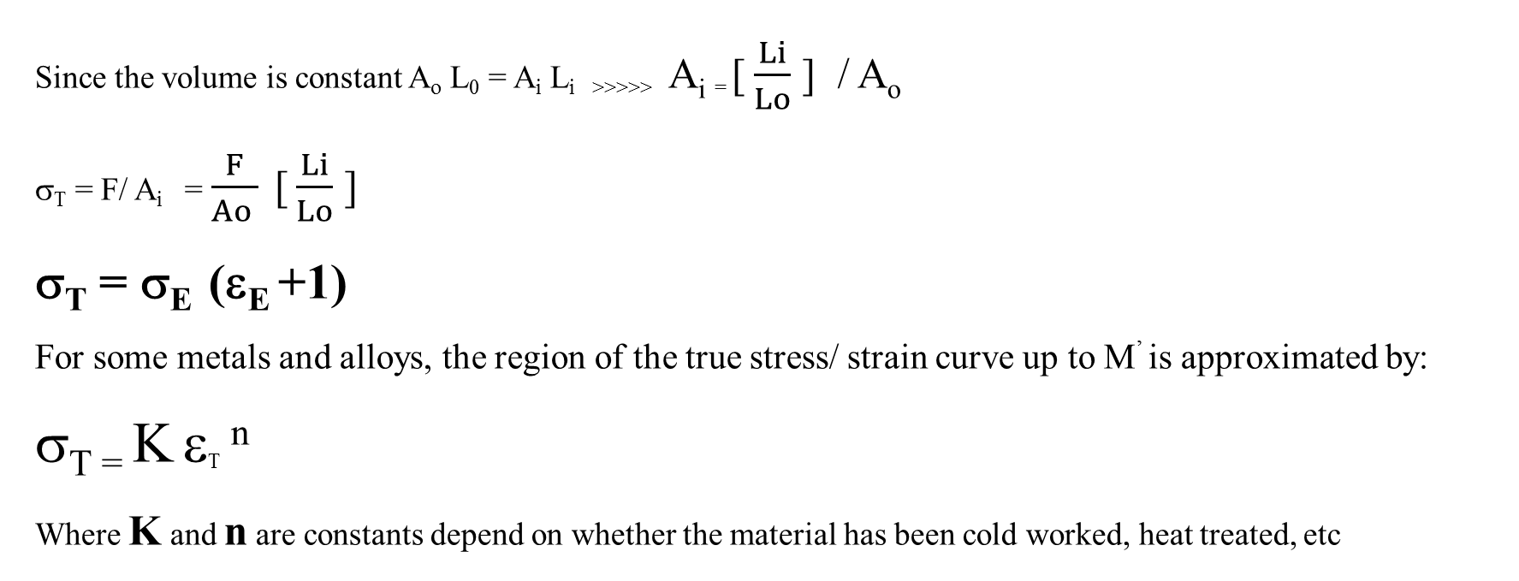
Engineering stress σ_{E} = F / A_{o} where A_{o} is original area
True stress (σ_{T}) = F/ A_{i} , where A_{i} is the area where the fracture occurring at the necking region
Since the volume is constant A_{o} L₀ = A_{i} L_{i >>>>>} A_{i =} [ $\frac{Li}{Lo}$ ] / A_{o}
σ_{T} = F/ A_{i} = $\frac{F}{Ao }$ [ $\frac{Li}{Lo}$ ]
σ_{T} = σ_{E} (ε_{E} +1)
For some metals and alloys, the region of the true stress/ strain curve up to M’ is approximated by:
σ_{T =} K ε_{T} ^{n}
Where K and n are constants depend on whether the material has been cold worked, heat treated, etc

Slide 3
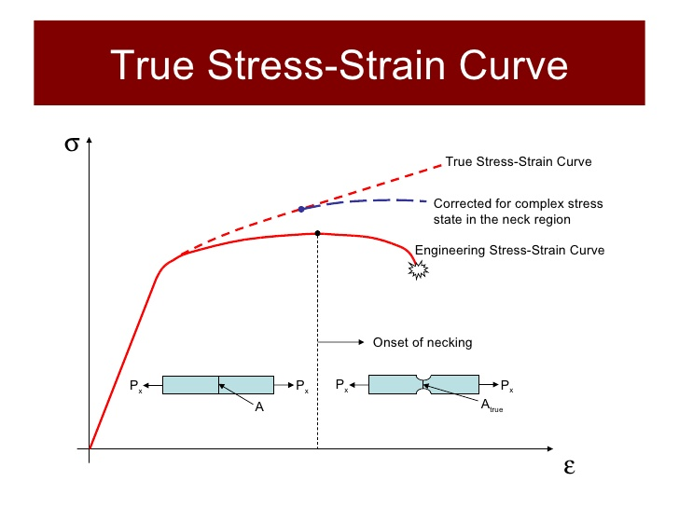
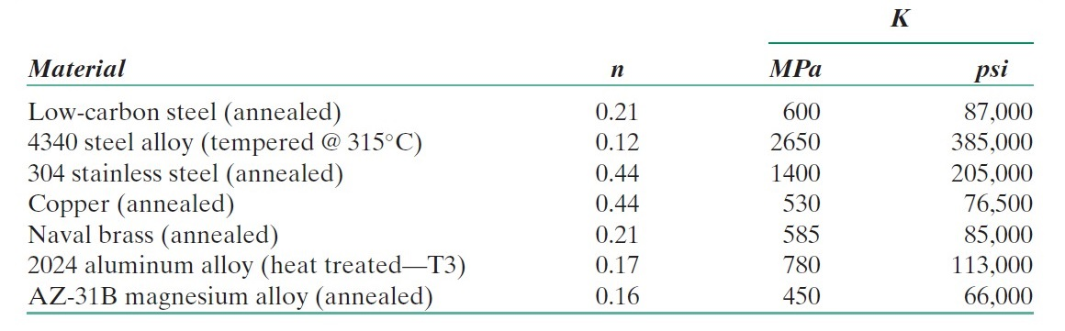
Figure (10) True stress-strain curve

Slide 4
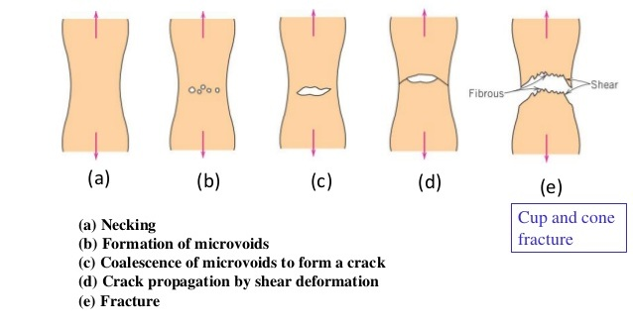
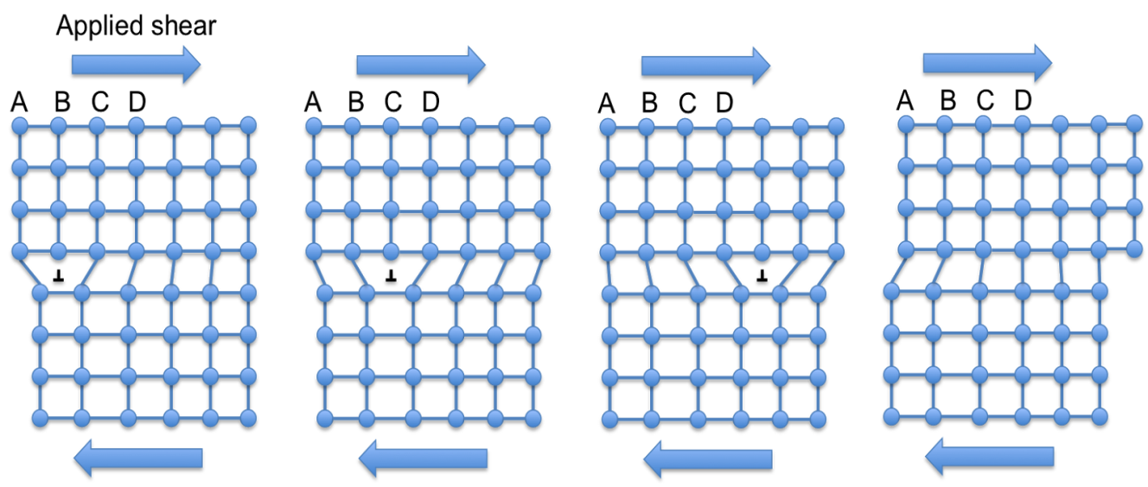
Ductile and Brittle materials fracture
Fracture: separation of a body into pieces due to stress, at temperatures below the melting point. Steps in fracture:
1- crack formation 2- crack propagation
In ductile fracture, the crack grows at a slow pace and is accompanied with a great deal of plastic deformation due to the motion of dislocation. In this, the crack does not expand except when high levels of stress are present.
Under the view of a microscope, the surfaces of materials with ductile fracture appear irregular and rough, and exhibit some dimpling
Figure (12) Dislocations motion in ductile materials
Figure (11) Steps of fracture for ductile materials

Slide 5
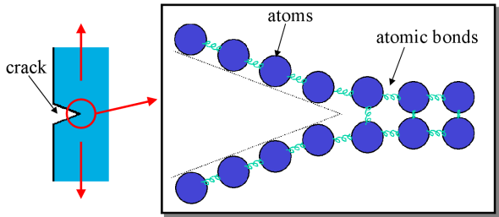
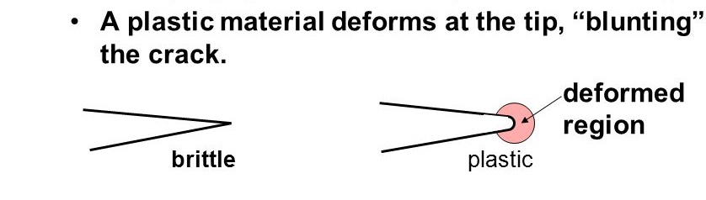
Brittle Fracture
Very little or no plastic deformation, Crack propagation is very fast , Crack propagates nearly perpendicular to the direction of the applied stress, Crack often propagates by cleavage - breaking of atomic bonds along specific crystallographic planes (cleavage planes).
Figure (12) difference in cracks for ductile and brittle materials
Figure (13) Crack propagation in Brittle materials

Slide 6
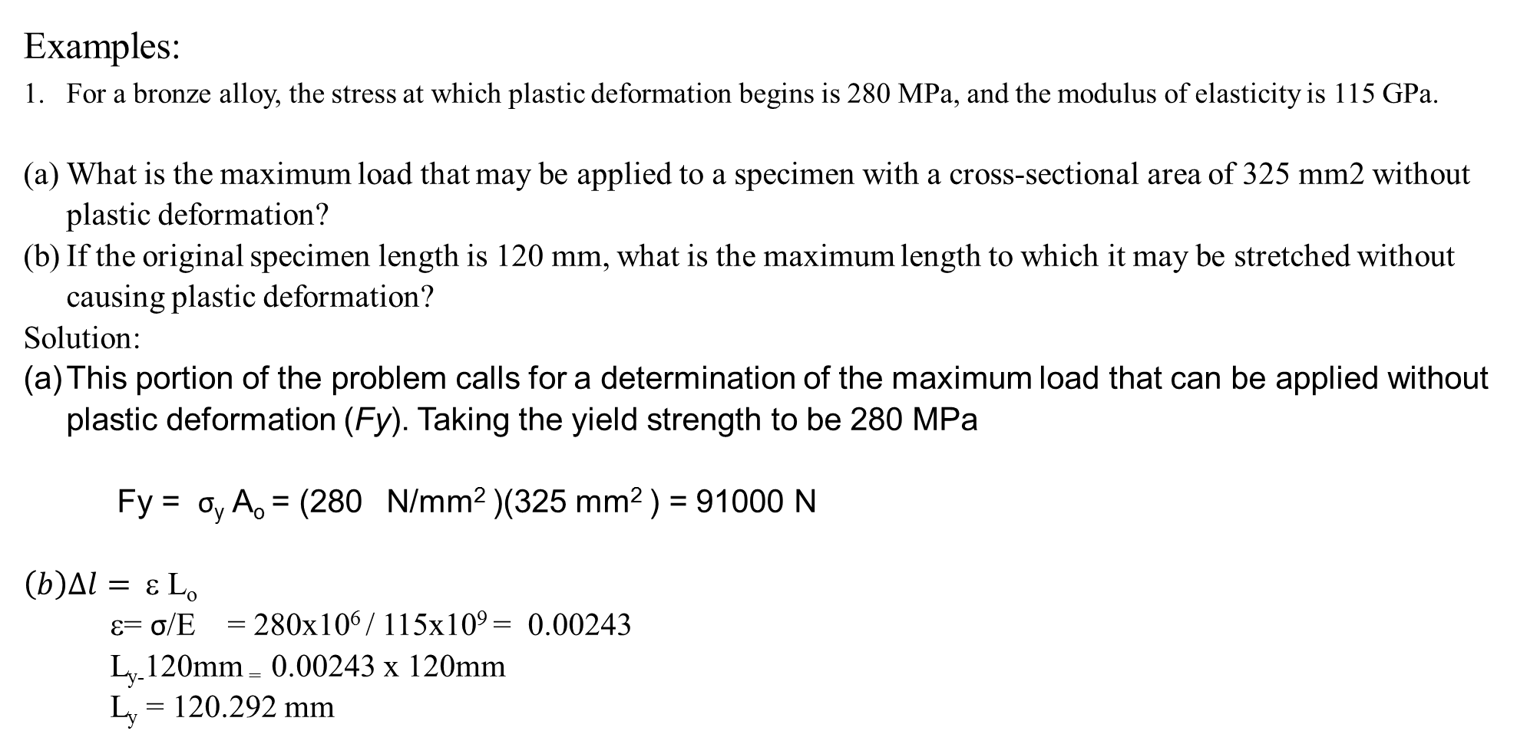
Examples:
For a bronze alloy, the stress at which plastic deformation begins is 280 MPa, and the modulus of elasticity is 115 GPa.
What is the maximum load that may be applied to a specimen with a cross-sectional area of 325 mm2 without plastic deformation?
If the original specimen length is 120 mm, what is the maximum length to which it may be stretched without causing plastic deformation?
Solution:
This portion of the problem calls for a determination of the maximum load that can be applied without plastic deformation (Fy). Taking the yield strength to be 280 MPa
Fy = σ_{y} A_{o} = (280 N/mm² )(325 mm² ) = 91000 N
$\left(b\right)∆l=$ ε L_{o}
ε= σ/E = 280x10⁶ / 115x10⁹ = 0.00243
L_{y-}120mm ₌ 0.00243 x 120mm
L_{y} = 120.292 mm

Slide 7
Example #2:
From the tensile stress–strain behavior for the brass specimen shown in
Figure below determine the following:
(a) The modulus of elasticity
(b) The yield strength at a strain offset of 0.002
(c) The maximum load that can be sustained by a cylindrical specimen having
an original diameter of 12.8 mm
(d) The change in length of a specimen originally 250 mm long that
is subjected to a tensile stress of 345 MPa

Slide 8
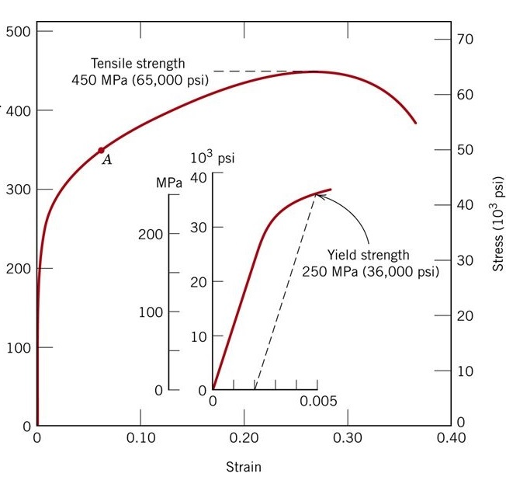
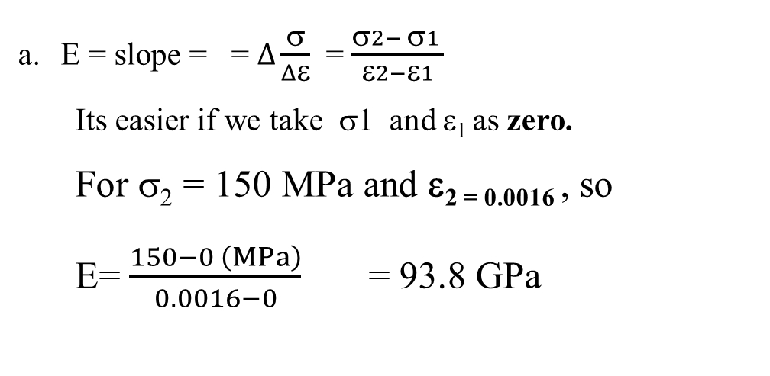
E = slope = = $Δ\frac{σ}{Δε}$ = $\frac{σ2− σ1 }{ε2−ε1}$
Its easier if we take σ1 and ε₁ as zero.
For σ₂ = 150 MPa and ε_{2 = 0.0016} , so
E= $\frac{150−0 \left(MPa\right)}{0.0016−0}$ = 93.8 GPa

Slide 9
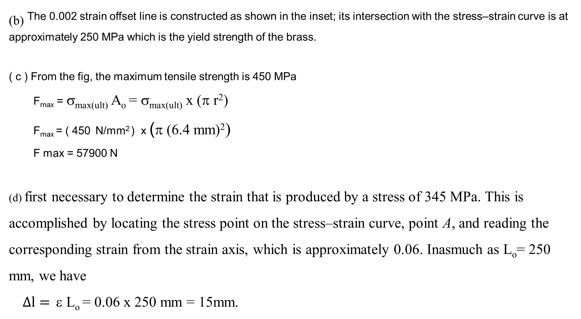
_{(b)} The 0.002 strain offset line is constructed as shown in the inset; its intersection with the stress–strain curve is at approximately 250 MPa which is the yield strength of the brass.
( c ) From the fig, the maximum tensile strength is 450 MPa
F_{max} = σ_{max(ult)} A_{o} = σ_{max(ult)} x (π r²)
F_{max} = ( 450 N/mm² ) x (π (6.4 mm)²)
F max = 57900 N
(d) first necessary to determine the strain that is produced by a stress of 345 MPa. This is accomplished by locating the stress point on the stress–strain curve, point A, and reading the corresponding strain from the strain axis, which is approximately 0.06. Inasmuch as L_{o}= 250 mm, we have
$∆l=$ ε L_{o} = 0.06 x 250 mm = 15mm.

Slide 10
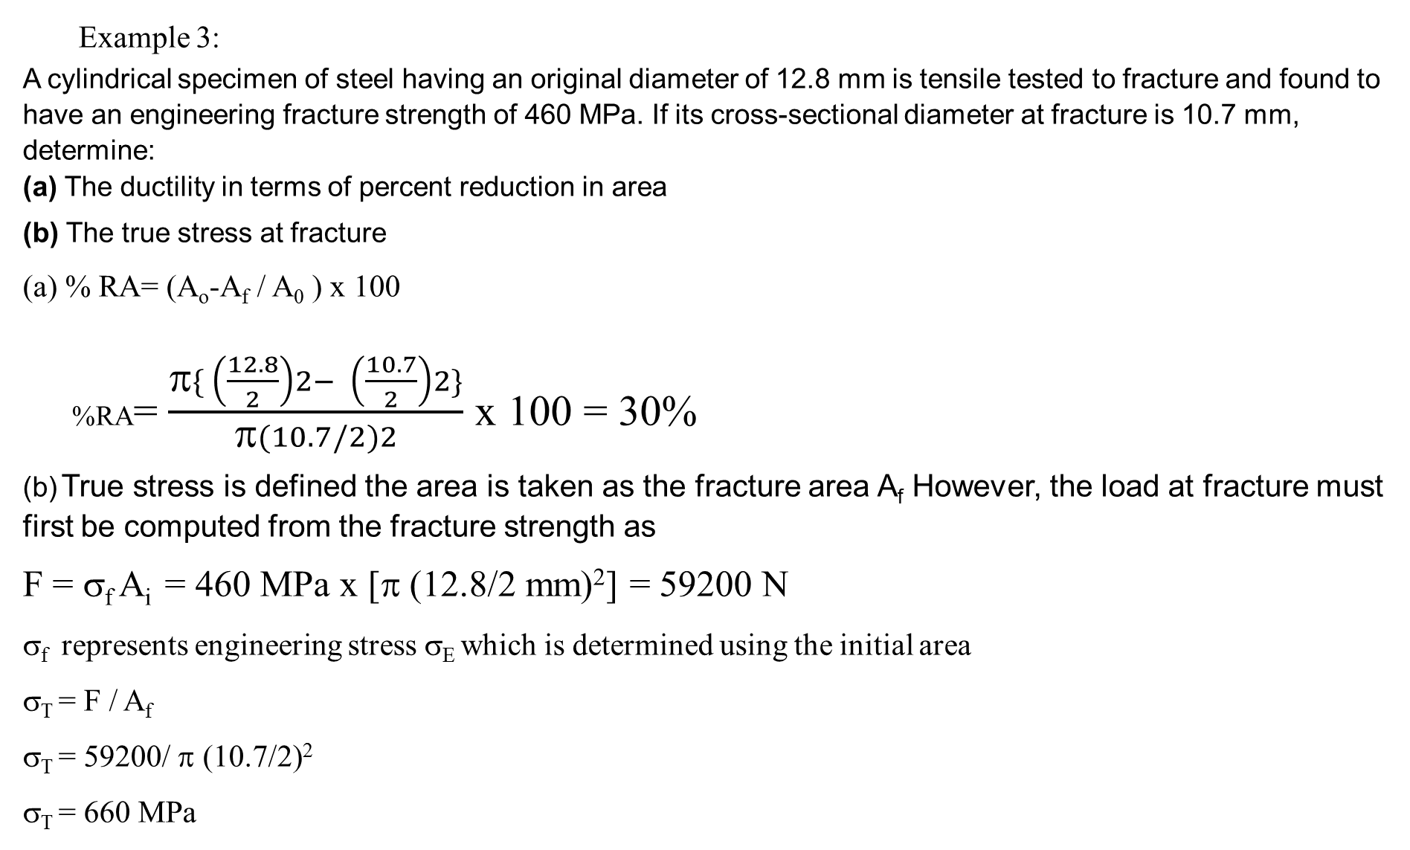
Example 3:
A cylindrical specimen of steel having an original diameter of 12.8 mm is tensile tested to fracture and found to have an engineering fracture strength of 460 MPa. If its cross-sectional diameter at fracture is 10.7 mm, determine:
(a) The ductility in terms of percent reduction in area
(b) The true stress at fracture
(a) % RA= (A_{o}-A_{f} / A₀ ) x 100
%RA= $\frac{π\{ \left(\frac{12.8}{2}\right)2− \left(\frac{10.7}{2}\right)2\}}{π(10.7/2)2}$ x 100 = 30%
(b) True stress is defined the area is taken as the fracture area A_{f} However, the load at fracture must first be computed from the fracture strength as
F = σ_{f} A_{i} = 460 MPa x [π (12.8/2 mm)²] = 59200 N
σ_{f} represents engineering stress σ_{E} which is determined using the initial area
σ_{T} = F / A_{f}
σ_{T} = 59200/ π (10.7/2)²
σ_{T} = 660 MPa

Slide 11
Example 4: A cylindrical specimen of aluminum having a diameter of 12.8 mm and a gauge length of 50.800 mm is pulled in tension. Use the load–elongation characteristics shown in the following table to complete parts (a) through (e).
Load Length
N mm
0 50.800
7,330 50.851
15,100 50.902
23,100 50.952
30,400 51.003
34,400 51.054
38,400 51.308
41,300 51.816
44,800 52.832
46,200 53.848
47,300 54.864
47,500 55.880
46,100 56.896
44,800 57.658
42,600 58.420
36,400 59.1
(a) Plot the data as engineering stress versus engineering strain.
(b) Compute the modulus of elasticity.
(c) Determine the yield strength at a strain offset of 0.002.
(d) Determine the tensile strength of this alloy.
(e) What is the approximate ductility, in percent elongation?

Slide 12
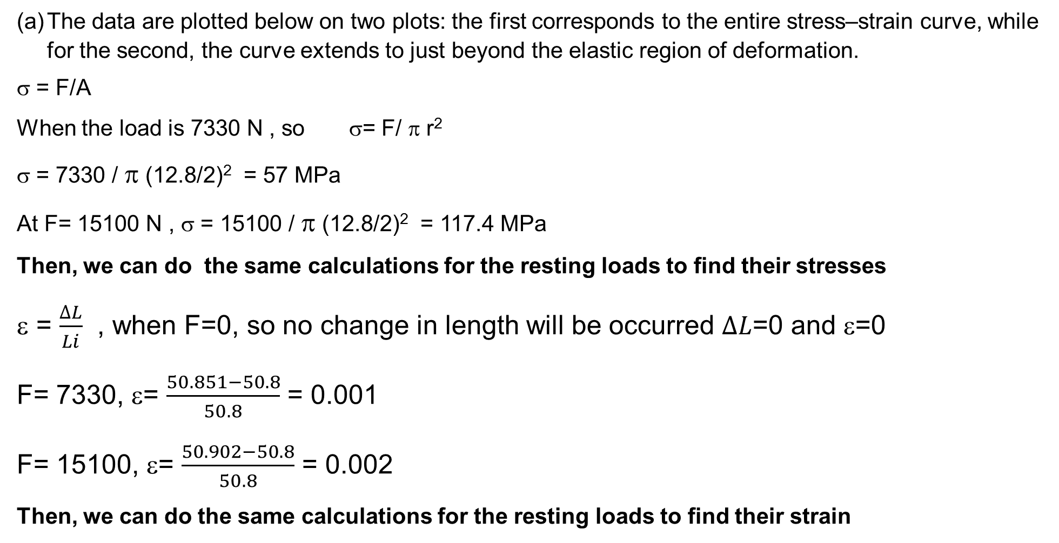
The data are plotted below on two plots: the first corresponds to the entire stress–strain curve, while for the second, the curve extends to just beyond the elastic region of deformation.
σ = F/A
When the load is 7330 N , so σ= F/ π r²
σ = 7330 / π (12.8/2)² = 57 MPa
At F= 15100 N , σ = 15100 / π (12.8/2)² = 117.4 MPa
Then, we can do the same calculations for the resting loads to find their stresses
ε = $\frac{∆L}{Li}$ , when F=0, so no change in length will be occurred $∆L$=0 and ε=0
F= 7330, ε= $\frac{50.851−50.8}{50.8}$ = 0.001
F= 15100, ε= $\frac{50.902−50.8}{50.8}$ = 0.002
Then, we can do the same calculations for the resting loads to find their strain

Slide 14
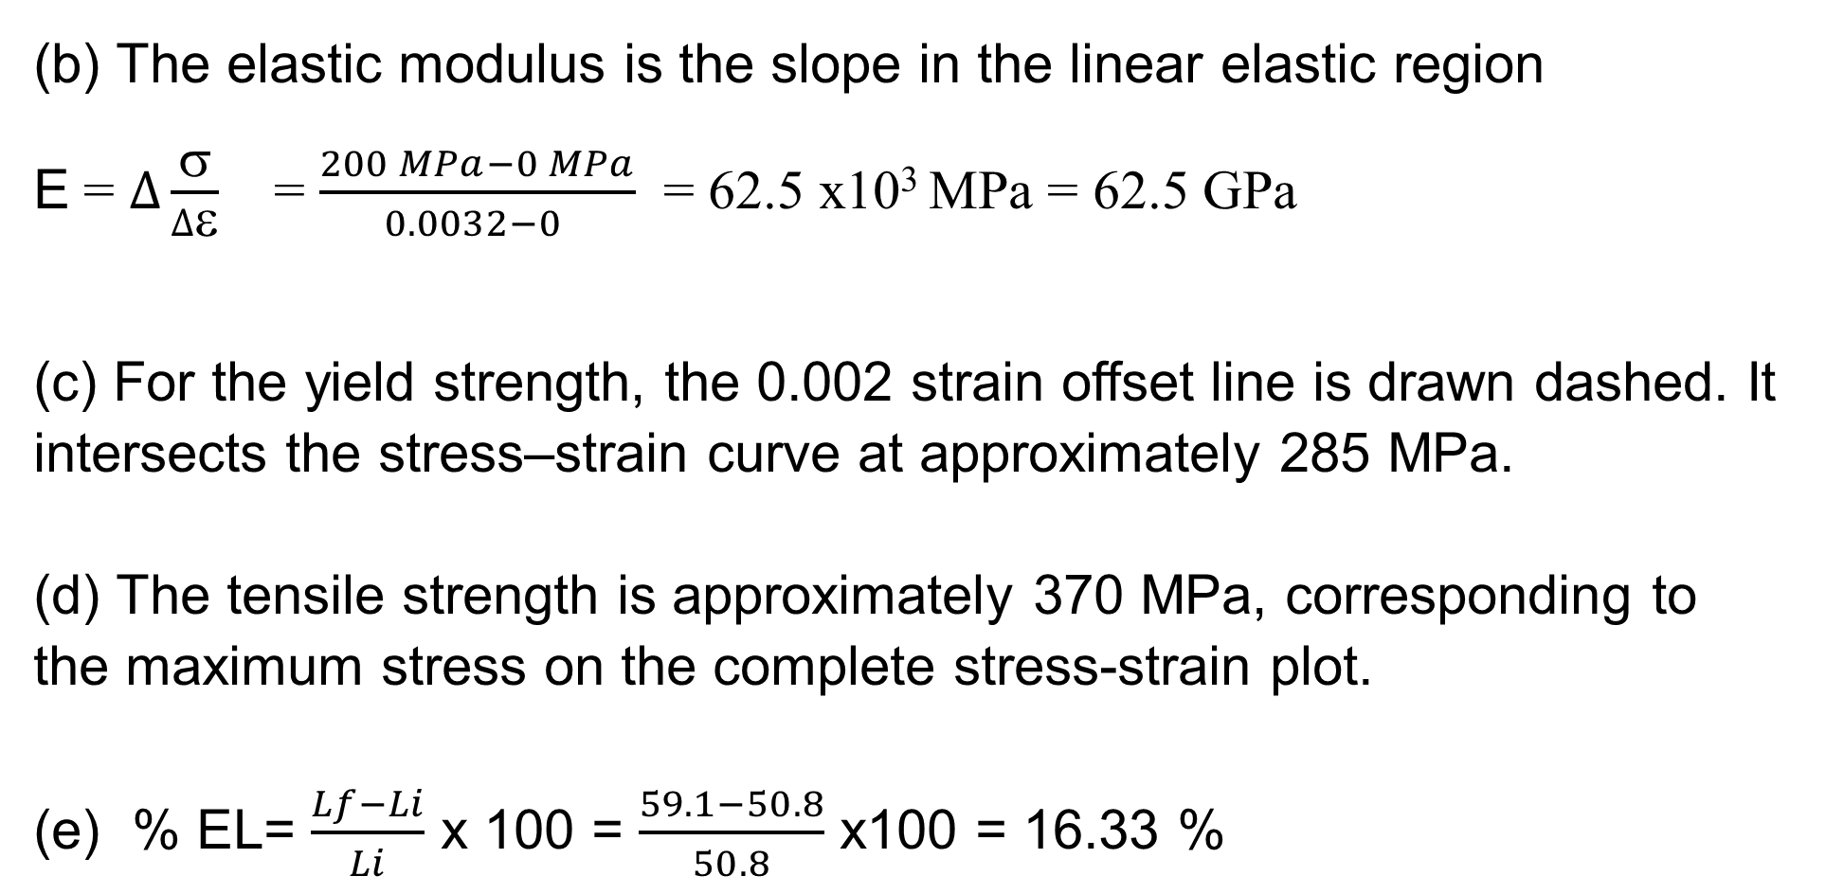
(b) The elastic modulus is the slope in the linear elastic region
E = $∆\frac{σ}{∆ε}$ = $\frac{200 MPa−0 MPa}{0.0032−0 }$ = 62.5 x10³ MPa = 62.5 GPa
(c) For the yield strength, the 0.002 strain offset line is drawn dashed. It intersects the stress–strain curve at approximately 285 MPa.
(d) The tensile strength is approximately 370 MPa, corresponding to the maximum stress on the complete stress-strain plot.
(e) % EL= $\frac{Lf−Li}{Li}$ x 100 = $\frac{59.1−50.8}{50.8}$ x100 = 16.33 %

Slide 15
Example 5 :
For some metal alloy, a true stress of 345 MPa produces a plastic true strain of 0.02. How much will a specimen of this material elongate when a true stress of 415 MPa is applied if the original length is 500 mm? Assume a value of 0.22 for the strain-hardening exponent, n.
σ_{T} = K (ε_{T}) ^{n}
Next we must solve for the true strain produce when a true stress of 415 MPa is applied

