Slide 1
Bearing and Azimuth

Slide 2
Bearing
Bearing describes the direction of a line; in highway design, we call it “tangent”
It cannot be larger than 90º
It is measured in relation to the north or south ends and are placed in one of the quadrants (NE, NW, SE, SW)
Each line has two bearings, depending on which end of the line is being considered

Slide 3
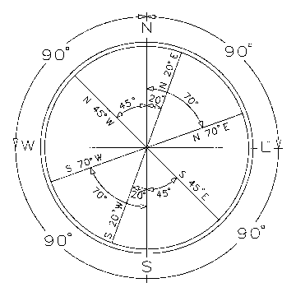
True Meridian
Note: Old maps use Magnetic Meridian
http://www.firstam.com/faf/dimensions/directions.html

Slide 4
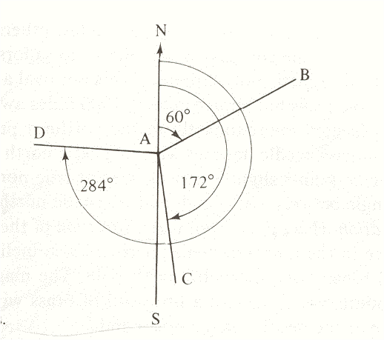
Azimuth

Slide 5
CONVERTING
Converting Bearing to Azimuth:
North East: azimuth angle equals bearing Angle
Ex: N 76º 30’ E = 76º 30’
South East: azimuth angle equals 180 minus bearing angle
Ex: S 42º 28’ E = 180º – 42º 28’ = 137º 32’
South West: azimuth angle equals 180 plus bearing angle
Ex: S 36º 47’ W = 180º + 36º 47’ = 216º 47’
North West: azimuth angle equals 360 minus bearing angle
Ex: N 62º 56’ W = 360º - 62º 56’ = 297º 04’

Slide 6
CONVERTING
Converting Azimuth to Bearing:
North East: the prefix N and the suffix E must be added
Ex: 76º 30’ = N 76º 30’ E
South East: the azimuth angle is subtracted from 180º and S and E are added
Ex: 168º 40’ = 180º – 168º 40’ = S 11º 20’ E
South West: 180º is subtracted from the azimuth angle and S and W are added
Ex: 195º 22’ = 195º 22’ – 180º = S 15º 22’ W
North West: the azimuth angle is subtracted from 360º and N and W are added
Ex: 314º 35’ = 360º – 314º 35’ = N 45º 25’ W

Slide 7
BEARING
N
N 90º 0’ 0” E
N 65º 11’ 36” E
C
L
S 85º 10’ 15” E
The center line is always located in the
middle of the highway, with the exception
of the PI for horizontal curves.

Slide 8
BEARING
N
N 90º 0’ 0” E
N 65º 11’ 36” E
C
L
S 75º 10’ 15” E
Δ
Convert bearing to azimuth:
S 75º 10’ 15” E = 104º 49’ 45’’
N 65º 11’ 36” E = 65º 11’ 36”
Compute angle:
Δ = 104º 49’ 45’’ - 65º 11’ 36” = 39º 38’ 09”
Δ = 40º 38’ 09” L (L for left)

