Slide 1
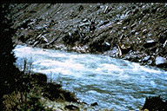
BAE 6333 – Fluvial Hydraulics
Nonuniform Flow –
Rapidly Varied Flow

Slide 2
Thus far…And now beyond
Ability to predict flow profile for gradually varied flow – up to h_{c}
Rapidly Varied Flow – downstream of critical depth over a short stream length
Supercritical to Subcritical
Subcritical to Supercritical
Implicit assumption from before of a hydrostatic pressure distribution is no longer valid

Slide 3
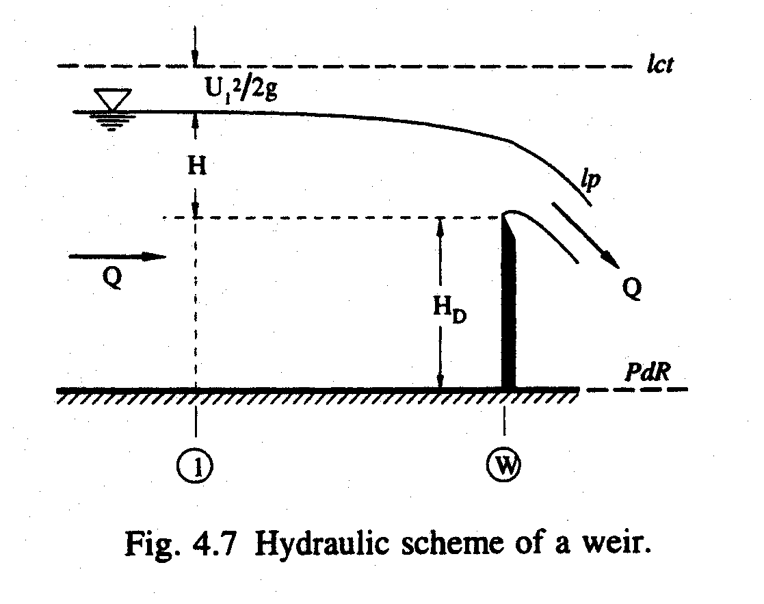
Rapidly Varied Flow
Weirs and Spillways – used to control the discharge in a channel

Slide 4
Rapidly Varied Flow
Weirs and Spillways – used to control the discharge in a channel
Discharge equations usually based on energy equations with discharge coefficient (K_{D}) – See Equation 4.32 (small approach velocity)
Graf presents empirical relations for:
Sharp-crested weirs
Spillways
Mobile spillways (gate)

Slide 5
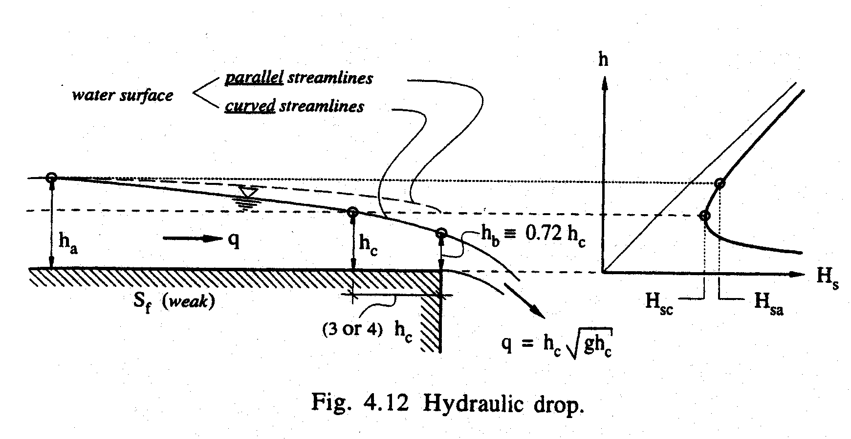
Rapidly Varied Flow
Hydraulic Drop – M2 or H2 profile
Flow is subcritical upstream of the drop
Critical depth is the smallest possible flow depth for a given discharge:
Because of flow being rapidly varied (not hydrostatic), critical depth (h_{c}) occurs just upstream of the drop
Depth at section of drop (h_{b}):

Slide 6
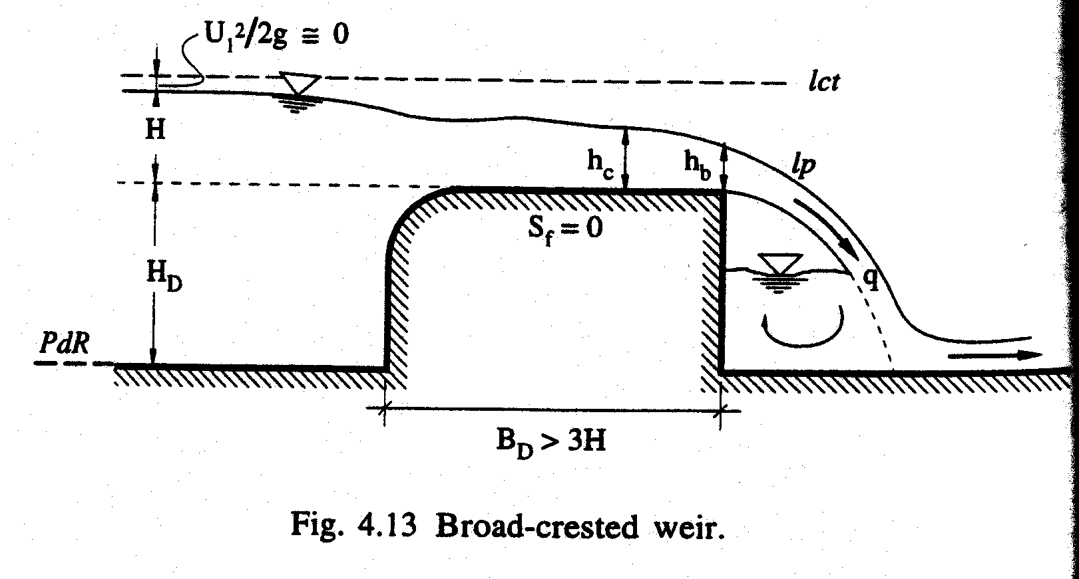
Rapidly Varied Flow
Hydraulic Drop – Broad-Crested Weir:
Weir can be assimilated to a short rectangular channel with a hydraulic drop
Critical depth occurs just upstream of the drop
Discharge equation:

Slide 7
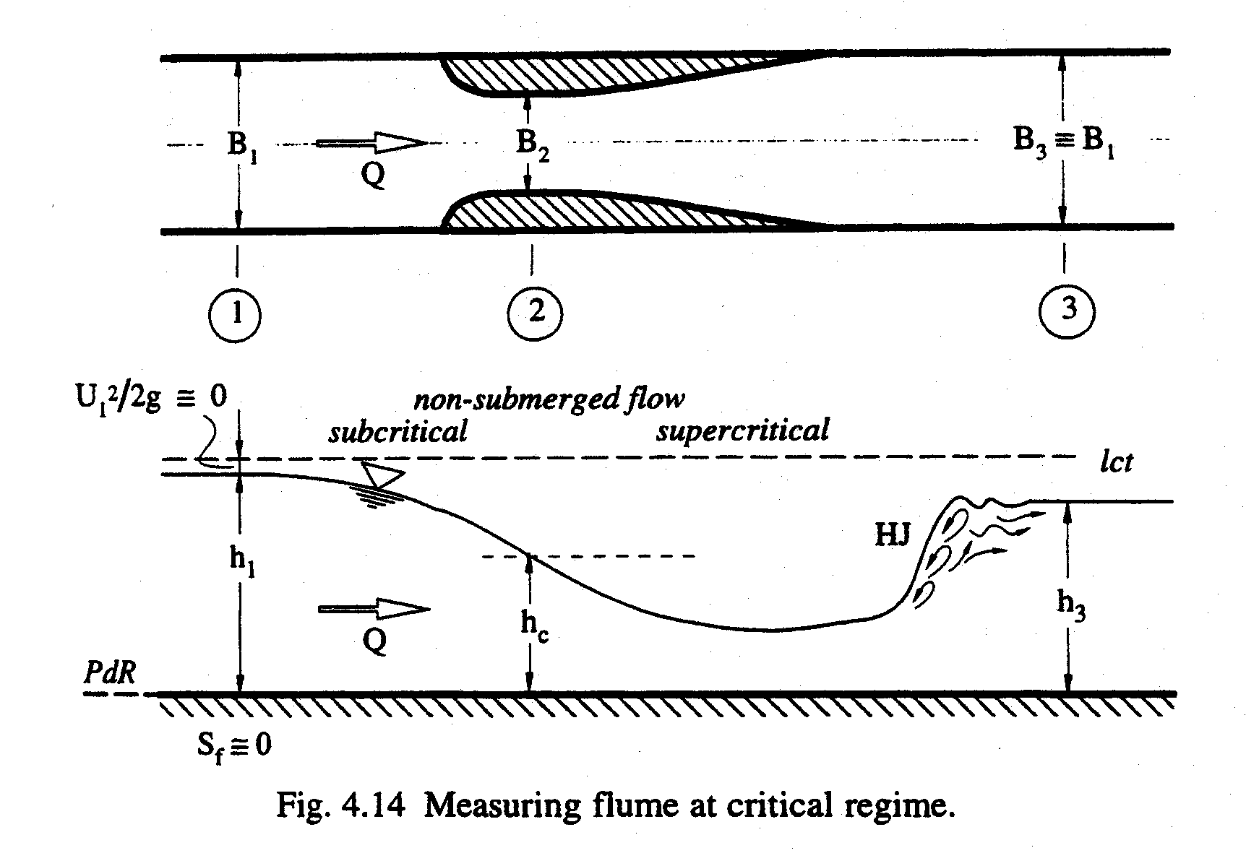
Rapidly Varied Flow
Hydraulic Drop – Parshall Flume or Venturi canal:
Vertical and/or horizontal constriction (throat) in a channel (rectangular) followed by a progressive enlargement
Geometry must allow for h_{c} somewhere in throat
Discharge equation:

Slide 8
Rapidly Varied Flow
Hydraulic Drop – Parshall Flume or Venturi canal:
Difficulty with this equation is predicting (accurately) the location of h_{c}
Usually expressed as function of upstream flow depth (h₁)

Slide 9
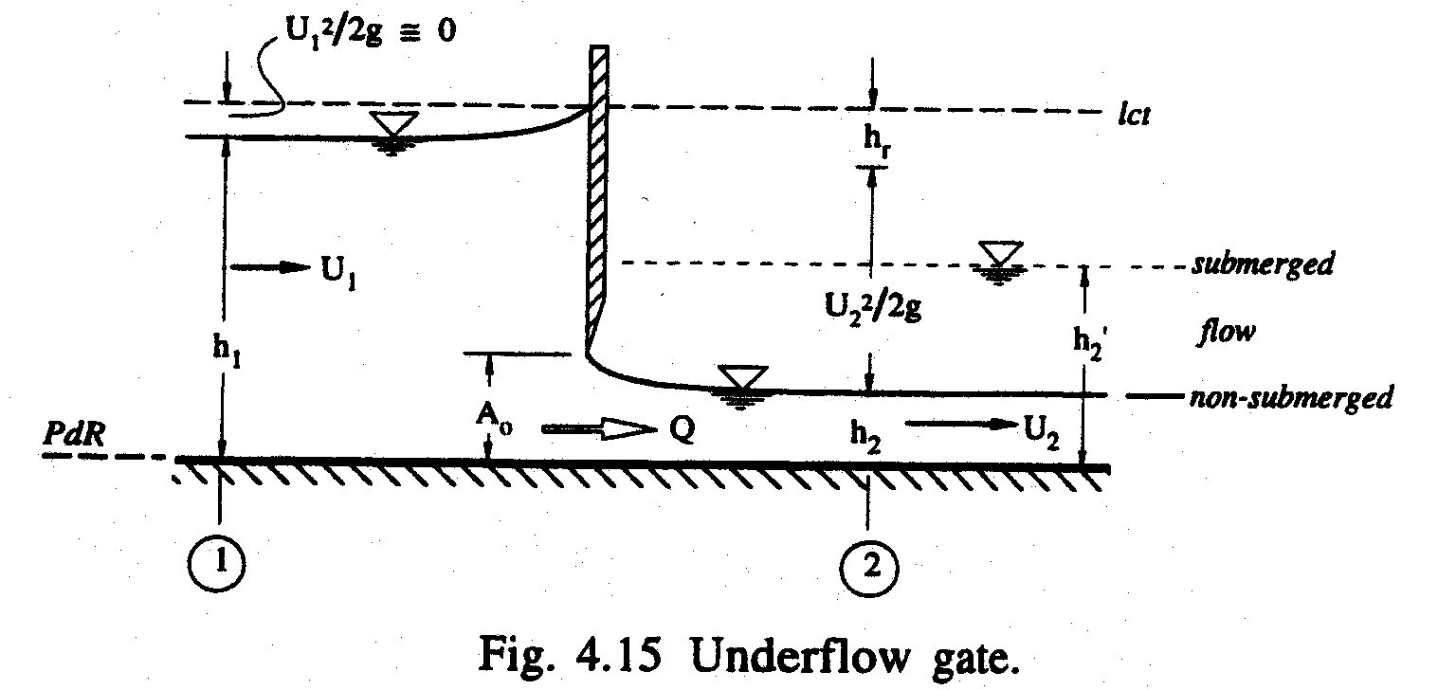
Rapidly Varied Flow
Underflow Gates – used for measuring flow in a channel or controlling discharge leaving a reservoir
Usually vary A_{o} for needs of hydraulic engineer (vary Q)
Most common type is the sluice gate

Slide 10
Rapidly Varied Flow
Underflow Gates
Discharge equation based on energy equation before and after the gate:
See Equation 4.38 for gate coefficient (K_{v})

Slide 11
Hydraulic Jump
Step change in depth from shallow to deep without change in channel cross-section
Jump actually discontinuity in water surface profile (dy/dx = ∞)

Slide 12
Hydraulic Jump in Rectangular Channel
Consider a horizontal, rectangular section after a spillway (Note that y = h and V = U):

Slide 13
Hydraulic Jump in Rectangular Channel
Assume that we can identify two sections (1, 2) where flow is uniform outside the complexities of the jump
Neglect shear stresses (friction) because we are going to take points 1 and 2 close together
Momentum:

Slide 14
Hydraulic Jump in Rectangular Channel
Pressure forces are assumed hydrostatic (momentum):
Considering conservation of mass:
Considering energy with head loss due to turbulence:

Slide 15
Hydraulic Jump in Rectangular Channel
SOLUTIONS:

Slide 16
Hydraulic Jump in Rectangular Channel
Actual structure of a hydraulic jump depends on the Froude number:
Five Types of Surface and Jump Conditions:
1. Standing Wave – Energy Dissipated <5%
2. Weak Jump – Energy Dissipated 5-15%
3. Oscillating Jump – Energy Dissipated 15-45%
4. Steady Jump – Energy Dissipated 45-70%
5. Strong Jump – Energy Dissipated 70-85%

Slide 17
Hydraulic Jump in Rectangular Channel

