Slide 1
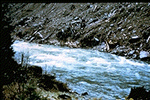
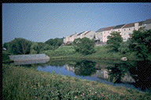
BAE 6333 – Fluvial Hydraulics
Nonuniform Flow

Slide 2
Computation of Water Surface Profiles
Three forms of this equation:

Slide 3
For natural water courses…
Channel bed varies continuously, so it is common to investigate the position of the water table with respect to a horizontal datum (h+z):

Slide 4
Example 4.C – Graf
A small river conveys a discharge of Q = 3 m3/s. The geometry of sections 1 to 6 are reported along with the Manning’s n value. The local head-loss coefficients are estimated to be:
reach: 1-2 2-3 3-4 4-5 5-6
K_{ss}: 0.10 0.30 0.30 0.15 0.10
Compute the water surface profile in the reach between sections 1 to 6 for h = 401.2 m and h = 402.4 m.

Slide 5
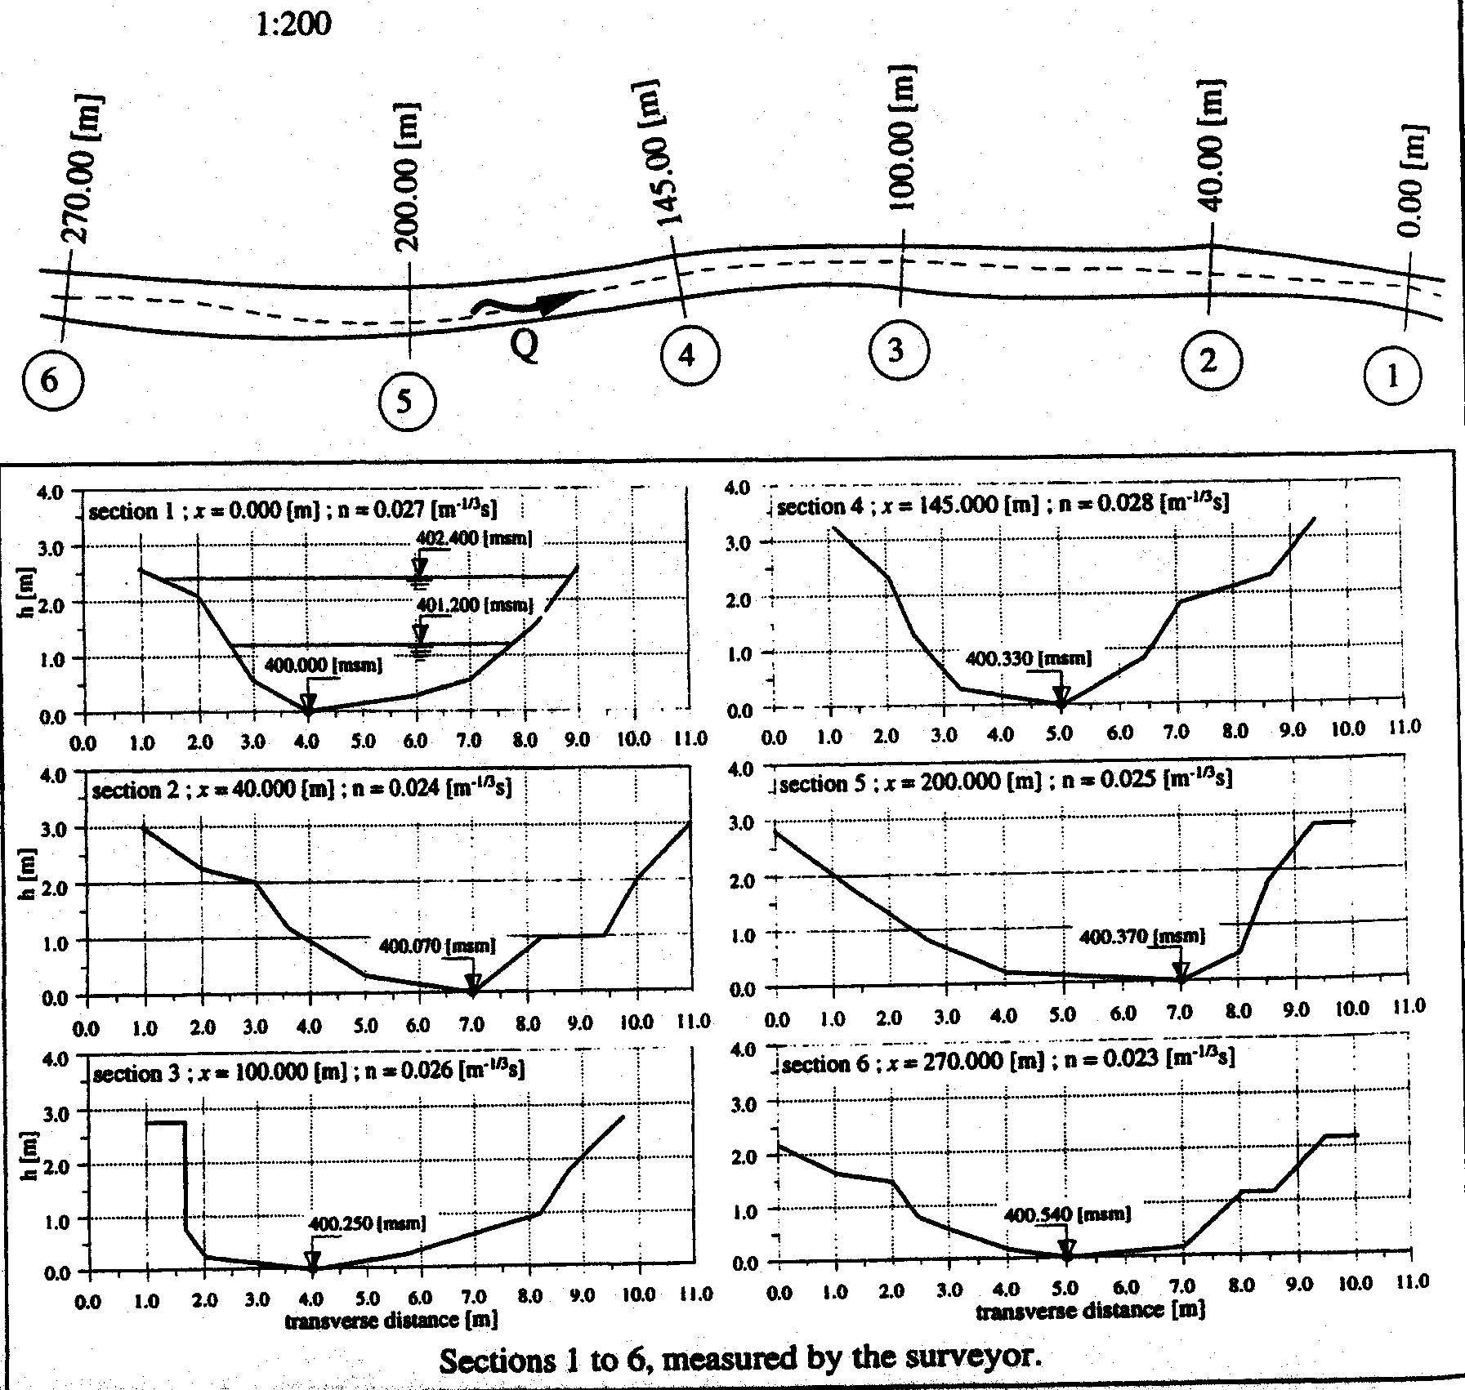
First point…
Geometry of channel is irregular and geometric characteristics can not be given with simple equations...
How do you get A, B, P, and R_{h}?

Slide 6
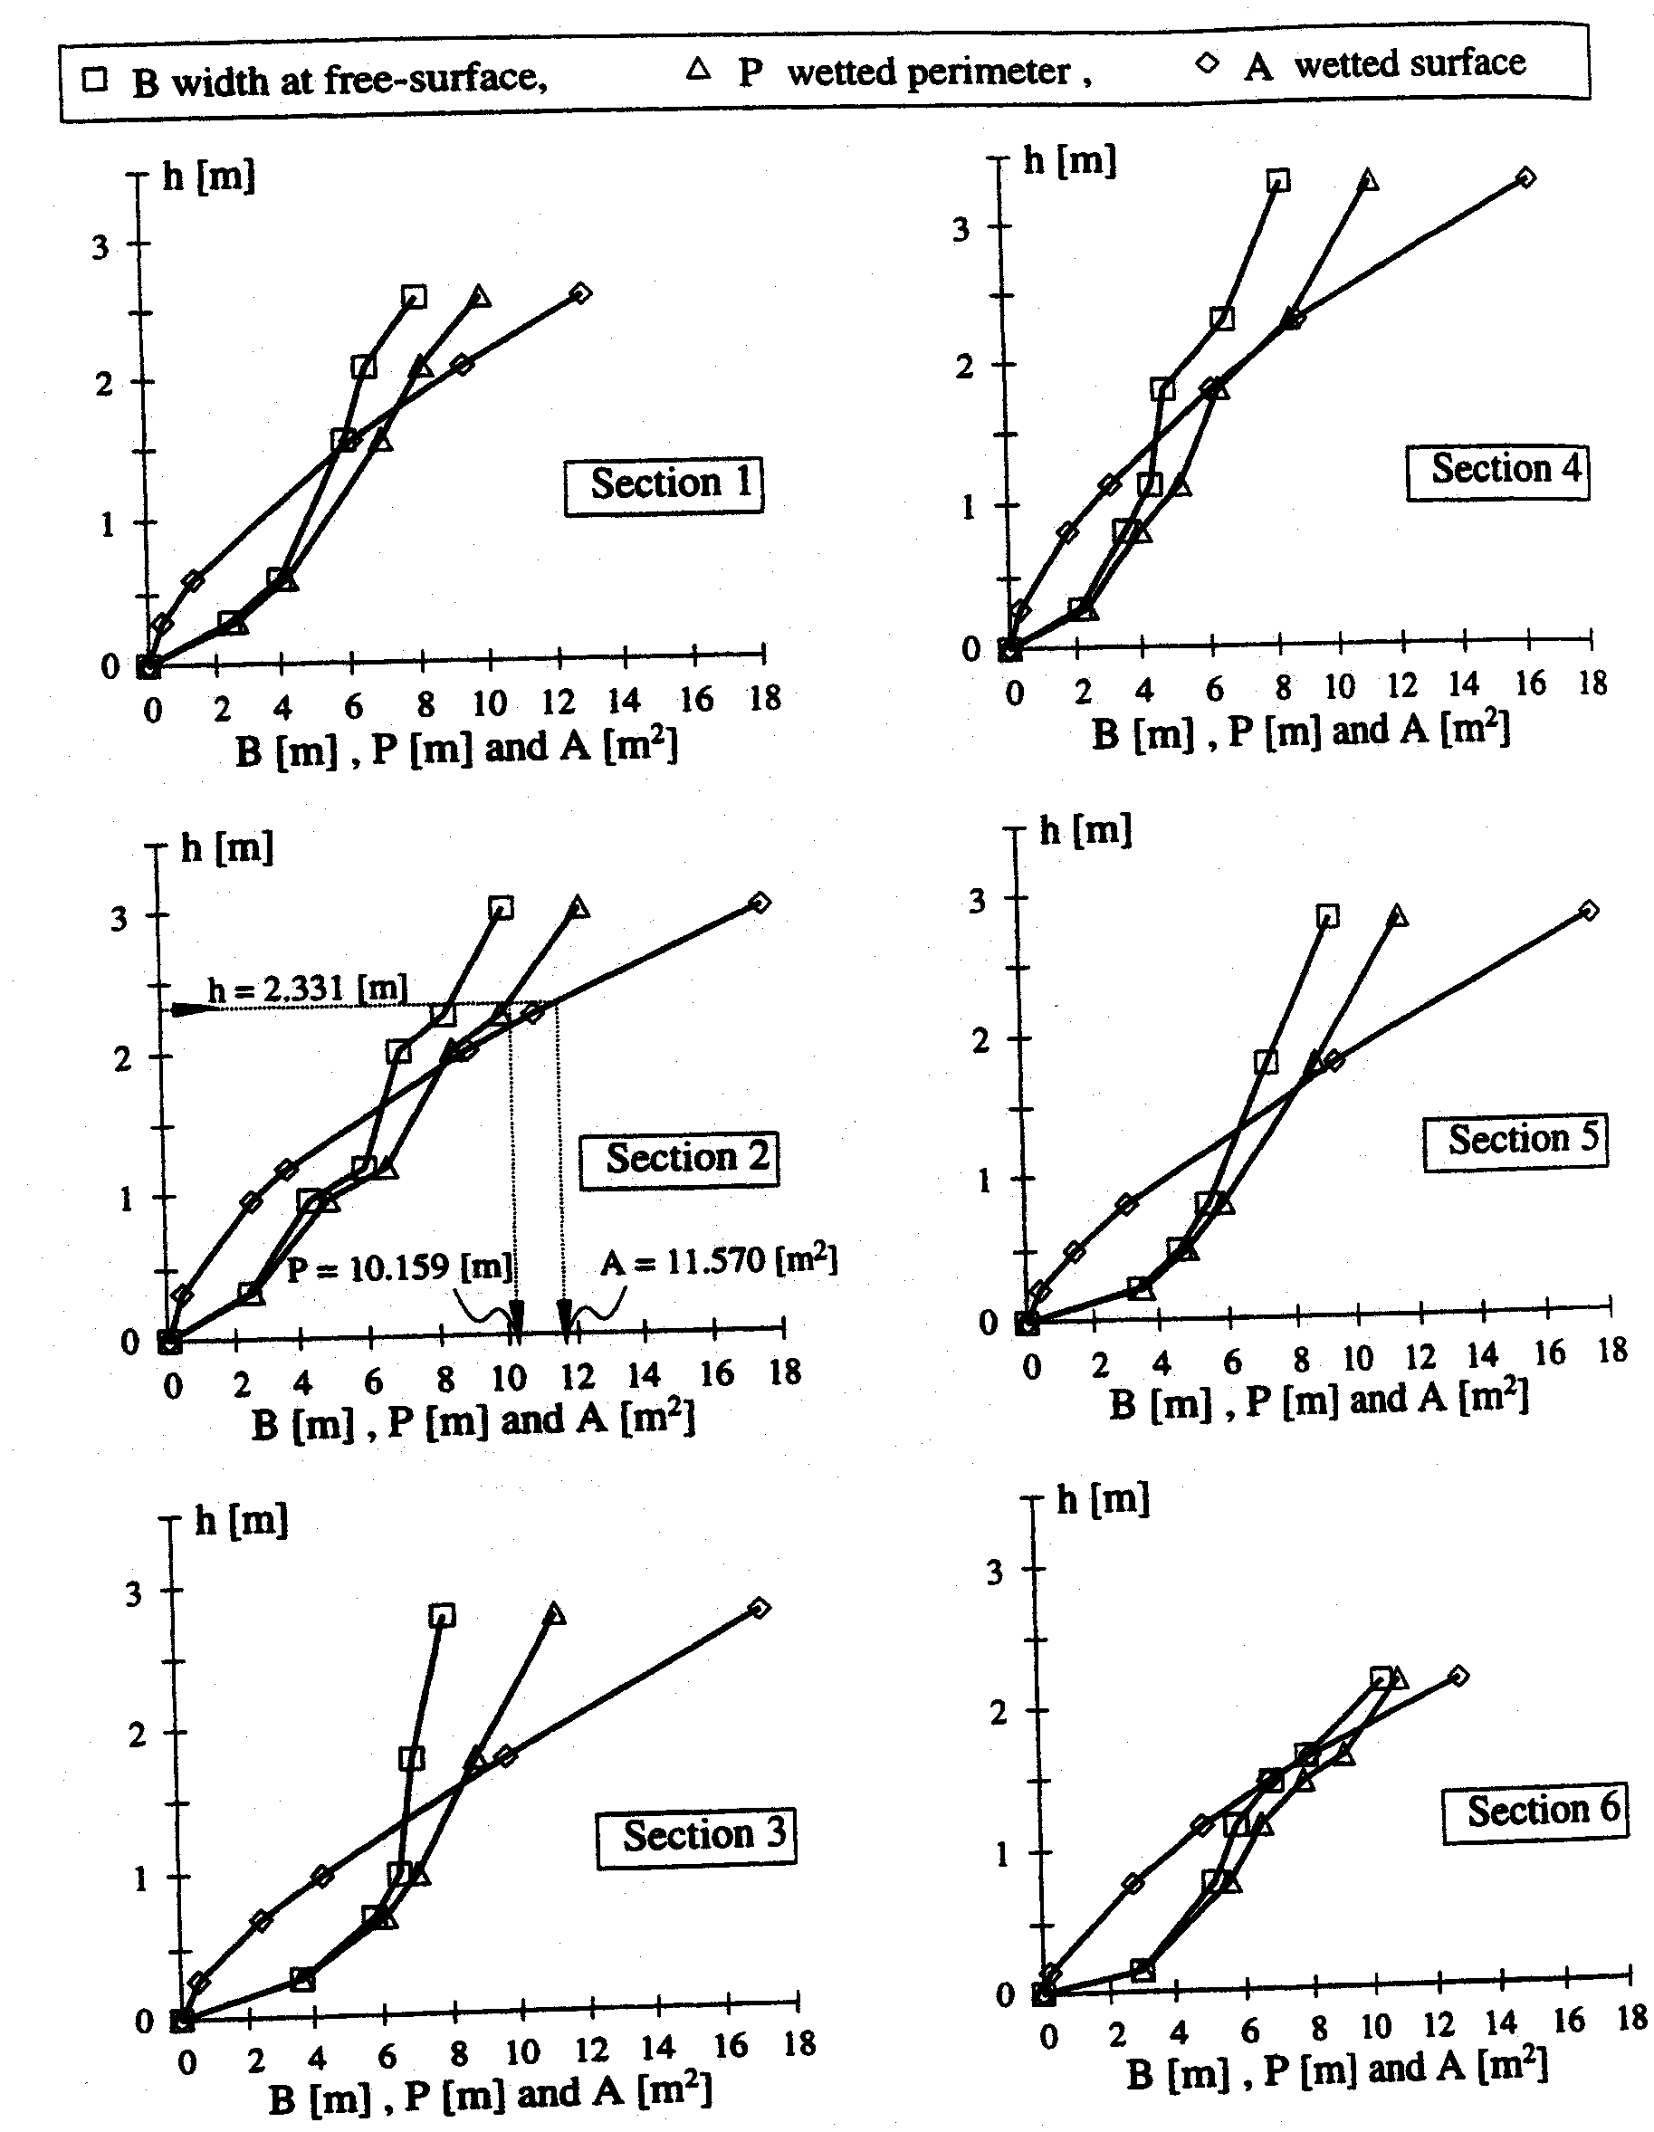

Slide 7
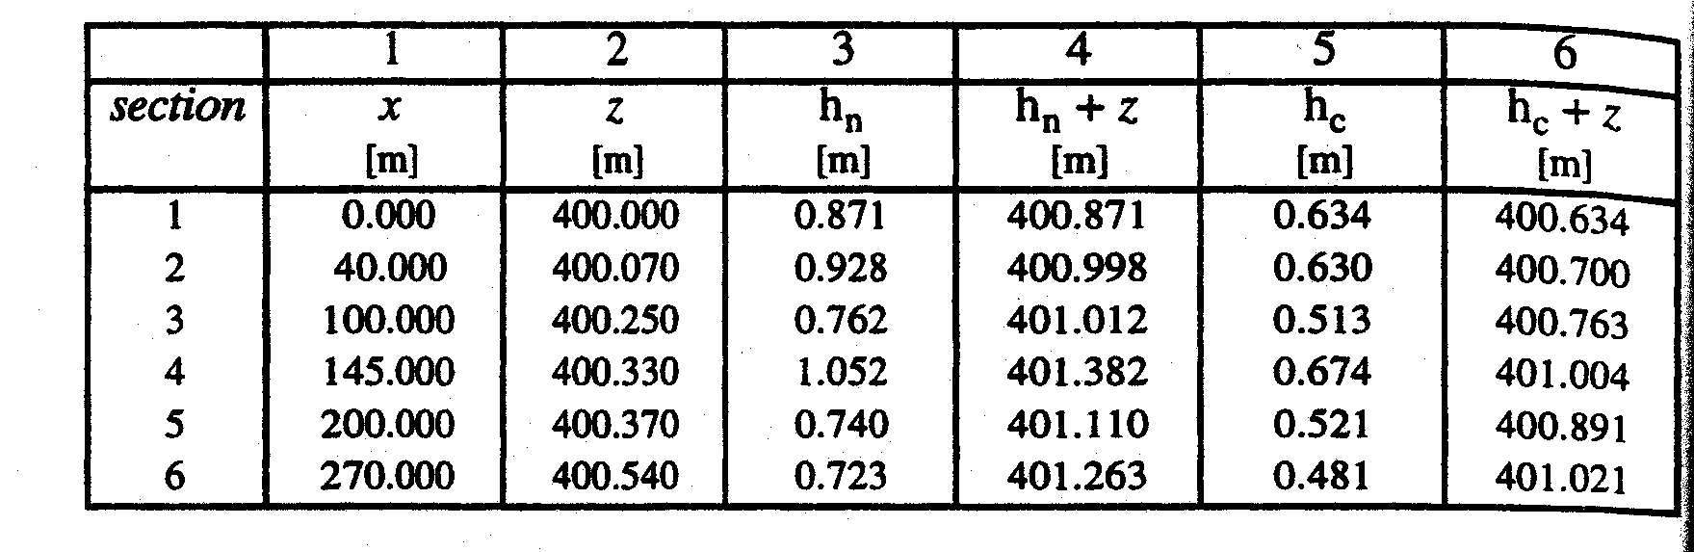
First Question…
What kind of water-surface profile do we have?
  Need h_{c} and h_{n}
  How do we do this for a channel that is changing continuously?

Slide 8
We can now compute the water surface profile…
Graf uses the standard step method…

