Slide 1
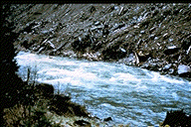

Design of Stable Channels
CH-4
Riprap-Lined Channels

Slide 2
Providing Channel Protection
In cases where vegetation is not suitable, riprap is often used to stabilize channels…
  Riprap = rough, angular rocks of varying size
Place riprap on surfaces that are well compacted and stable
  Toe protection for channel bank riprap
Design of riprap…
  Select rock size large enough so that the force attempting to overturn the rocks is less than the gravitational force acting on the rocks

Slide 3
Providing Channel Protection
Gradation of riprap:
  Select particle size distribution such that voids between the larger particles are filled with smaller particles
  Suggested gradation by Simons and Senturk (1977, 1992):
Size | % Finer
0.2d₅₀ | 0
0.5d₅₀ | 20%
d₅₀ | 50%
2d₅₀ | 100%

Slide 4
Sloping Bed
Design procedures:
  Federal Highway Administration (FHA)
  SCS Procedure
  CSU Procedure

Slide 5
Sloping Bed - FHA
FHA:
  Uses a maximum stable depth of flow given by the following equation (d₅₀ and h_{max} in ft, and γ = 62.4 lb/ft³):
  Velocity of flow given by Manning’s equation with n given by…

Slide 6
Example- 4.15
Determine the d₅₀ riprap size required to convey 115 cfs down a 10% slope in a rectangular channel 18 ft wide. Riprap is for the bottom and use the FHA procedure.

Slide 7
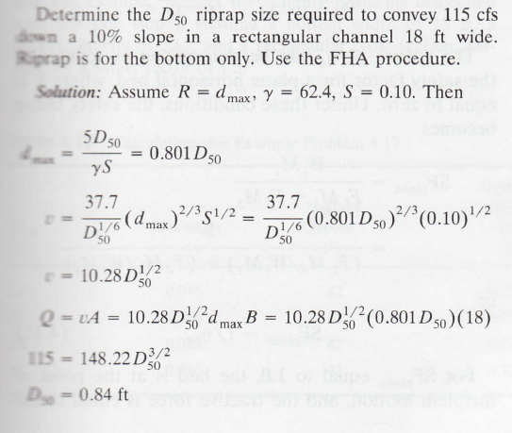

Slide 8
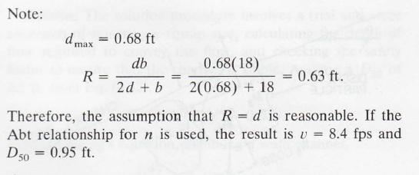

Slide 9
Sloping Bed - SCS
SCS:
  Also uses a maximum stable depth of flow
  Equation (d₇₅ and h_{max} in ft):
  Velocity of flow given by Manning’s equation with n given by…

Slide 10
Example – 4.16
Determine the d₅₀ riprap size required to convey 115 cfs down a 10% slope in a rectangular channel 18 ft wide. Riprap is for the bottom and use the SCS procedure.

Slide 11
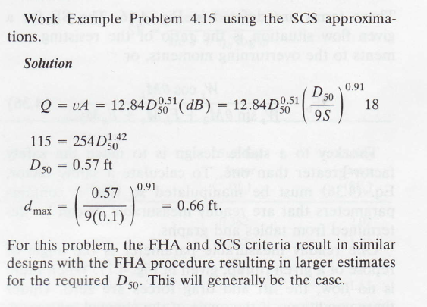

Slide 12
Sloping Bed - CSU
CSU Procedure (Simons and Senturk, 1977, 1992):
  Safety Factor (SF) concept
    SF = ratio of resisting forces (moments) to driving forces (moments)
    SF = 1 (Point of incipient motion)
    Recommend SF > 1.5 to account for variability in particle sizes

Slide 13
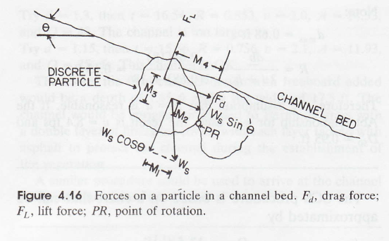
Sloping Bed - CSU
CSU Procedure (Simons and Senturk, 1977, 1992):
  Consider forces acting on a channel bed sloped at an angle θ:

Slide 14
Sloping Bed - CSU
CSU Procedure (Simons and Senturk, 1977, 1992):

Slide 15
Example – 4.17
Determine the d₅₀ riprap size required to convey 115 cfs down a 10% slope in a rectangular channel 18 ft wide. Riprap is for the bottom (neglect stability problems associated with the side slopes). Assume a specific gravity of sediment of 2.65 with ϕ = 42º. Design for a safety factor of 1.5.

Slide 16
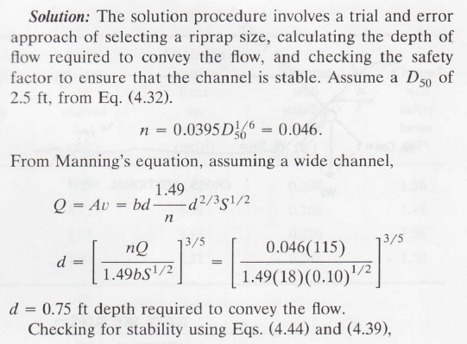

Slide 17
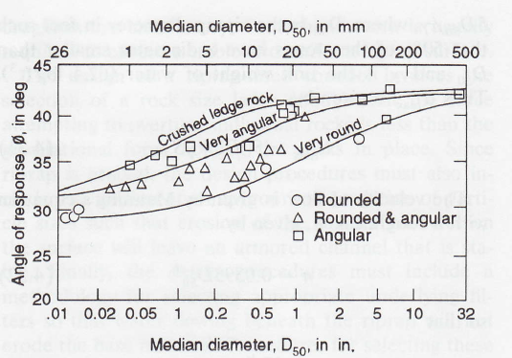

Slide 18
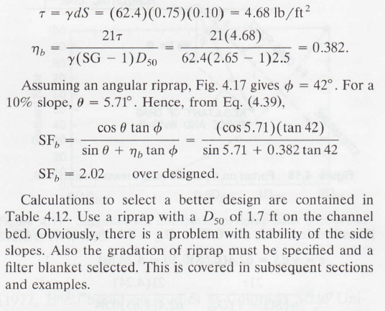

Slide 19
Channel Bank Stability
CSU Procedure - Stevens and Simons (1971) and Simons and Senturk (1977, 1992):
  Difference from bed is that drag forces are not aligned with the down slope gravitational forces
  Equations assume that the ratio of lift to drag forces is 0.5

Slide 20
Channel Bank Stability

Slide 21
Example – 4.19
Determine the d₅₀ riprap size that will be stable on the bed and channel side slopes with m = 2.5 in a trapezoidal channel (18 ft bottom width). The channel needs to convey 115 cfs down a 10% slope. Assume a specific gravity of sediment of 2.65 with ϕ = 42º. Design for a safety factor of 1.5.

Slide 22
