Slide 1
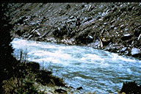
Design of Stable Channels CH-4
Grass-Lined Channels

Slide 2
Providing Channel Protection
For bare soil channels, allowable shear stress is small –
Results in channels that are wide with shallow flows
If the channel can be protected from erosion, then allowable velocities can be increased – Vegetation!
Grass-lined channels are common in urban areas to transmit storm water
Usually preferred to concrete lined channels
Design is different because these channels cannot withstand lengthy inundation and wetness
Channel Roughness – Manning’s n becomes a strong function of U, R_{h}, and vegetation type (height)
Experimental work has shown that Manning’s n can be related to UR_{h}

Slide 3
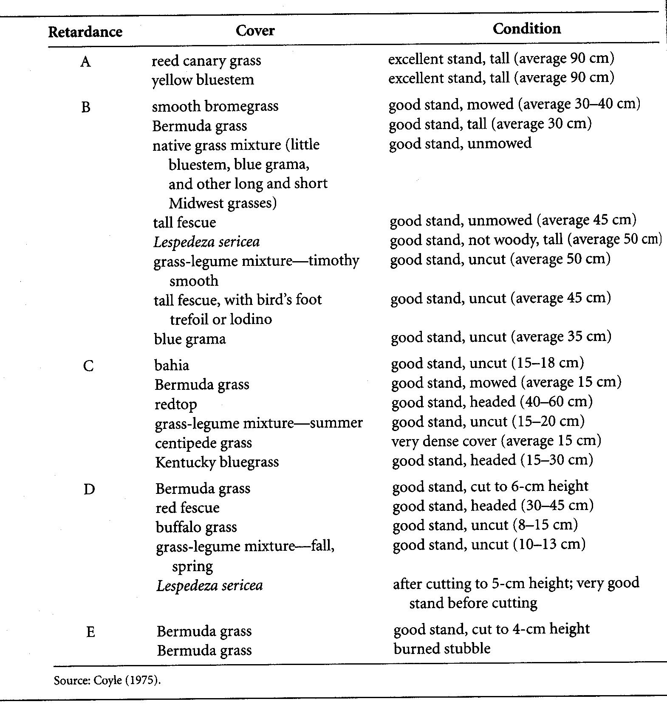
Retardance Classes (SCS, 1969)

Slide 4
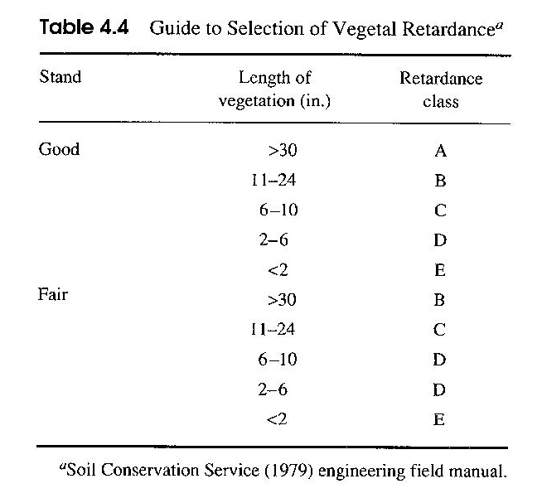
Guide to Selection of Vegetal Retardance

Slide 5
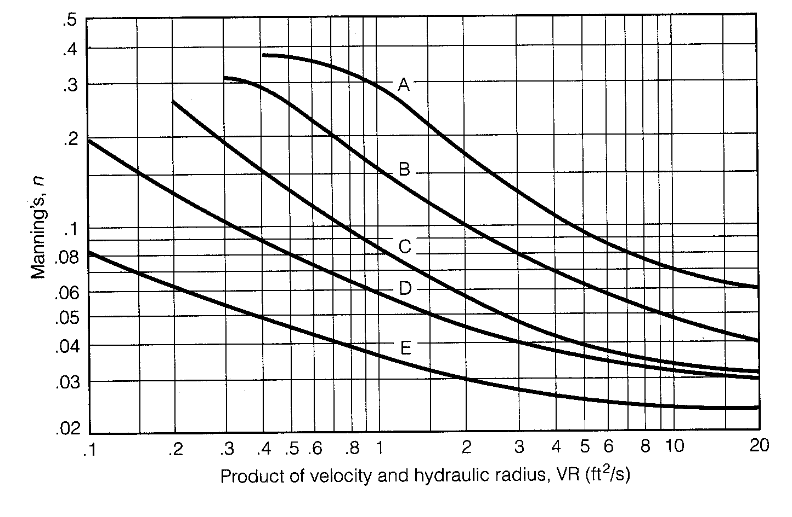
Manning’s n-UR_{h} Relationship

Slide 6
Manning’s n-UR_{h} Relationship
Temple et al. (1987) developed the following approximation for the Manning’s n–UR_{h} relationships:
Retardance | I
A | 10.000
B | 7.643
C | 5.601
D | 4.436
E | 2.876

Slide 7
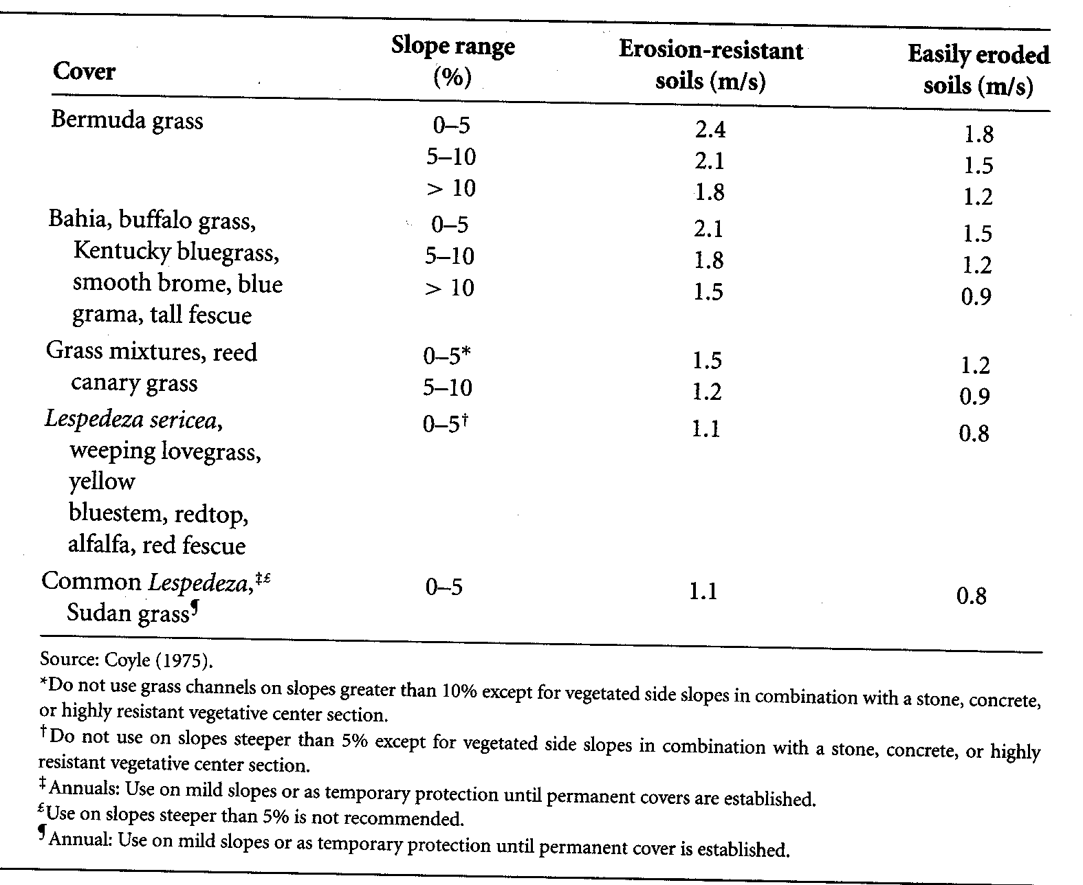
Maximum Permissible Velocities
Suggested by SCS based on channel slope and erodibility of soil

Slide 8
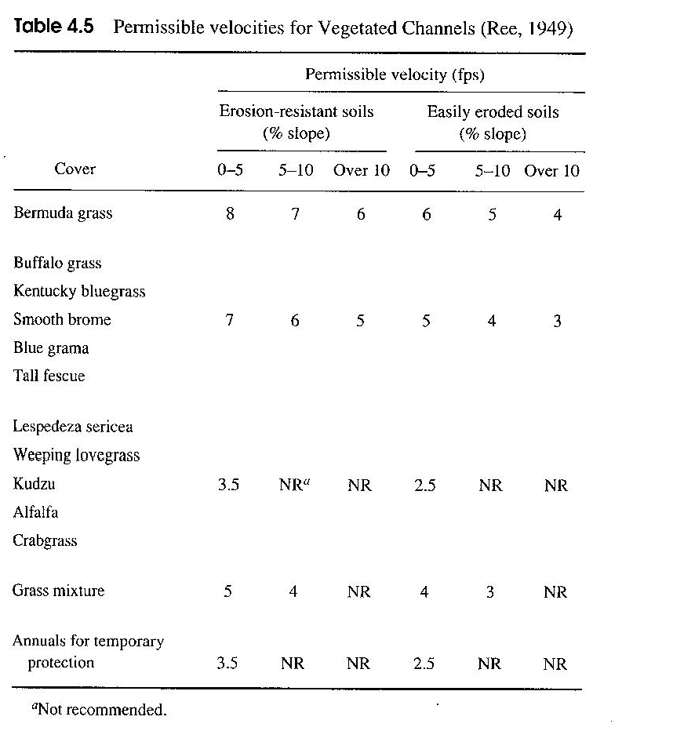
Maximum Permissible Velocities

Slide 9
Freeboard Requirement
Freeboard requirement (should be at least 30 cm):

Slide 10
Design Procedure
Stage 1
Assume an n value and determine value of UR_{h}
The lower bound retardance of the channel is specified based on the type of grass
Select maximum permissible velocity and compute the value of R_{h}
Use Manning’s equation and the assumed value of n to compute a UR_{h}
Repeat steps 1-4 until the values of UR_{h} agree
Determine A from the design flow and maximum permissible velocity
Determine the channel proportions for the calculated values of R_{h} and A

Slide 11
Design Procedure
Stage 2
Assume a depth of flow for the channel identified in Stage 1 of the design and compute A and R_{h}
Compute the average velocity, U = Q/A
Compute UR_{h} using steps 1 and 2
Use the results of step 3 to determine n using the upper bound retardance
Use the n from step 4, R_{h} from step 1, and the Manning equation to compute U
Repeat steps 1 through 5 until values of U in steps 2 and 5 are approximately equal
Add the appropriate freeboard

Slide 12
Example
Design a triangular grass-lined channel to handle an intermittent flow of 0.7 m³/s. The channel is to be excavated in an easily erodible soil (d₅₀ = 1 mm, ϕ = 35º) on a longitudinal slope of 2%, and lined with Bermuda. During the early stages of the channel development, the height of the grass will be maintained at 4 cm; during the latter stages of development, the Bermuda will be at a height of 30 cm.

