Slide 1
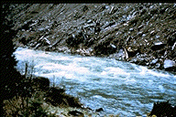

River Mechanics
CH-1
Introduction/Open-Channel Flow

Slide 2
Sediment Transport as an “Impossible Field”
Albert Einstein – Informed his son (Hans Albert) to chose research fields in which success was not impossible
  Hans chose “sediment transport” to prove his father wrong!
  Graf (author of one of the reference books) was a Ph.D. student of Hans Albert Einstein

Slide 3
Sediment Transport as an “Impossible Field”
“Innovation and compromise in formulating sediment transport by rivers” – Ettema and Mutel (2004)
  Innovative – emerging concepts of turburlent flow and probability theory
  Compromise – simplifying assumptions and empiricism
Uncertainties of 100% or more are common for predicting rates of sediment transport in natural rivers

Slide 4
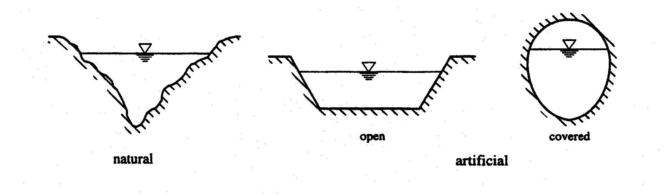
Types of Channels
Channel – flowing transport system where free surface is subject of atmospheric pressure
  Two types of channels:
    Natural Channels
      Gullies, Rivers, Streams
      Geometry and Hydraulics are Irregular
      Application of hydraulic theory gives approximate results
    Artificial Channels
      Irrigation and drainage canals or closed channels where flow does not fill the entire cross-section
      Geometry and Hydraulics are regular
      Application of hydraulic theory gives reasonably realistic results

Slide 5
Types of Channels
    Prismatic Channels – a channel whose cross-section does not vary and the longitudinal slope and roughness remains constant
      NOTE that the flow depth may vary

Slide 6
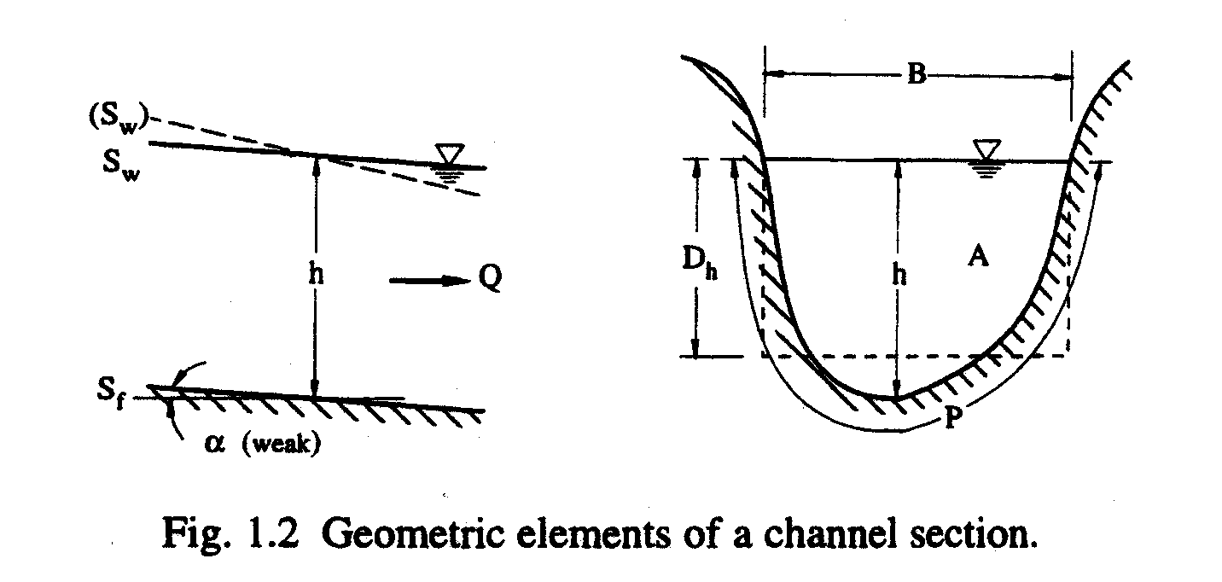
Geometric Elements of a Channel
Wetted Area, A – area of the cross-section occupied by water (or liquid)
Wetted Perimeter, P – length of the line of contact between the liquid and the bed and walls of the channel (not free-surface)
Hydraulic Radius, R_{h} – ratio of A to P
R_{h} = A/P
Top Width, B – width at the free-surface

Slide 7
Geometric Elements of a Channel
Hydraulic Depth, D_{h} – ratio of the area to the top width
D_{h} = A/B
See table on next slide for geometric elements of different types of channels!

Slide 8
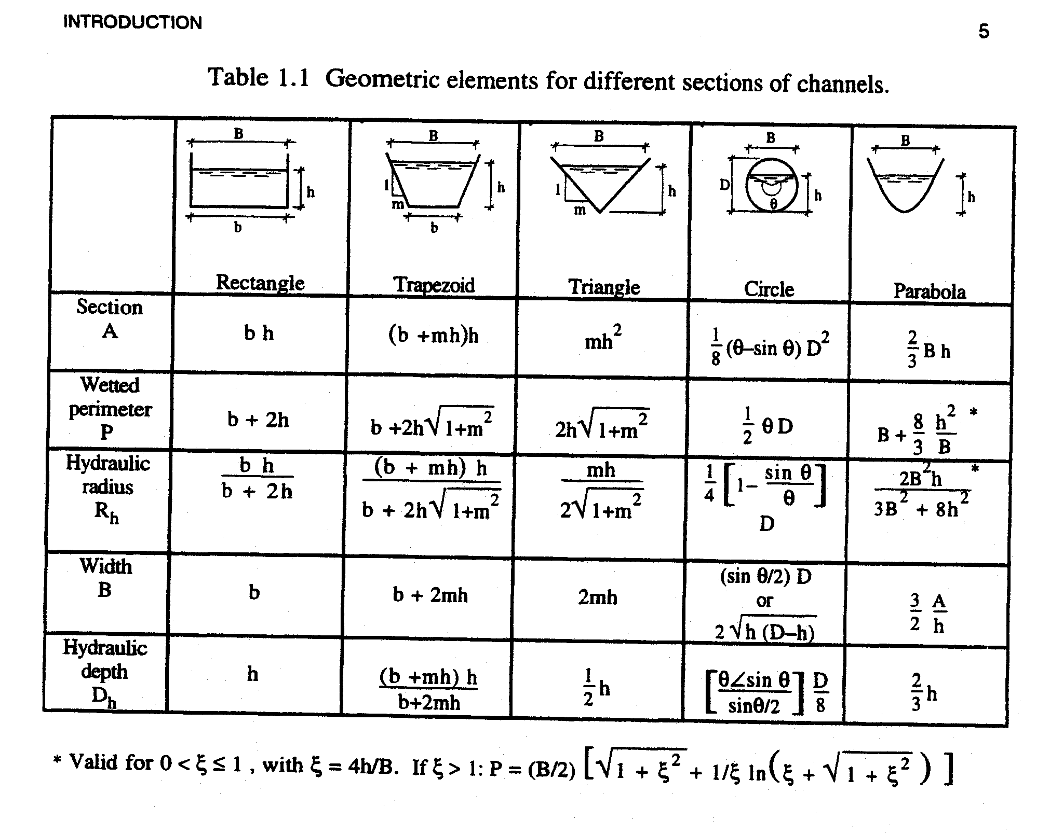

Slide 9
Two Longitudinal Slopes
Slope of the bed, S_{f}
  Remember that the bed can be immobile (fixed) or mobile (movable)
Slope of the water surface (piezometric), S_{w}
Graf refers to slopes that are “weak” – if the bed angle (α) is less than 10º
  tan (α) = sin (α)
  S_{f} = sin (α)

Slide 10
Types of Flow in Open-Channels
Flow depth, D_{h}, varies as a function of space and time
  1-D – D_{h}=f(x,t)
Steady vs. Unsteady:
  Steady – average velocity of flow, U, point velocity, u, and flow depth, h or D_{h}, do not change with time
    Discharge remains constant, IF, there is no lateral inflow or outflow:
    Q = UA
    Open-channel flow rarely steady; however, temporal variations are often “sufficiently slow”

Slide 11
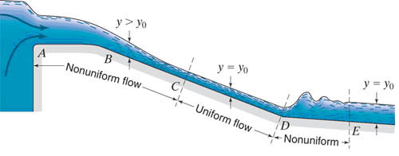
Types of Flow in Open-Channels
Uniform vs. Non-uniform:
  Uniform – flow depth, D_{h}, and other parameters remain the same at all cross-sections (S_{f} = S_{w})
  Non-uniform also called “varied flow”
  Varied flow can be accelerated (dU/dx>0) or decelerated (dU/dx<0)
  NOTE that uniform (non-uniform) flow can be steady or unsteady

Slide 12
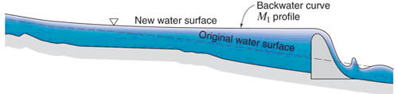
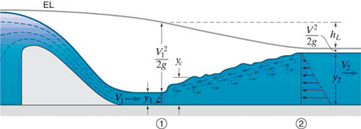
Types of Varied Flow
Gradually Varied Flow – depth as well as other parameters vary slowly from one section to another
  Assume that over small sections that flow is quasi-uniform with constant U
Rapidly Varied Flow – depth as well as other parameters change abruptly over a short distance (hydraulic jump)

Slide 13
Flow Regimes
Three types of forces:
  Inertia
  Gravity
  Friction (Viscosity and Roughness)
Interplay of these forces gives rise to set of dimensionless numbers (U_{c} = characteristic velocity, U_{c} = U; L_{c} = characteristic length, L_{c} = R_{h} or D_{h}):
  Fr = U_{c}/ (gL_{c})^{1/2} = U/(gD_{h}) ^{1/2}
  Re = U_{c}L_{c}/ν = 4R_{h}U/ν or Re’ = R_{h}U/ν
  Relative Roughness = k_{s}/L_{c}

Slide 14
Re – Laminar/Transition/Turbulent
Pipe Flow – Critical Re = 2000
Open-Channel Flow:
  Laminar – Re’ < 500
  Transition – 500 < Re’ < 2000
  Turbulent – Re’ > 2000
Open-channel flow is almost always TURBULENT!

Slide 15
Fr – Subcritical or Supercritical
Open-Channel Flow:
  Subcritical (fluvial) Flow – Fr < 1 (Disturbance waves can not be transferred upstream against flow)
  Critical Flow – Fr = 1
  Supercritical (Torrential) Flow – Fr > 1

Slide 16
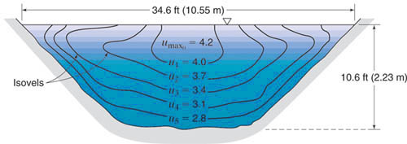
Distribution of Velocity in Channel
Point velocities, u(x,y,z,t) at walls and bed are zero (no-slip boundary condition)
Velocities, u(x,y,z,t), increases as move to water surface
  Maximum velocity just below the water surface
  Velocity profile approximately logarithmic

Slide 17
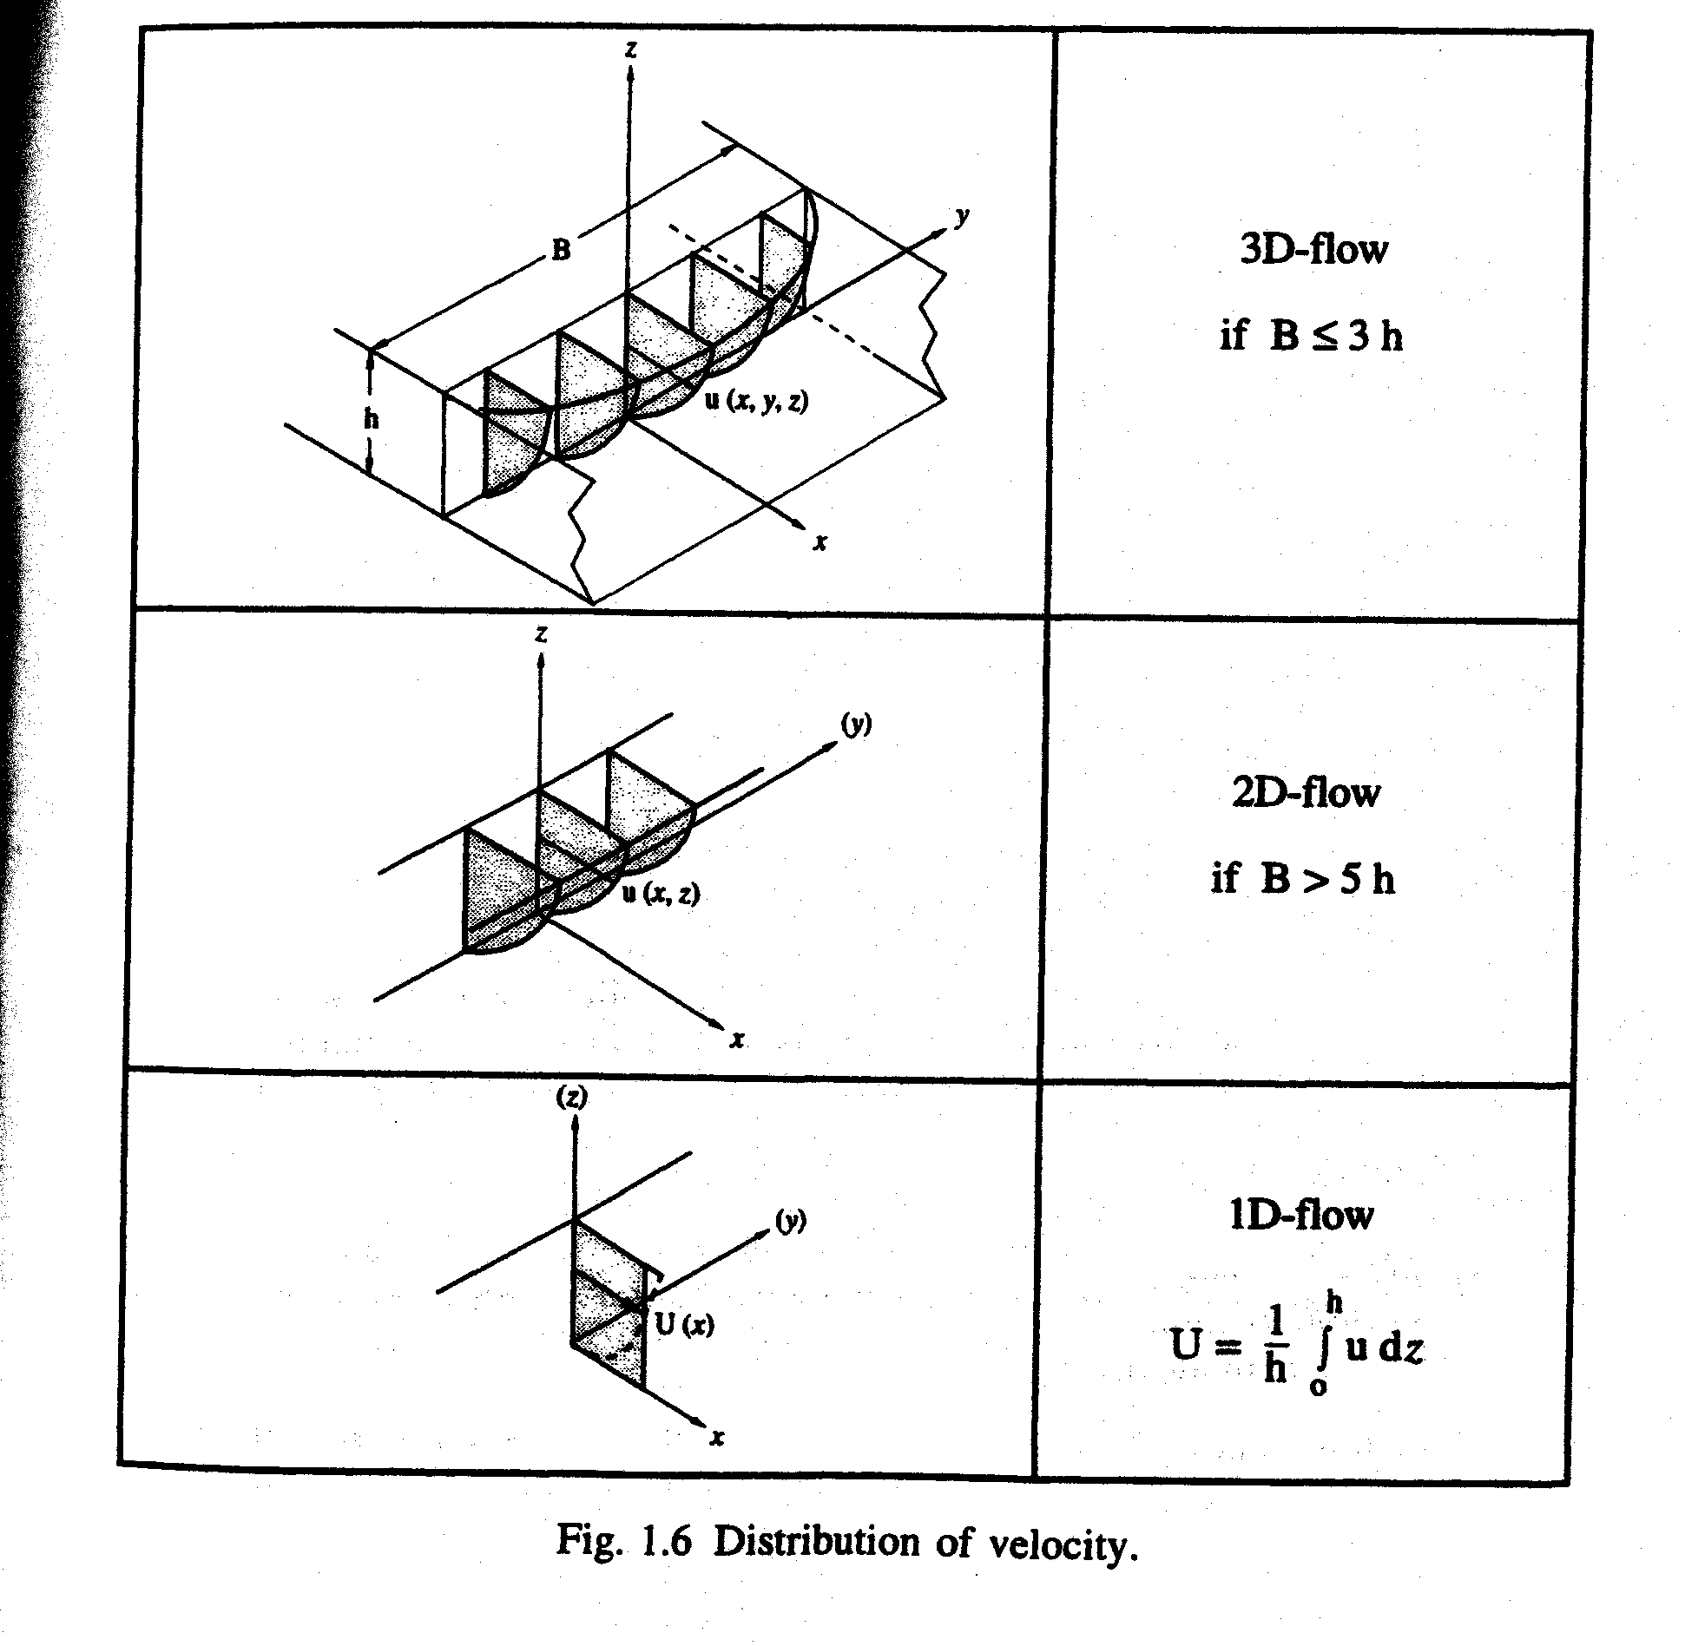

Slide 18
Consider steady flow…
Point velocities – u(x,y,z)
  Three-dimensional flow – see Figure 1.6
  If B > 5h, flow can be assumed two-dimensional, u(x,z), except for close to walls and bed – see Figure 1.6
  One-dimensional flow, U(x) – simplified case where average velocity, U(x) is integration of point velocities
    Simplest: U = u_{0.4}
    USGS:
      U = 0.5 (u_{0.2} + u_{0.8})

