Slide 1
Manufacturing process 5
الجامعة المستنصرية
كلية الهندسة – قسم الهندسة الميكانيكية
مادة موا هندسية
د. ناظم مجبل فالح

Slide 2
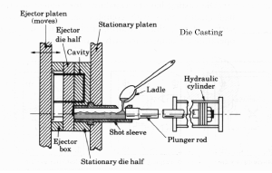
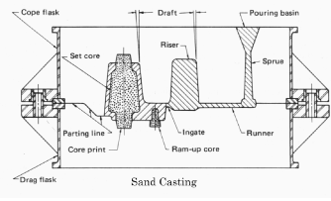
Casting Processes
Introduction of molten metal into a mold cavity; upon solidification, metal conforms to the shape of the cavity.
Die Casting
Sand Casting

Slide 3
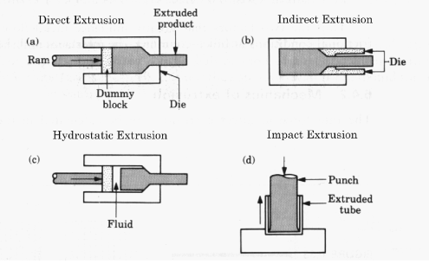
Forming and Shaping Processes
Bulk deformation processes that induce shape changes by plastic deformation under forces applied by tools and dies.
Forging
Extrusion

Slide 4
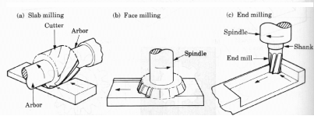
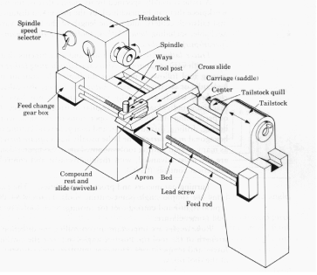
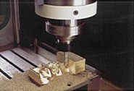
Machining Processes
Material removal from a work piece: cutting, grinding, nontraditional machining processes.
Milling
Lathe Machine

