Slide 1
Manufacturing process 4
الجامعة المستنصرية
كلية الهندسة – قسم الهندسة الميكانيكية
مادة موا هندسية
د. ناظم مجبل فالح

Slide 2
Manufacturing a Product: General Considerations
Material Selection
Processing Methods
Final Shape and Appearance
Dimensional and Surface Finish
Economics of Tooling
Design Requirements
Safety and Environmental Concerns

Slide 3
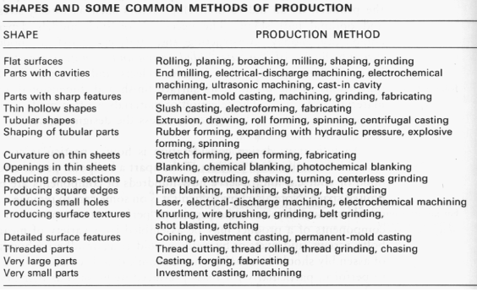
Choosing Methods of Production
Use a Selection Chart

Slide 4
Manufacturing Processes for Metals
Casting: expendable mold and permanent mold.
Forming and Shaping: rolling, forging, extrusion, drawing, sheet forming, powder metallurgy, molding
Machining: turning, boring, drilling, milling, planing, shaping, broaching, grinding, ultrasonic machining, chemical machining, electrical discharge machining (EDM), electrochemical machining, high-energy beam machining
Joining: welding, brazing, soldering, diffusion bonding, adhesive bonding, mechanical joining
Finishing: honing, lapping, polishing, burnishing, deburring, surface treating, coating, plating

